Slide 1


A Practical Introduction to the Blockchain and DLT World
NeCS Winter School, Fai della Paganella, Thursday, January 23, 2020
Burkhard Stiller, Christian Killer, Bruno Rodrigues, Eder Scheid
Communication Systems Group CSG
Department of Informatics IfI
University of Zürich UZH
[stiller¦killer¦rodrigues¦scheid]@ifi.uzh.ch
With many thanks addressed to T. Bocek, M. Franco, S. Rafati, and Dr. E. Schiller

Slide 2
Outline
1. Background
2. Principles of Blockchains
3. Blockchain Operations
4. Consensus Mechanisms
5. Blockchain Eras
6. Electronic Payment Systems
7. Bitcoins
8. Ethereum
9. Ethereum Wallet – Practical Part I
10. Smart Contract – Practical Part II
11. To Blockchain or not to Blockchain?
12. A Critical Review
Coffee Break
Slides accessible as a PDF for download:
https://files.ifi.uzh.ch/stiller/NeCS-WinterSchool-BC-print.pdf

Slide 3
1. Background
Notes:
Cloud computing
- History / Definition / characteristics
- IaaS, PaaS, …
Virtualization
- TBD (GM)
3

Slide 4
Distributed Systems to Remember
Distributed systems face very large numbers of
  Devices, users, applications, …
  which determine scalability challenges
Any “participant” – hardware, software, individual – is operated or operates autonomously and transparently
  There is no central control, no single, real-time, unique state
Failures happen in a heterogeneous environment and need to be handled (application- or system-specific) such that systems runs securely

Slide 5
Characteristics of Distributed Systems
1. Transparency
  Single view of the system
  Hide numerous details
2. Heterogeneity
  Networks
  Computers (HW)
  Operating systems (SW)
  Programming languages
  Developers
3. Failure Handling
  Detecting
  Masking
  Tolerating
  Redundancy
  Recovery
4. Openness
  Extensibility
  Publication of interfaces
5. Scalability
  Controlling the cost of resources
  Controlling the performance
  Preventing resources from running out
  Avoiding performance bottlenecks
6. Security
  Secrecy, privacy, integrity
  Confidentiality
  Authentication, authorization
  Non-repudiation

Slide 6
Overlay Networks to Remember
ON operates on top of underlay
  Typically the underlay is the Internet (IP-based)
  ON is determined by informal “rules and regulations”
P2P system instantiates a dedicated overlay
  Using its own addressing scheme
  Applying its own high-level communication protocol for peers
  “Limited” to participating peers following the overlay rules
Overlay application
  Runs within a given P2P system exploiting its functionality

Slide 7
Hash Functions and Hashes
Message Digest Code, MDC
    Message M (arbitrarily long) → Hash H(M)
    (hash with a minimum of 128 bit length)
  Note: “One-way” feature of hash function:
    Efficient generation
    Very low collision possibility: M, M‘ with H(M)=H(M‘)
    Examples: (MD5), RIPEMD-160, SHA-256
Message Authentication Code, MAC
    Message M, key K → Hash H(M, K)
    May be constructed out of MDC
    HMAC (RFC 2104), e.g., HMAC-SH-256
    Cryptographic strength of underlying hash function de-pending on size of its hash output, size, and quality of key
M
MDC
H(M)
M
K
MAC
H(M,K)
HMAC: Hash-based MAC, RIPEMD: RACE Integrity Primitives Evaluation Message Digest, SHA: Secure Hash Algorithm

Slide 8
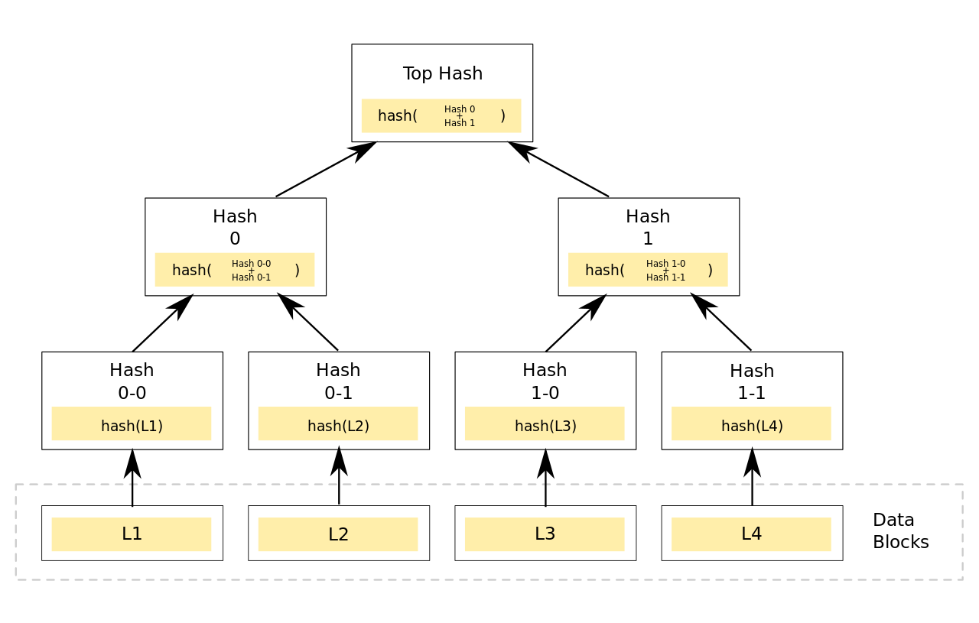
Merkle Trees
Merkle (or hash) tree
  Every leaf node is labeled with the hash of a data block and
  Every non-leaf node is labeled with the cryptographic hash of the labels of its child nodes.
  Top of a tree there is a root hash
Characteristics
  Efficient and secure verification
  content of large data
  For binary hash trees:
  computing hashes is proportional to the
  logarithm of the number of leaf nodes of the tree
  Usually cryptographic hash functions used (e.g., SHA-256)
https://en.wikipedia.org/wiki/Merkle_tree#/media/File:Hash_Tree.svg

Slide 9
Nonce
Nonce
  Arbitrary number that can be used just once in a cryptographic communication
    Often a random or pseudo-random number issued in an authentication protocol to ensure that old communications cannot be reused in replay attacks
  A nonce may also include a timestamp to ensure exact timeliness
    Prerequisite: clock synchronization between organizations
  Example:
    Salt: random data that is used as an additional input to a one-way function hashing data (password or passphrase)

Slide 10
Data Type “Linked List”
Linear collection of data elements (records)
  Linear order of records is given
  by pointers to the next record
  Data structure as a group of nodes
  represents an implicit sequence
  Example: backward linked list
  Data structure as a group of nodes
  represents an explicit sequence
  due to record identifiers added
Pointer
Pointer
Pointer
Content
Content
Content
Record 4713
Record 4712
Pointer
Record 4711
Pointer
Pointer
Content
Content
Content

Slide 11

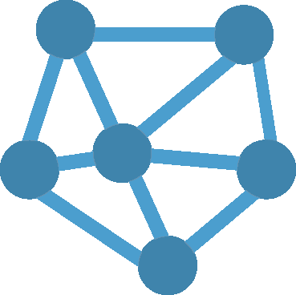
Databases
Databases (DB)
  Access control for users and the “SysAdmin” (trusted root)
    Centralized, physical, and trusted servers are maintained
  Potentially central point of failure, loss, or misuse
  Exchange of records between clients/database via commands
    SQL statement s include: INSERT, SELECT, UPDATE, DELETE, …
  Databases typically maintain the ACID principle on transactions
    Atomicity, Consistency, Isolation, Durability (ACID)
    However, records updated are updated and records deleted are deleted → No storage of any history (standard case)
Distributed DBs
  Every copy runs on a trusted node

Slide 12
2. Principles of Blockchains
Notes:
Cloud computing
- History / Definition / characteristics
- IaaS, PaaS, …
Virtualization
- TBD (GM)
12

Slide 13
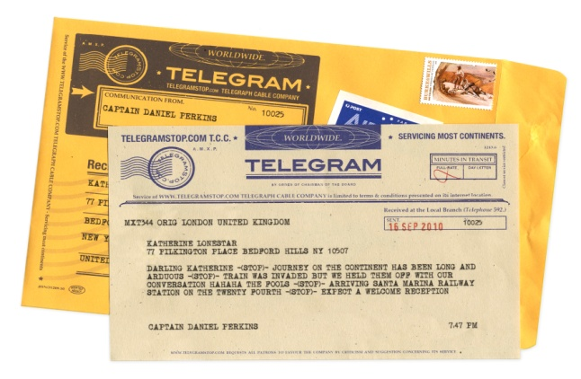








The Digitization of Society
Physical
Objects
Money?
Telegram
Encyclopedia
Money
Ended Dec 29, 2017
in Belgium
Digitized
Representations
Since mid 70’s, RFC 524
Since 2001
Since 2009
Bitcoins
Systems operated as decentralized and distributed systems!

Slide 14

Key Idea: “Replacing” (Central) Databases
Distributed Ledgers replace clients’ access-protected writes to an authoritative database via validation rules
by a distributed consensus of decentralized validators
  where the database’s state depends on majority agreement of update validity (consensus)
Data-
base
Data-
base
Distributed
Ledger (DL)
Validation Rules
Validator
Validator
Validator
Client
Client
Client
Client
Client
Client
Client
Client
Based on Terence Spies:
Blockchain Mechanics

Slide 15


DL/BC Types and Terminology – Simplified
Private permissioned
    Read/write/consensus restricted to authorized nodes (pre-defined stakeholders)
  “Enterprise-grade” DL
Private permissionless
    Write/consensus restricted to authorized nodes (pre-defined stakeholders)
    Read partially open
  “Consortium-grade” DL
Public permissioned
    Write/consensus restricted to authorized nodes (pre-defined stakeholders)
    Read open to everyone
  “Controlled collaborative” DL
Public permissionless
    Read/write/consensus open
    to everyone
    No restrictions and full transparency
  “Public” BC, the BC
For writers
DL
BC
No real blockchains:
“restricted” stakeholders
capabilities!
For X to Y!
The real and only
blockchain (BC)!

Slide 16



Definition
“Private” BC
“Public” BC
[Distributed Ledgers (DL) or] Blockchains (BC)
  Digital records of who-owns-what w/o a central storage
  Consensus Mechanism (CM) ensures that each node‘s copy
  of the ledger is identical to every other node’s copy
  Write access to BCs by miners or validators (with data
  from any asset owner) for transactions via CM and cryptographic signatures, read access at no “costs”
Key advantages of (public) BCs
  Immutable, traceable, and preventing “double spending”
+

Slide 17
“Who-owns-what” Records
A digital asset is determined by an electronic representation, such as a source file, which inherently bears the right of use of this source.
A token (digital token) can be a digital asset, issued by a stakeholder, which gives the holder the right to participate within the network of stakeholders
  It may allow for “payments” inside that network
A coin (digital coin) is a digital representation of value, specifically designed to represent digital “money” within a network of stakeholders, typically the BC, and beyond
  Counterfeiting and double-spending prevented by cryptography
⇨ One can buy a token with a coin, but generally not a coin with a token.

Slide 18
Token Types
Utility tokens provide access digitally to an application or service by means of a blockchain
Asset tokens represent assets such as (a) a debt or (b) an equity claim on the issuer
  E.g., they promise a share in future company earnings or future capital flows – analog to equities, bonds, or derivatives
Payment tokens are used (a) as a means of payment for acquiring goods or services or (b) as a means of money or value transfer
  Synonymous to “cryptocurrencies” (thus, a dedicated “coin”)
    Note: Cryptocurrencies give rise to no claims on their issuer
Finma Guidelines for ICOs, February 2018

Slide 19
3. Blockchain Operations
Notes:
Cloud computing
- History / Definition / characteristics
- IaaS, PaaS, …
Virtualization
- TBD (GM)
19

Slide 20



Blockchain Ingredients
Public key cryptography and hashes
  Asymmetric approach for arbitrary users
    Ensures validation and authentication (in turn authorization)
Internet
  Networked infrastructure for everyone
  Distributed system with arbitrary users and devices (nodes)
    Peer-to-peer (overlay network) communication paradigms: protocol
    Storage capabilities for “any”-sized data volumes
Incentives
  Supporting rewards for participants’ tasks performed within an overlay network by a “protocol” enabling communications
    Ensures participation of anyone (potentially non-trusted stakeholders)

Slide 21
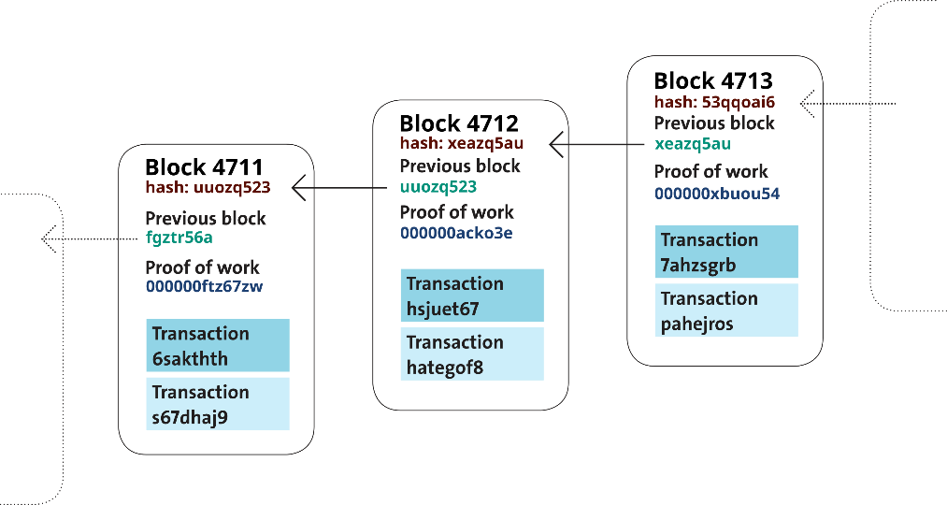



Blockchain Operations
Transactions (content) collected in blocks
  New blocks created regularly
A block contains a hash of and a
pointer to the previous block …
Consensus mechanism required to determine
the block to be integrated into this blockchain
  Public blocks contain, e.g., solved crypto puzzles (PoW)
    E.g., a form of partial hash collisions (SHA-256)
Creation of valid blocks performed by anyone (incentive)
  Solving crypto puzzles ≡ confirmation of blocks ≡ Mining
  Computational expensive → Avoids double spending
→ Blockchain
reward
Notes:
21

Slide 22
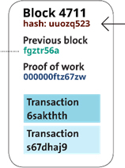
Blockchain Data Structure in Detail (1)
BCs are a backward-ordered, linear list of blocks
  Chain starts with genesis block to which others are back-linked
Blocks contain (at least)
  Transaction (tx) data (content, payload)
  Pointer to and a hash of the previous block
  Cryptographically hashed value of crypto puzzle (result of PoW)
  Time stamp
BC’s structural and technical characteristics
  Chain may show side chains, but only one valid branch finally
    Chronological order guaranteed by previous block’s hashes
  A BC network is organized as a peer-to-peer network
    Overlay topology may change, replicas of BC are hold on multiple nodes, exchanges of new blocks performed within that overlay, anyone to join

Slide 23

Blockchain Data Structure in Detail (2)
Transactions (tx/Tx)
  Data structure encoding the transfer of “value”
    From a source (“input”) to a destination (“output”)
  Structures are typically not related to accounts or identities
    Chunk of “value” locked with a specific secret known by the owner
  Example tx content
    Version of tx
    Input counter – The number of separate input values
    Inputs – The values
    Output counter – The number of separate input values
    Outputs – The values
    Locktime – Earliest time at which tx will be valid (to be relayed on the BC network or added to the BC), typically a Unix timestamp
UTXO or account

Slide 24

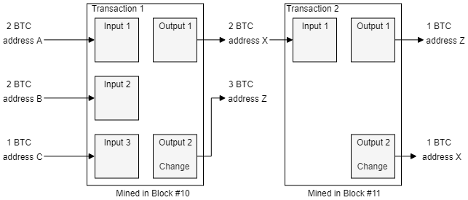
Unspent Transaction Output (UTXO)
Concept based on physical money, e.g., bills
  Balance is calculated by total of unspent outputs
  Each transaction has inputs (unspent outputs) and outputs
    Possible to combine one or more outputs as inputs to form a transaction
Balances:
A: 0 BTC
B: 0 BTC
C: 0 BTC
X: 1 BTC
Z: 4 BTC
Balances:
A: 2 BTC
B: 2 BTC
C: 1 BTC
Balances:
A: 0 BTC
B: 0 BTC
C: 0 BTC
X: 2 BTC
Z: 3 BTC
Unspent Outputs
Spent Outputs
Notes:
Use bitcoins / bitcoin

Slide 25
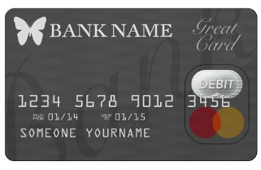
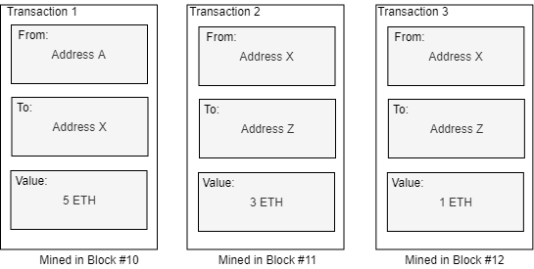
Account-based Model
Account maintained by a global state
Similar concept to a debit card
  Each transaction modifies the state of accounts
    Balance should be larger or equal than spending amount
Balances:
Account A: 0 ETH
Account X: 2 ETH
Account Z: 3 ETH
Balances:
Account A: 0 ETH
Account X: 1 ETH
Account Z: 4 ETH
Balances:
Account A: 0 ETH
Account X: 5 ETH
Account A’s initial balance: 5 ETH
Notes:
Use bitcoins / bitcoin

Slide 26

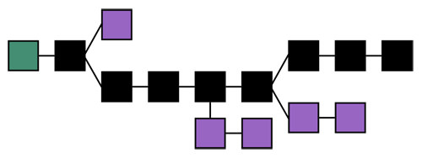

Blockchain Terminology (1)
Distributed Ledger or Blockchain
Blockchain Network
Block
Miner
Chain: Backward-linked list of cryptography-based (hash-secured) pointers to previous blocks

Slide 27
Blockchain Operations in Detail
For illustrative reasons, the Bitcoin BC (BTC) is used here.
Overall operations consists out of 4 steps (in principle)
  User A wants to pay user B the amount of 1 BTC (bitcoin)
    This intent is broadcast as a transaction via the P2P protocol into
    the BC network
  Any miner interested, adds this transaction to his/her respective current block
  Any of these minors wins a lottery and “mines” the block
    That miner solved the crypto puzzle at first
    Such a block may contain multiple transactions and is mined in well-defined periods of time
  The “definitive block “– including the transactions and the new hash – is broadcast to the BC network again as well and added to everyone’s BC copy

Slide 28
Hash Computation and Checks (1)
Once a set of transactions becomes available, a block is created by utilizing the following data
    Transaction(s)
    Hash of previous block
    Nonce (arbitrary number, used only once)
    Other information (depending on the BC)
The hash of new block is calculated meeting the “target”
    Target hash is a number (absolute value) that a hashed block header must be less than or equal to in order for a new block to be awarded
      Value used to determine the “difficulty of the input”
      Value adjusted to ensure that blocks are processed “in time”
Once the hash was computed, the hash is broadcast to the BC network and checks are performed

Slide 29
Hash Computation and Checks (2)
  Accepted blocks require the miners to solve a crypto puzzle (PoW): hash
    Difficult to produce (time-consuming, energy), but easy to verify
    Validity is ensured by checking if a block’s hash value is less than “current target”
      Hash is above the target value → Another miner may have found a suitable hash (not known yet to others), block attached to local BC only, but miner lost the distributed lottery, nonce will be incremented and a retry starts
      Hash is below the target value → This miner won the distributed lottery and the new block’s hash determines the crypto puzzles’ result (PoW result ≡ hash)
  Since each block contains the preceding block’s hash, a sequence of those determines a larger amount of work
    Changing any block would require the regeneration of all successors and redoing the work on the data they contain
    Thus, at least 6 successors are required to consider a block being valid
  The PoW (hash, result of the crypto puzzle) is validated by other members of the BC network by confirming the new hash before adding the block to their local copy, at 51% of the network hashing power’ ok, the block is “definitive”

Slide 30
Blockchain Terminology (2)
Mining (Process)
  The process of BC members trying to solve the crypto puzzle and adding the respective new block onto the BC
Miners
  Those BC members, who run machines to solve crypto puzzles
  Their reward in case of a successful inclusion are tokens of BC
    In case of the bitcoin BC the reward are BTC (incentives to participate)
Checks
  Verification of hashes broadcast to the BC network

Slide 31

Target Value and Adaptation Algorithm
Mining is rewarded → Likely more miners join
    Higher processing capacity increases likelihood on finding hash earlier
Block creation rate increases, average mining time decreases
    To maintain the ideal goal of 10 min mining per block: change difficulty, which effects the “target value”
BC network decreases target value to increase difficulty
    Decreasing target values increases difficulty to find the hash
Block creation rate decreases and average mining time increases again
    System stabilizes itself again, and continue as of above
Reverse of cycle applies, if block creation rate decreases

Slide 32
Consensus: Hash-based Proof-of-Work (PoW)
Based on Terence Spies:
Blockchain Mechanics
Key: One cannot compute an input from an output
  To find a hash with N zeros at input start, requires 2*N computations, which proves computational work performed
  Hashing an incrementing “nonce” as hash input, leads to zeros
The distributed game sets the difficulty N of the game
  Players get a list of blocks and their content (see slide before)
Players accumulate “points” by creating blocks
  Hashing the previous block, finding a hash of the new block with enough zeros, and transmitting this block to everyone
in 3e-05 seconds, nonce = 0 yielded 0 zeros. value = 4c8f1205f49e70248939df9c7b704ace62c2245aba9e81641edf…
in 0.000138 seconds, nonce = 12 yielded 1 zeros. value = 05017256be77ad2985b36e75e486af325a620a9f29c54…
in 0.000482 seconds, nonce = 112 yielded 2 zeros. value = 00ae7e0956382f55567d0ed9311cfd41dd2cf5f0a7137…
in 0.014505 seconds, nonce = 3728 yielded 3 zeros. value = 000b5a6cfc0f076cd81ed3a60682063887cf055e47b…
in 0.595024 seconds, nonce = 181747 yielded 4 zeros. value = 0000af058b74703b55e27437b89b1ebcc46f45ce55d6….
in 3.491151 seconds, nonce = 1037701 yielded 5 zeros. value = 00000e55bd0d2027f3024c378e0cc511548c94fbeed0e….
in 32.006105 seconds, nonce = 9913520 yielded 6 zeros. value = 00000077a77854ee39dc0dc996dea72dad8852afbde6….
in 590.89462 seconds, nonce = 186867248 yielded 7 zeros. value = 0000000225060b16117b23dbea9ce6be86ac439d….
in 4686.171007 seconds, nonce = 1424462909 yielded 8 zeros. value = 000000002dd743724609a9f57260e2492908d….

Slide 33
Blockchain Terminology (3)
Difficulty
  Measure of how difficult it is to find a new block compared to the easiest it can ever be
  Recalculated every 2016 blocks in the BTC BC such that the last 2016 blocks would have been calculated within two weeks
    On average, one block is mined every 10 min
Consensus
  State reached where the majority of members of the same P2P network agrees on the same mining output (51% agree)
  This state of the consensus is secure and tamper-resistant, immutable with respect to the blocks
  Respective block data is persisted to the BC network’s nodes

Slide 34
Communications – The Flood Protocol
New transactions and mined blocks are broadcast to
the BC network
  Minimum of 8 neighbors maintained in Bitcoin P2P network
Temporary BC splits possible
  2 miners arrive at 2 different, but valid hashes at the same time
  P2P network resolves that split in short time to 1 valid branch
  Clients only accept “longest chain of blocks” as valid (pruning)
    Length is determined by the most combined difficulty, not #blocks
As soon as block gets “solved” as valid, every miner in the BC network must stop the current mining process on that block and can start with the next one

Slide 35
Transaction (tx/Tx) Fees
Mining and consensus finding require resources
  Specifics depend on the dedicated approach used
Generally, tx fees are part of the tx
  Compensation for miner to mine
    Tx fees are collected by that miner
    Tx fees are set by the BTC’s market forces
  Tx fees incentivize a miner to include a tx into a block
    High fees: early selection; low fees: delayed selection
      No requirement for tx fees, but mining may be delayed “forever”
  Tx fees are countermeasures against “spam” as providing no tx fees inside a tx may not lead to its selection
  Tx fees are typically calculated by the size of the tx (in Byte)
    A calculation of the tx fees based on the tx values is not applied

Slide 36
Blockchain Transaction Types
On-chain tx
  Available on the blockchain visible to all nodes on the BC
  Tx valid when a communicated that tx across the network
    Tx times may vary depending on the network load or tx queued
Off-chain tx
  Value resides outside of the blockchain
  Tx executed instantly
On-chain tx with off-chain storage of data
  The same is valid as for on-chain tx
  Additionally, the tx does not contain the full data, but only a hash of the data, which is stored off-chain
    Reduces storage size of BC for many tx or large volume

Slide 37
Blockchain Addresses (1)
Transactions on a blockchain require the knowledge of the blockchain address of the sender and recipient
  Address as 27-34 digit code consists of letters and numbers
    Generated by the wallet, where public-private key pairs are stored, from public key via cryptographic hash function (“finger print”)
    Usually currency-specific, addresses belong to a certain blockchain
  Example Bitcoin
    A = RIPEMED160(SHA256(K))
    with A Bitcoin address and K public key
    Results in a 160 bit (20 Byte) number
  Note: A public key IS NOT the same as a Bitcoin address,
  but this is derived from a key with a one-way hash function!

Slide 38
Blockchain Addresses (2)
Address representations
  Base58 encoding (subset of Base64)
    Text-based binary-encoding format, using upper- and lowercase letters, but omitting “0” and “O”, “l” and “I”, and “\”, “/”, and “+”
    Balancing compact representation, readability, and error detection
  Base58Check encoding
    Adds 4 Byte checksum (error-checking over encoded data) to the add
      Used for BTC, prevents transcription and typing errors
    Example:
      Add a prefix to data (version byte), 0x00_{h} in the Bitcoin address case 0x80_{h} in case of a private key to be encoded
      Compute double SHA checksum (CS):
      CS = SHA256(SHA256(prefix+data)), with “+” concatenation,
      and use of 4 first bytes of this 32 Byte hash

Slide 39
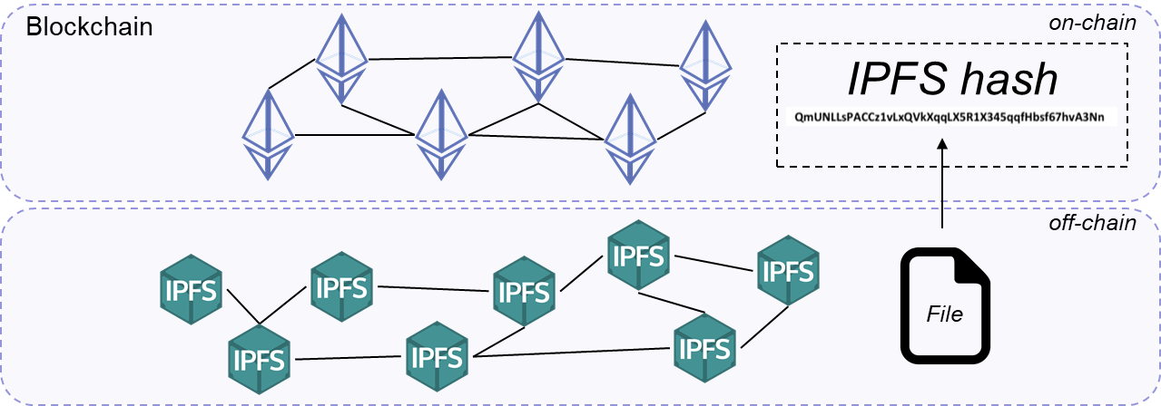
Off-chain Signaling of Addresses
Problem: BCs typically show limited storage capacity
Solution
  Digital representation of a file (“hash reference” != “PoW result”) is stored on-chain and the file itself is stored off-chain
Practice
  Peer-to-peer network stores and shares hypermedia (e.g., graphics, audio, video, plain text) in a distributed file system
IPFS: Inter-Planetary File System
https://ipfs.io/

Slide 40
Wallets
Container for private keys
  Structured files, databases
  Wallets contain keys (as keychains of private/public keypairs) not coins (which are stored on the BC as tx outputs), thus, keys prove the ownership of a coin!
Wallet types
  Non-deterministic (random): just a collection (hard to maintain)
  Deterministic (seeded): keys derived from a common seed (random number+index) via hash-functions
    Hierarchical deterministic (HD) – BIP0032/BIP0044 standard – with keys in a tree structure: parent ⇨ children ⇨ grandchildren
    Structure organizes inputs, branches with categories (e.g., departments)
  Paper: character strings, 2D codes, BIP0038 encrypted print

Slide 41
Smart Contracts (1)
A Smart Contract (SC) resides inside transactions
  Executed and validated on every node
  In Bitcoin (a blockchain-based cryptocurrency), SCs specify how to withdraw, escrow, refund, or transfer BTC from A to B
Smart contracts first mentioned in 1994/96
Smart contracts alone are not “smart”
  They need an infrastructure
  A blockchain is the ideal infrastructure
A smart contract is a computerized transaction protocol that executes the terms of a contract. The general objectives of [a] smart contract[’s] design are to satisfy common contractual conditions (such as payment terms, liens, confidentiality, and even enforcement), minimize exceptions both malicious and accidental, and minimize the need for trusted intermediaries. Related economic goals include lowering fraud loss, arbitrations and enforcement costs, and other transaction costs. [N. Szabo] .
http://www.fon.hum.uva.nl/rob/Courses/InformationInSpeech/CDROM/Literature/LOTwinterschool2006/szabo.best.vwh.net/smart.contracts.html
http://www.fon.hum.uva.nl/rob/Courses/InformationInSpeech/CDROM/Literature/LOTwinterschool2006/szabo.best.vwh.net/smart_contracts_2.html

Slide 42
Smart Contracts (2)
SCs can be exchanged (not only transactions)
  This is the code or program to be executed
    “Programs and APIs” on the BC
  Thus, SC are programs that encode conditions and outcomes
E.g., SCs can define secure escrow services
  Ready to use program working on pre-determined conditions between any two users (e.g., a provider and a customer)
  “Real-time” operations
  Near zero marginal cost
Note: Smart Contracts are neither “smart” nor “legal”!

Slide 43
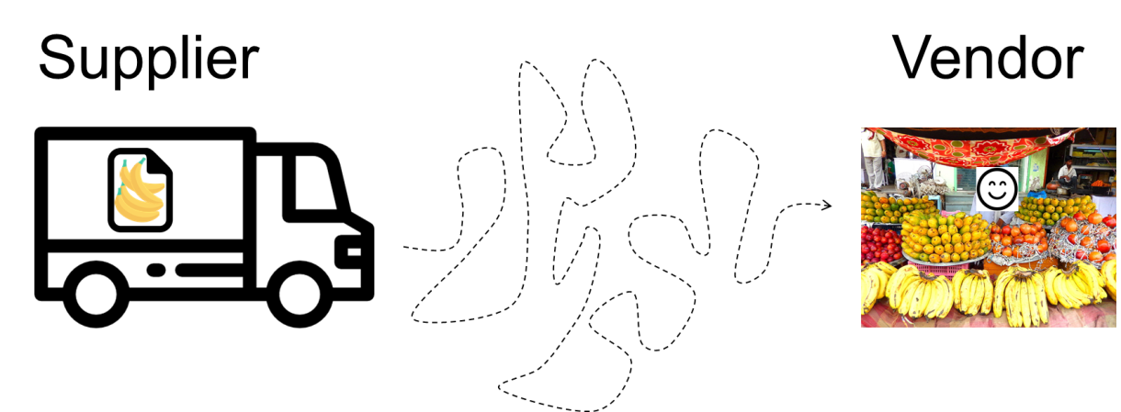






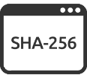


Blockchain‘s Immutability Exploited
Time stamping proves existence, integrity, and creation/exchange of digital assets
  Keeping track of the creation and modification time
  Can be based on off-chain solutions
Example
  Vendor want to buy Bananas from the Supplier.
  Supplier need to ensure the quality of Bananas
3
1
2
4
Private between Supplier/Consumer
X Bananas
Dated
DD.MM.YYY
Ensured by
Supplier
Generated
Document
Hash is publicly available and verifiable
1jSjp7hS4jsUn...
Banana
Doc
or
1jSjp7hS4jsUn...
Shipment of
Bananas
Timestamp
Digital
Signature
Signed and timestamped document
of the banana shipment
The hash is stored on chain and can be
publicly verified by those with access to the
Banana Doc
A digital representation is created
and the document is stored off-chain
Supplier can use a blockchain-based time stamping solution to ensure the quality of his products

Slide 44
4. Consensus Mechanisms
Notes:
Cloud computing
- History / Definition / characteristics
- IaaS, PaaS, …
Virtualization
- TBD (GM)
44

Slide 45
Mechanisms for Distributed Agreement
Also called “Distributed Consensus” algorithms
The 4 key characteristics
  Uniform agreement: No two nodes decide differently
  Integrity: No node decides twice
  Validity: If a node decides on value v, then v was proposed by some node
  Termination: Every node that does not crash eventually decides on some value
Given a cluster of N nodes and a set of proposals P₁ to P_{m}, every non-failing node will eventually decide on a single proposal P_{x} without the possibility to revoke that decision. All non-failing nodes will decide on the same P_{x}.
https://pradeeploganathan.com/blockchain/consensus/

Slide 46
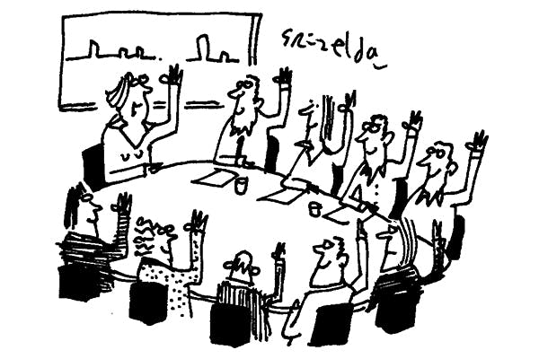
Mechanisms for Distributed Agreement
How to decide on a single consensus proposal P_{x}?
There are many aspects a consensus mechanism has to address:
  How many of the non-failing nodes are entitled to vote?
    How to decide who is entitled to vote?
  How to ensure a decision in a deterministic manner?
    How fast until a decision is reached?
N nodes
S nodes
That may propose P₁, P_{m} proposals
S and N nodes can make proposals
That may be decided by a subset S of N nodes, such that S is smaller than N and S is odd

Slide 47
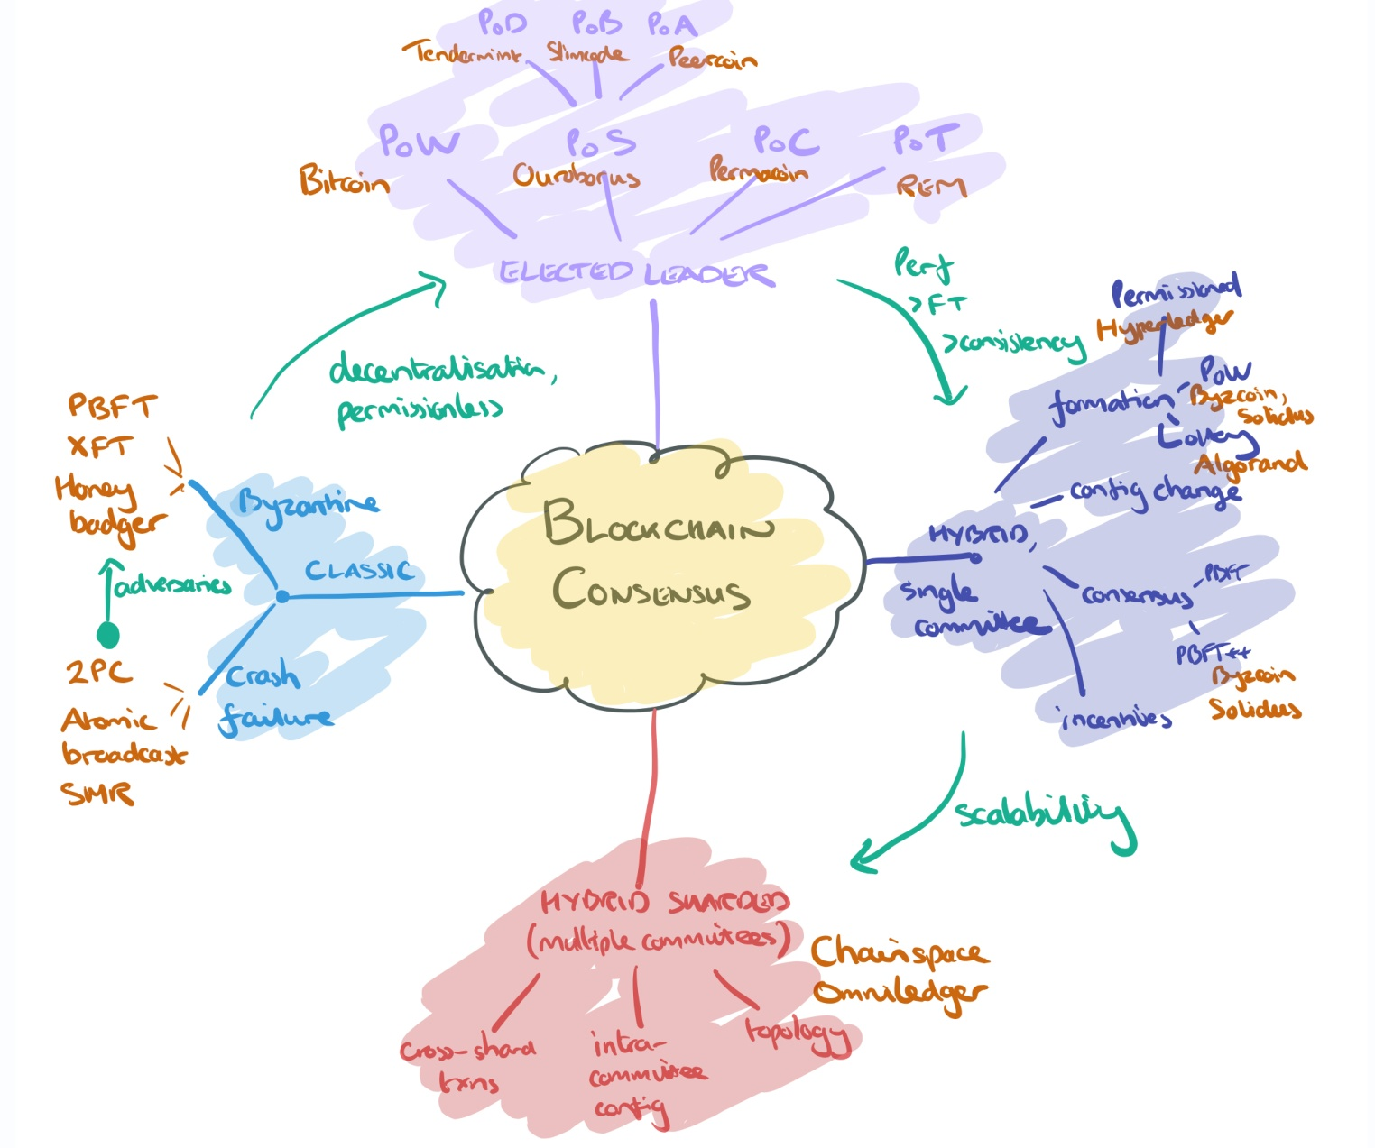
Evolution of Consensus Mechanisms
Byzantine fault
tolerance-based,
which is a more
traditional
approach
based on
rounds of
votes.
Proof-based or leader-
based consensus,
whereby a leader
is elected
and
proposes
a final
value
2
3
1
4
Figure

Slide 48
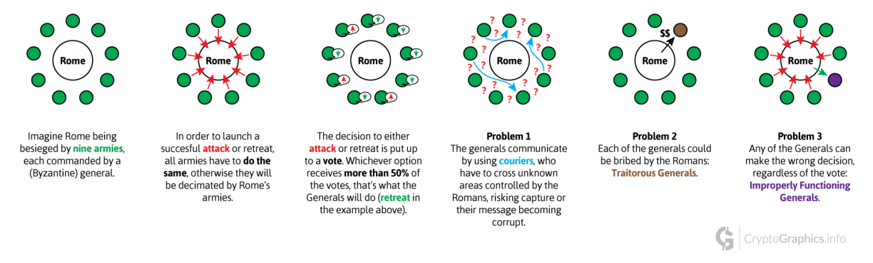
Consensus Mechanism Types (1)
Classical Consensus Models
  Crash failure models → honest nodes failing
  Byzantine Failure Tolerance (BFT)
    State machine replication
  BFT General’s Problem
HyperLedger (SOLO, Kafka mechanisms), Stellar

Slide 49
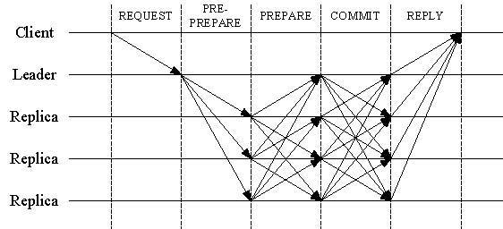
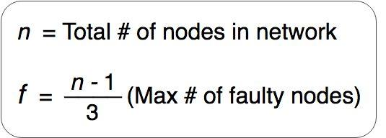
Byzantine Fault Tolerance (BFT)
Described as the capacity of a system to handle or survive unreliable situations and (all kinds of) failures
Practical BFT (PBFT): assume a small fraction of nodes as Byzantines (dishonest)
Other examples: XFT, HoneyBadger
3 phase protocol
    A client sends a request to invoke a service
    The primary leader multicasts the requests to the replicas
    Replicas execute the request and send a reply to the client
    The client wats for F+1 replies from different replicas with the same result
PBFT property

Slide 50
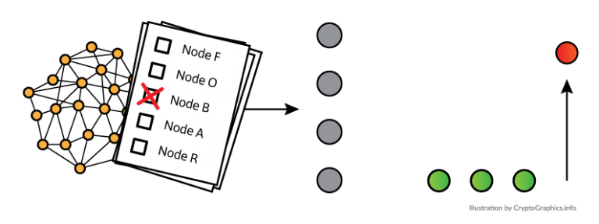
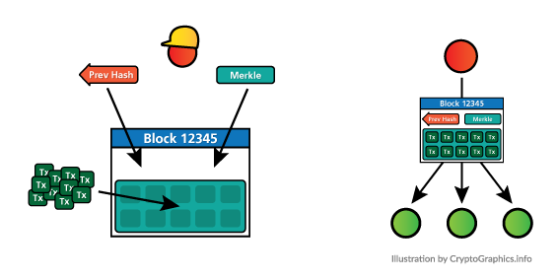
delegated BFT (dBFT)
Nodes in the network elect a group of consensus nodes (e.g., CoZ)
Leader/speaker randomly
chosen from consensus nodes,
remainders are delegates
Leader/speaker creates new block, needs to be positively checked by 2/3 of all delegates
If 2/3 agree, block is added to the
chain
Countermeasures for dishonest
leader/speakers or delegates

Slide 51
Consensus Mechanism Types (2)
Elected Leader Models
  Probabilistic elected leader in a
    Lottery-like
    Competition, or
    Probabilistic algorithm
Elected Leader
PoX: Proof-of-X, where X=
A: Age
B: Burn
C: Capacity (storage)
D: Deposit
S: Stake
T: Trust
W: Work
d: delegated
PoW
dPoS
PoS
PoC
PoT
Bitcoin
EOS
Bazo
Permacoin
REMChain
PoD
PoB
PoA
Tendermint
Slimcoin
Peercoin

Slide 52
Proof-of-Work (PoW)
Set of transactions becomes available, block is created, by utilizing the following data
  Transaction(s), hash of previous block
  Nonce (arbitrary number, can only be used once)
  Other information (depending on BC)
Hash of new block is calculated
Checking performed once hash was computed
  Hash is above the target value → Another miner may have found a suitable hash, block attached to local BC, but miner lost the lottery, otherwise nonce will be incremented, retry
  Hash is below the target value → This miner won the lottery and the new block’s hash determines the PoW result

Slide 53
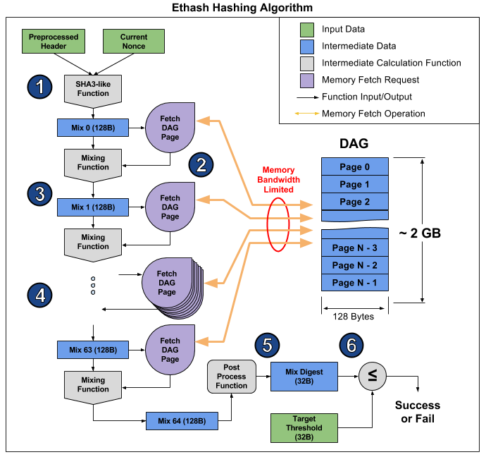

Ethereum PoW – Ethash
Based on partial hash collision (target hash)
  Works as a memory-bound cryptographic sponge
  Requires heavy fetching of data on the DAG (RAM intensive process)
The Pre-processed Header (derived from the latest block) and the Current Nonce (the current guess), are combined using a SHA3-like algorithm to create our initial 128 byte mix, called Mix 0 here.
DAG (Directed Acyclic Graph) - randomly generated dataset
Designed to be ASIC-resistant as it only require large amounts of memory, which favors smaller miners

Slide 54

Ethereum PoW – Ethash
Based on partial hash collision (target hash)
  Works as a memory-bound cryptographic sponge
  Requires heavy fetching of data on the DAG (RAM intensive process)
The Mix is combined with the retrieved DAG page. This is done using a ethereum-specific mixing function to generate the next mix, called Mix 1 here.
DAG (Directed Acyclic Graph) - randomly generated dataset
Designed to be ASIC-resistant as it only require large amounts of memory, which favors smaller miners

Slide 55

Ethereum PoW – Ethash
Based on partial hash collision (target hash)
  Works as a memory-bound cryptographic sponge
  Requires heavy fetching of data on the DAG (RAM intensive process)
The Mix is used to compute which 128 byte page from the DAG to retrieve, represented by the Get DAG Page block.
DAG (Directed Acyclic Graph) - randomly generated dataset
Designed to be ASIC-resistant as it only require large amounts of memory, which favors smaller miners

Slide 56

Ethereum PoW – Ethash
Based on partial hash collision (target hash)
  Works as a memory-bound cryptographic sponge
  Requires heavy fetching of data on the DAG (RAM intensive process)
Steps 2 & 3 are repeated 64 times, finally yielding Mix 64.
DAG (Directed Acyclic Graph) - randomly generated dataset
Designed to be ASIC-resistant as it only require large amounts of memory, which favors smaller miners

Slide 57

Ethereum PoW – Ethash
Based on partial hash collision (target hash)
  Works as a memory-bound cryptographic sponge
  Requires heavy fetching of data on the DAG (RAM intensive process)
Mix 64 is post processed, yielding a shorter, 32 byte Mix Digest.
DAG (Directed Acyclic Graph) - randomly generated dataset
Designed to be ASIC-resistant as it only require large amounts of memory, which favors smaller miners

Slide 58

Ethereum PoW – Ethash
Based on partial hash collision (target hash)
  Works as a memory-bound cryptographic sponge
  Requires heavy fetching of data on the DAG (RAM intensive process)
Mix Digest is compared against the predefined 32 byte Target Threshold. If Mix Digest is less than or equal to Target Threshold, then the Current Nonce is considered successful, and will be broadcast to the ethereum network. Otherwise, Current Nonce is considered invalid, and the algorithm is rerun with a different nonce
DAG (Directed Acyclic Graph) - randomly generated dataset
Designed to be ASIC-resistant as it only require large amounts of memory, which favors smaller miners

Slide 59
Proof-of-Stake – PoS (1)
Blocks are “mined” according to the amount of “tokens” he or she holds (stake)
  The higher is the number of tokens (coins) at stake, the higher is the “mining power” (linear relation)
  Nodes receive block reward as inherent incentive
F mines block
B
D
F
H mines block
H
A
blockchain
A
H
H
H
F
...
A mines block
G
# Tokens
C
E
A, H high
B, C, G medium
D, E, F low

Slide 60
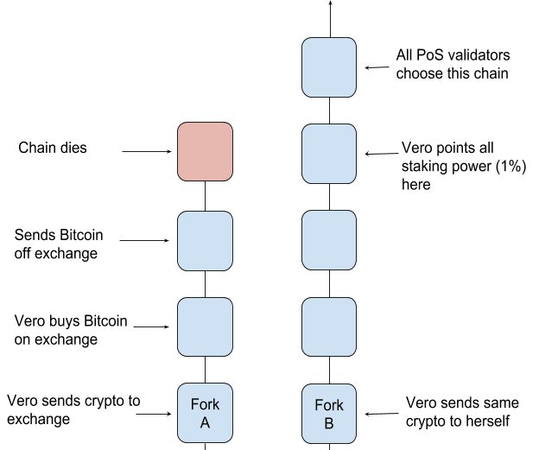
Proof-of-Stake – PoS (2)
Nothing-at-stake problem
  Creating forks is “costless”, when someone is not burning an external resource (e.g., mining power)
    PoS alone
    is “unworkable”
    and leads to
    misuse
PoS variant:
  DPoS: nodes can
  delegate their stakes
  to a list of nodes
Notes:
Source: “Understanding Proof-of-Stake: The Nothing at Stake Theory” https://medium.com/coinmonks/understanding-proof-of-stake-the-nothing-at-stake-theory-1f0d71bc027

Slide 61
Proof-of-Authority (PoA)
PoA is a modified form of PoS, where instead of stake a validator’s identity performs the role of stake
Authorities (nodes) are allowed to create news blocks
  Clique (practical implementation) of PoA
    Requires N/2+1 (more than 50%) of signers to be honest
    Authorities sign new blocks in a Round-robin (RR) fashion
D sign block
B
D
F
H
H sign block
A
blockchain
A
D
E
H
A
...
A sign block
G
C
E
RR Turn
E sign block
A, D, E, H are authorities

Slide 62


Alternatives
Proof-of-Burn (PoB)
  Mechanisms should proof that participants burned “coins”
    Sending them to a verifiably unspendable address
    This is expensive from each individual’s point of view
    But it consumes no resources other than burned asset
    Ultimate source of scarcity remains PoW-based cryptocurrency
Proof-of-Capacity (PoC)
  Also known as Proof-of-Space
    Miner has to proof a (free) storage capacity to be entitled to create blocks
    Miners has to stake their disk (hard-drive or SSD) capacity to create blocks
      Similar to PoS in this sense

Slide 63
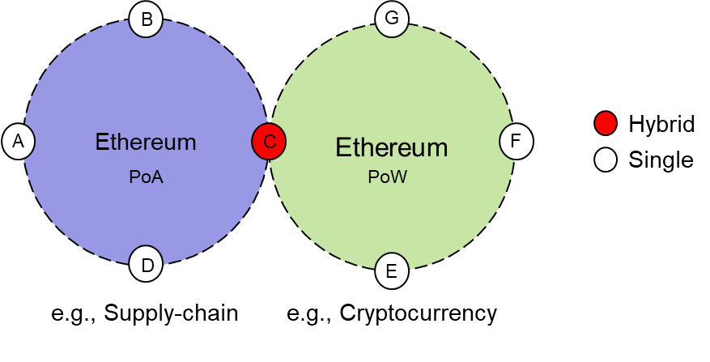
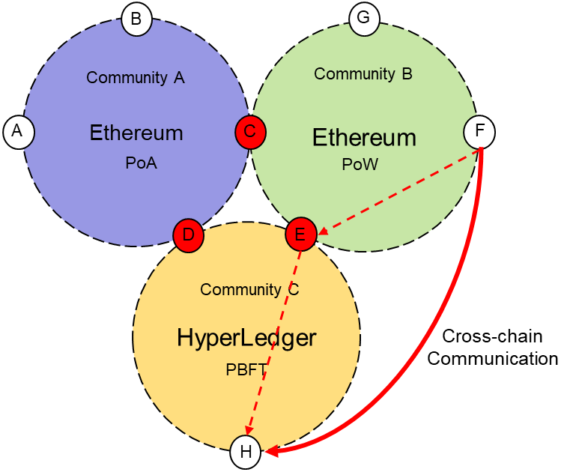
Hybrid Consensus
Hybrid consensus models
  Using a single consensus
  results in limitations
    Combination of different
    consensus mechanisms
Hybrid sharding
  System can be organized into
  shards (communities)
    Cross-chain communications
    Applied by CSG’s Bazo BC (cf. later)

Slide 64
Comparison of Consensus Mechanisms
Incomplete
view!
Mechanism | Security Level | Depending on | Scalability | Remarks
BFT | “Reasonable”: Leader pre-elected 51% failure | - | Medium | Trust in pre-election
dBFT | “Reasonable”: set of leaders pre-elected | - | Medium | Trust in set of leaders
PoW | High: 51% attack | Hashes | Controversial | Energy consumption high, needed to ensure high security level (by design)
PoS | Unknown: “Nothing-at-Stake” | PoW-based “stake” | Under discussion | “Costless” forking, thus, measurable assets needed
PoA | Identity-based | PoS, PoW | Under discussion | Authorities required
Shards | Unknown | Any Po“X” | Unknown | Communities, interoperability

Slide 65
5. Blockchain Eras
Notes:
Cloud computing
- History / Definition / characteristics
- IaaS, PaaS, …
Virtualization
- TBD (GM)
65

Slide 66











Blockchain 1.0
Digital Currency or Cryptocurrencies
  Decentralized payment system
  Bitcoin as the father of digital currencies
    Still, not much awareness of (other) blockchain capabilities
  Proof-of-Work (PoW)
Genesis
Block
2008
Jan. 2009
Oct. 2009
May 2010
Nov. 2010
Feb 2011
2011-2012
Jun 2012
Sep 2012
Mar 2013
BTC Genesis Block
Two slices of Pizza for
10’000 BTC
1 BTC = 1 USD
Ripple is launched focusing Banking systems integration
BTC Market Cap
reaches 1B USD
Bitcoin (BTC)
Whitepaper
‘‘BTC Network’’ goes live.
FX exchange for BTCs
BTC Market Cap
reaches 1M USD
Digital wallets gain
popularity
Bitcoin Foundation
«Experimental» stage
Initial stage
Discovery of cryptocurrencies
Bitcoin forks (Litecoin, Dodgecoin, etc)
Central stage
Non-existent
Public Perception

Slide 67












Blockchain 2.0
Smart Contracts
  Ethereum unlocks the blockchain potential beyond cryptocurrencies
  Blockchain is able to run computer programs in a transparent and verifiable manner
Dec 2013
Jan 2014
Feb 2014
Jul 2014
2015
2015
Mar 2016
Jun 2016
Sep 2016
Ethereum is
announced
by Vitalik B.
Growth of Blockchain crypto start-ups
Attacks on exchanges makes MT.GOX to collapse
Ethereum project is launched. Investors start to recognize Ethereum’s potential
Investors joins Digital Asset Holdings, which represents Wall Street’s embrace of Blockchain. NASDAQ also commits to Blockchain
Ethereum goes live (Frontier) in July.
Hyperledger is released in December.
Ethereum goes in production (Homestead).
DAO (Decentralized Autonomous Organizatio) is hacked, losses estimated in 50M USD.
Workshop Blockchain on Healthcare
Blockchain Interoperability
V. Buterin
«Blockchain can be used beyond cryptocurrencies»
«Blockchain is definitely positive!»
«Avoiding the pointless BC project»
Continuous increase on the number of cryptocurrencies
Public Perception
Awareness for vulnerabilities in Smart Contracts

Slide 68




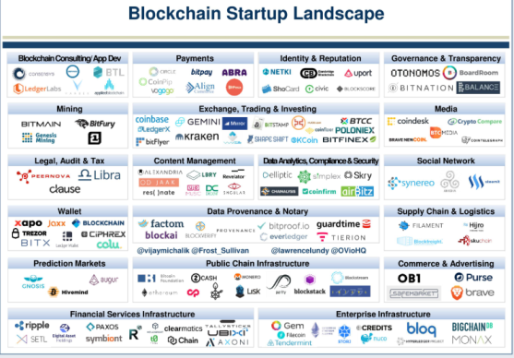






Blockchain 3.0
Decentralized Applications (DApps)
  Production stage:
    Large number of applications
  Scalability/Performance issues:
    Need for performance → new consensus protocols
    Need for storage → off-chain storage tools
2016
2017
2017
2017
2017
2017
2017
2015~2017
2018
Blockchain in the Supply-chain
BTC breaks 1’000 USD
Partnership IBM & Maersk
Supply-chain
Estonia uses Blockchain for Governmental Services
ETH Market Cap reaches 5B USD
1 BTC = 17’900 USD
Blockchain Identity
Blockchain IoT
Switzerland accepts tax payments in BTC! ☺
Growing as of today
«Let’s decentralize
the world!»
Excessive number of applications
BTC Bubble
Public Perception
2018

Slide 69













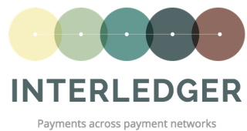


Blockchain 4.0
Ecosystem and Industry Integration
  Making blockchain effective in industry
  Decentralized and disconnected blockchain networks
    Vendor-specific blockchain technology, interoperable chains
  Need for standardization
As of today

Slide 70
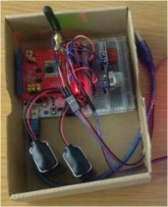
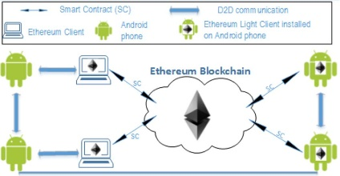
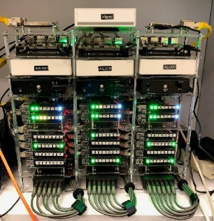
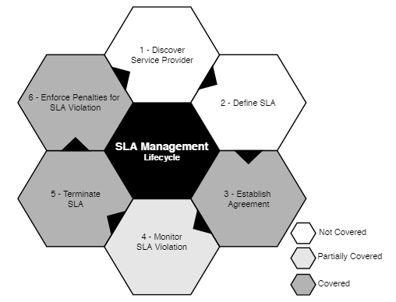
Applications of Eras and Consensus Mechanisms within CSG Projects
Pollution Monitoring
Trading Contracts
Project | BC Technology | Application Domain | Era | Consensus
IoT-based Pollution Monitoring | Ethereum | Environment | 3.0 | PoW
Blockchain-based Trading Contracts | Ethereum | Marketplaces | 3.0 | PoW
Blockchains for Cold-chains (BC4CC) | Multiple | Interoperability | 4.0 | Multiple
BLW: Foodchain | Ethereum | Food Supply-chain | 3.0 | PoW
Cryptocurrency from Scratch: BAZO | BAZO | Cryptocurrency | 1.0 | PoW ⇨ PoS
Blockchain Signaling System (BloSS) | Ethereum | Network Security | 3.0 | PoA
Blockchain eVoting | Dedicated BC | eVote | 3.0 | PoA
Automated SLA Compensation | Ethereum | Business Support | 3.0 | PoW
BloSS
SLA Compensation
CSG: Communication Systems Group

Slide 71
6. Electronic Payment Systems
Notes:
Cloud computing
- History / Definition / characteristics
- IaaS, PaaS, …
Virtualization
- TBD (GM)
71

Slide 72
Electronic Payments (or Systems)
Traditional payment approaches
  Cash, cheque
Gap in the past: no transfer of money via the Internet
Electronic payment approaches
  Means of running payments electronically over a network, such as the Internet or dedicated networks (IP-based)
  Example (Systems): Electronic Fund Transfer (EFT), debit/ credit card, ecash, software wallets, smart cards, crypto-currencies, Financial Electronic Data Interchange), interbank clearing (SWIFT)
Micropayment systems
  Pre-pay, post-pay, pay-as-you-go (once per transaction)
All with “measurable”
centralized elements

Slide 73
Cryptocurrencies (1)
A form of digital cash with general characteristics
  Faster, cheaper, reliable than “paper/coin” issued currency
Main two alternatives for creation of coins
  Issued by government(s) – centralized approach
    Involving Central Bank, banks, brokers, end-users
  Issued in a fully distributed manner – modern cryptocurrency
    Users transact directly with each other (no involvement of banks)
    Users store money themselves
General problems of cryptocurrencies
  Countermeasures against distributed fraud and manipulation
    Lack of trust
    Malicious transactions
    Double spending

Slide 74
Cryptocurrencies (2)
Automated prevention mechanisms against fraud
  Issuing of currency to be traceable & deterministic (algorithm)
  All transactions can be recorded in a decentralized manner
  All transactions can be verified, own and everyone’s else transactions
    Cryptographic mechanisms essential
Blockchains, distributed ledgers or public records, provide the key basis for modern cryptocurrencies
  They do not require a Trusted Third Party (TTP) nor trust as such, neither banks or users → “trustless”
  Everyone can trace the money being sent, received, verified, and recorded

Slide 75
Blockchains and Cryptocurrencies
Cryptocurrencies can either be
  Mined (CRY-M)
    Result of mining is the reward, a “coin” (native)
      E.g., Bitcoin rewards BTC, Ethereum rewards ETH
    Others define other crypto currencies or assets (non-native)
  Pre-created/burned (CRY-P)
    Result of pre-creation distributed by an Initial Coin Offering (ICO)
    Incentives for mining is collection of transaction fee
  No cryptocurrency (NRCY)
    Instead overlay assets are offered
      Many private blockchains do not use any native cryptocurrency

Slide 76
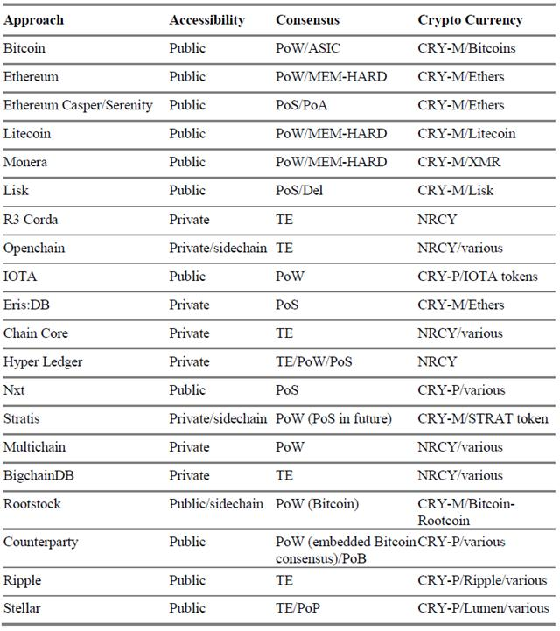
Cryptocurrency Overview (Never Complete)
~ 2900 cryptocurrencies today:
https://coinmarketcap.com/
Cryptocurrency ≠ Blockchain

Slide 77
7. Bitcoins
Notes:
Cloud computing
- History / Definition / characteristics
- IaaS, PaaS, …
Virtualization
- TBD (GM)
77

Slide 78

Bitcoin Characteristics (1)
Bitcoins are an experimental cryptocurrency (digital)
  Bitcoin is fully peer-2-peer (no central entity)
  1st Bitcoin issued on January 3, 2009
  Smallest unit: 0.00000001 BTC = 1 satoshi
Key characteristics
  Maximum of 21 million BTC
  Every transaction broadcast to all peers
    Every peers knows all transactions (~200 GByte as of today)
  Validation by proof-of-work (partial hash collision SHA-256)
    Difficult to fake Proof-of-Work (PoW)
    No double-spending
The Bitcoin initiator/inventor is unknown so far
Notes:
Use bitcoins / bitcoin

Slide 79
Bitcoin Characteristics (2)
Not relying on trust, but on strong cryptography
Weak anonymity (pseudonymity)
  All peers know all transactions
  Clustering: e.g., if a transaction has multiple input addresses, assume those addresses belong to the same wallet
Bitcoin not controlled by a single entity
  Only one development community, but not a central bank – Bitcoin Core’s SegWit vs. BTU (Bitcoin Unlimited)
Creation of Bitcoins performed via the reward for validation of payments (partial hash collisions)
Bitcoins can be exchanged for real currencies
  Several companies allow to exchange BTC for Dollar, Euro

Slide 80
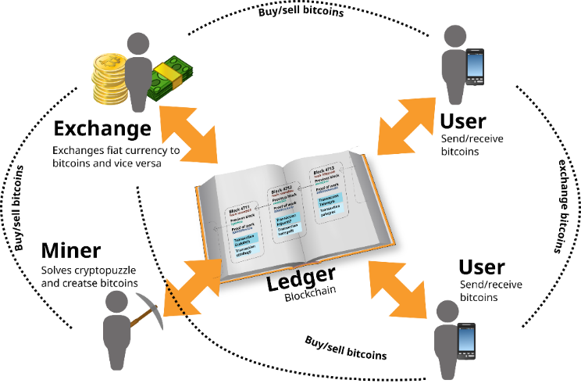
The Big Picture – Bitcoin (BTC)

Slide 81

Bitcoin Addresses
Bitcoin address is an identifier of 26-35 alphanumeric characters, beginning with the number 1 , 3, or bc1 that represents a possible destination for a Bitcoin payment
  Addresses can be generated at no cost by any user of Bitcoin
Currently 3 formats
Bitcoin transfer: Bitcoin sent to a person by sending bitcoins to one of their addresses
  Created on demand (offline, too), may be used multiple times
  Multi-signature addresses: combination of multiple private keys
P2PKH: Pay-to-Publickey-Hash, P2SH: Pay-to-Script-Hash, Bech32: Segregated Witness Address
https://en.bitcoin.it/wiki/Address

Slide 82

Bitcoin Mechanisms
UTXO (Unspent Transaction Output)
  Represents a chain of ownership as a chain of digital signatures where the owner signs a message transferring ownership of his UTXO to the receiver’s public key
A wallet holds public-private keys (wallet.dat)
  Public key, ECDSA 256 bit → Bitcoin address (receives BTC)
  Private key used for signing transactions
Transaction
  Peer A to send BTC to peer B → Creates transaction message
  Transaction contains input/output (BTC from/to)
  Peer A broadcasts transaction to all peers in the network
  Transaction stored in blocks → Block is created, verified ~1 min
ECDSA: Elliptic Curve Digital Signature Algorithm

Slide 83
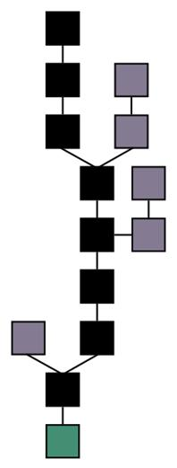
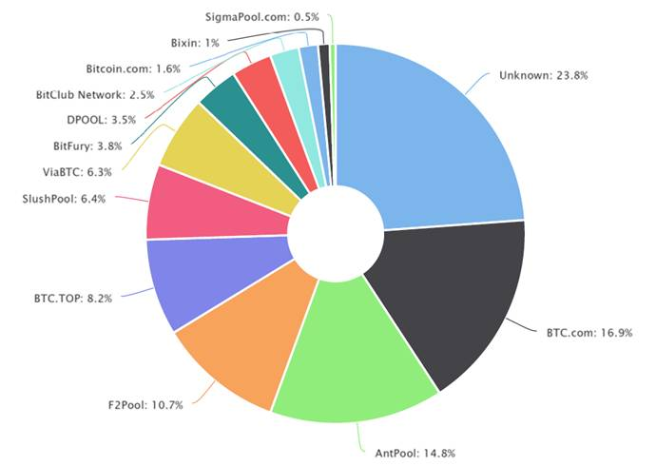
Bitcoin Mining (1)
Couple of big miners
  Miners specialized, AMD GPUs, FPGA, ASIC (Application-specific Integrated Circuit) [1][2][3]
Mining = creating valid blocks
Blocks are linked to previous blocks
  Longest block
  survive
  (most difficult)
Different level of
confirmations
  6 block conf. is
  considered
  secure
http://blockchain.info/pools

Slide 84
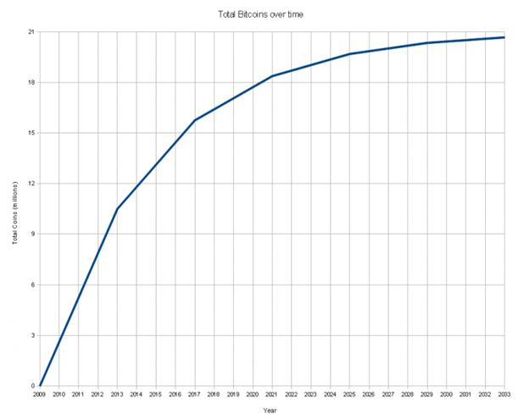
Bitcoin Mining (2)
Mining reward
  Halves every 210.000 blocks → max. 21 million BTC
  12.5 BTC per block creation
  Competition for creating valid block
Miner receives also tx fees
  Required, since BTC are limited
Dangerous, if someone
has more than 51%
computing power
  Can exclude and modify
  ordering of transactions

Slide 85
8. Ethereum
Notes:
Cloud computing
- History / Definition / characteristics
- IaaS, PaaS, …
Virtualization
- TBD (GM)
85

Slide 86
Ethereum Characteristics
Generalized blockchain, contracts Turing-complete
  Solidity with loops, arithmetical operations
  Every instruction needs to be paid for in “gas“
  Running out of gas, leads to state revertion, ETH gone
    Miner decides which transaction at which gas price to include
      Market for TX
White paper released in December 2013
Protocols designed from scratch
  Ethereum foundation located in Zug, non-profit
  Initiator known: Vitalik Buterin
Mining reward at
  Every block creation, at ~14 s

Slide 87
Ethereum Smart Contracts (1)
Computation on EVM is “very expensive”: every contract is run on every full Ethereum node
  Result on every node is the same
  “Global computer”, always running, always correct
For now, Proof-of-Work (PoW)
  But difficult with ASIC (memory-hard), starts at 1 GB RAM for full node and miner (2GB RAM should be enough)
Account-based
  External accounts: controlled by private keys
  Contract accounts never executed on their own
    Controlled by code
    All action fired from externally controlled accounts

Slide 88
Ethereum Smart Contracts (3)
ERC20 technical standard for Smart Contracts on Ethereum blockchain for implementing tokens
  Proposed: November 19, 2015
  January 2018: more than 21,000 ERC20 token contracts
    EOS, Tronix, VeChain, OmiseGO, MOD Token
ERC20 Token (Simplified)
  No allowance/approval/transferFrom
    Also no Approval event
  Using SafeMath (always use it)
  Creator gets 1,000 coins

Slide 89
Ethereum Releases
Olympic (past) – released 9.5.2015
  Last Ethereum Proof-of-Concept series
Frontier (past) - released 30.7.2015
  Main public network, “Beta”/use at your own risk
Homestead (past) - released 3.14.2016
  Public network considered “stable”, critical protocol changes
Metropolis (Byzantium, past) - released 16.10.2017
  Initial support for ZKP (private smart contracts), reward 3 ETH
Metropolis (Constantinople, now) – released 27.2.2019
  Bit-shifting, reward 2 ETH, other optimizations
Serenity (future)
  Scalability, proof-of-stake, Sharding, ZKP

Slide 90
9. Ethereum Wallet – Practical Part I
Notes:
Cloud computing
- History / Definition / characteristics
- IaaS, PaaS, …
Virtualization
- TBD (GM)
90

Slide 91

Exercise Goals
Differentiate between blockchain nodes
Create an address and send a transaction
Send funds and verify account balance
Verify a transaction sent using a blockchain explorer

Slide 92

Set-up Overview
Focus on Ethereum blockchain
  Ethereum Basics (cf. above) and Geth Commands here
  Connecting to your Node
  Connecting to CAS Blockchain
Connect to the CAS Wi-Fi
  Wi-Fi: cas2019
  Password: nopassword

Slide 93
Ethereum Basics – Recalled
Ethereum is a general purpose blockchain
  Support the execution of complex Smart Contracts (SC)
  Empowered the blockchain beyond financial applications
An Ethereum Virtual Machine (EVM) processes and executes smart contracts.
  Abstraction layer: the EVM connects requests (transactions) to and from the network
  SC operations requires Gas
    Mathematical operations, write data
    Table of EVM OP costs

Slide 94

Geth Client
Go implementation of the Ethereum Protocol
  CLI (Command Line Interface) client
  Entry point to the main, test and private networks
Management APIs
(personal) Manage accounts –
(eth) Send transactions –
Debug –
(mine) Miner –
Inspect transactions –
Geth

Slide 95
Management APIs
Personal API:
  personal.newAccount() // create a new acc.
Eth API:
  eth.accounts[0] //returns the first created acc.
  eth.sendTransaction({from:acc, to:acc, value:ethers}) //send transaction to acc.
Miner API:
  miner.setEtherBase(account) // define which account to receive ethers

Slide 96
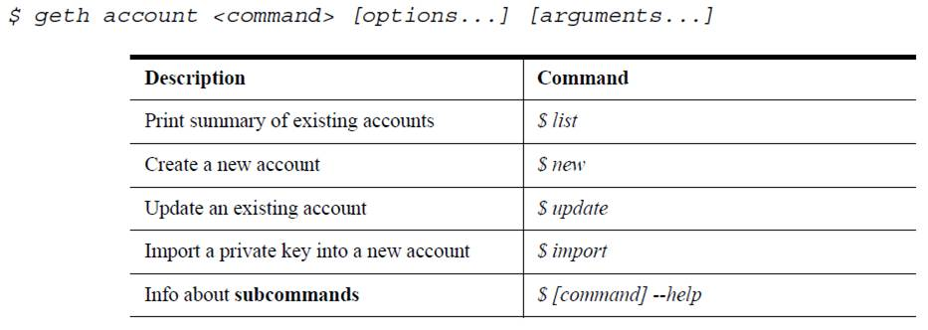
Geth Commands

Slide 97
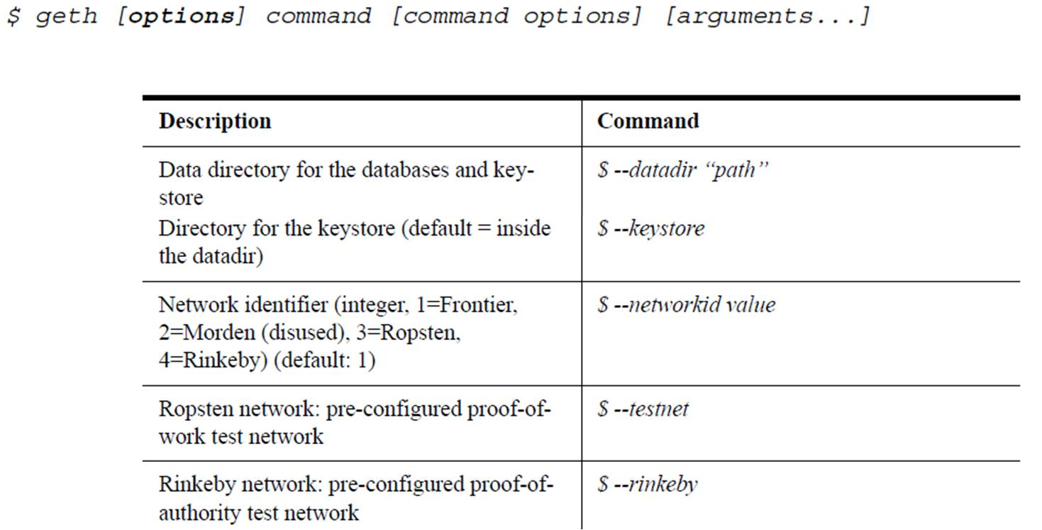
Geth Options (1)

Slide 98
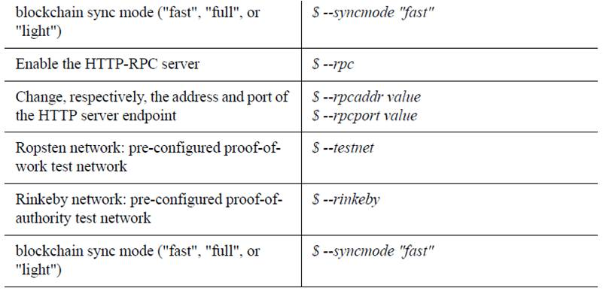
Geth Options (2)

Slide 99
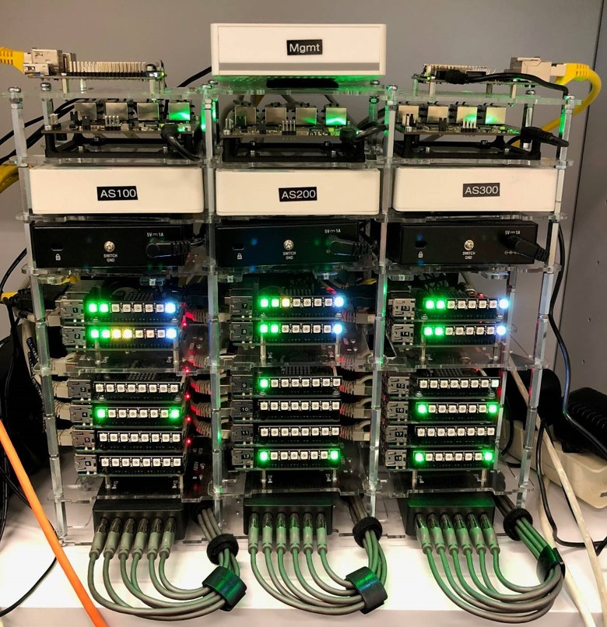
Blockchain Testbed Overview
Network Components
Blockchain Miners Nodes
Blockchain Client Nodes
(You will be accessing these)

Slide 100


Slide 101
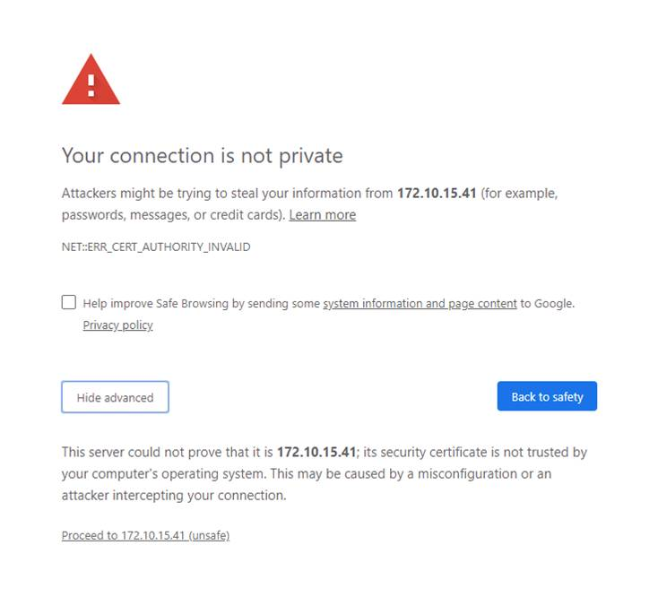

Connecting to Your Node
XX = Written in provided card
Nodes host a web-based shell:
  https://172.10.15.XX:4200
User: student
Password: 123456

Slide 102
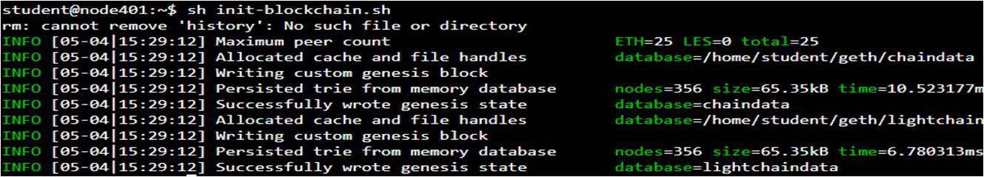
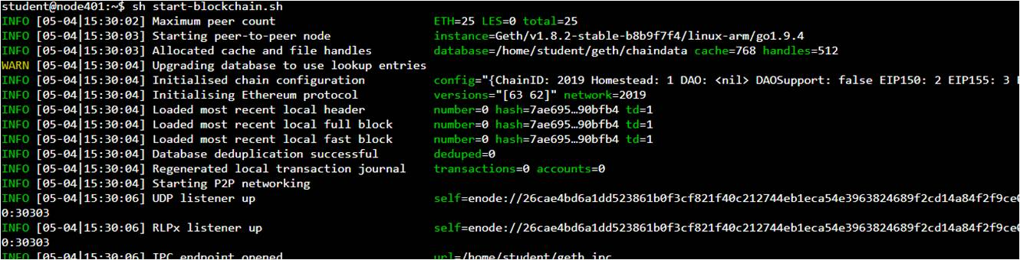
Blockchain Initialization
Step 1: Type: sh init-blockchain.sh
Step 2: Type: sh start-blockchain.sh

Slide 103
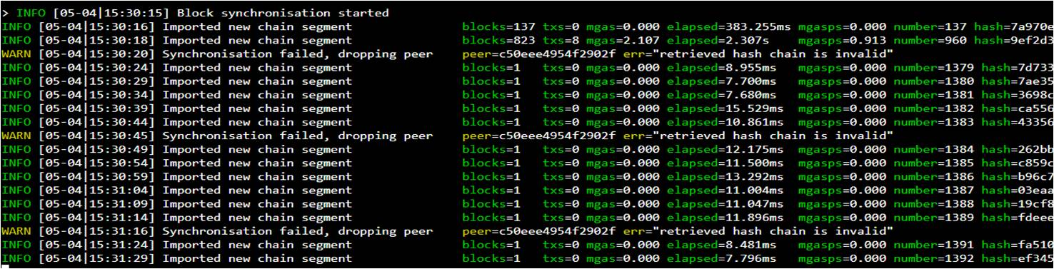
Blockchain Syncing
If the blockchain is syncing you will see this type of information:
You can also see the blocks being appended
Blockchain Explorer: http://172.10.15.22:8000

Slide 104

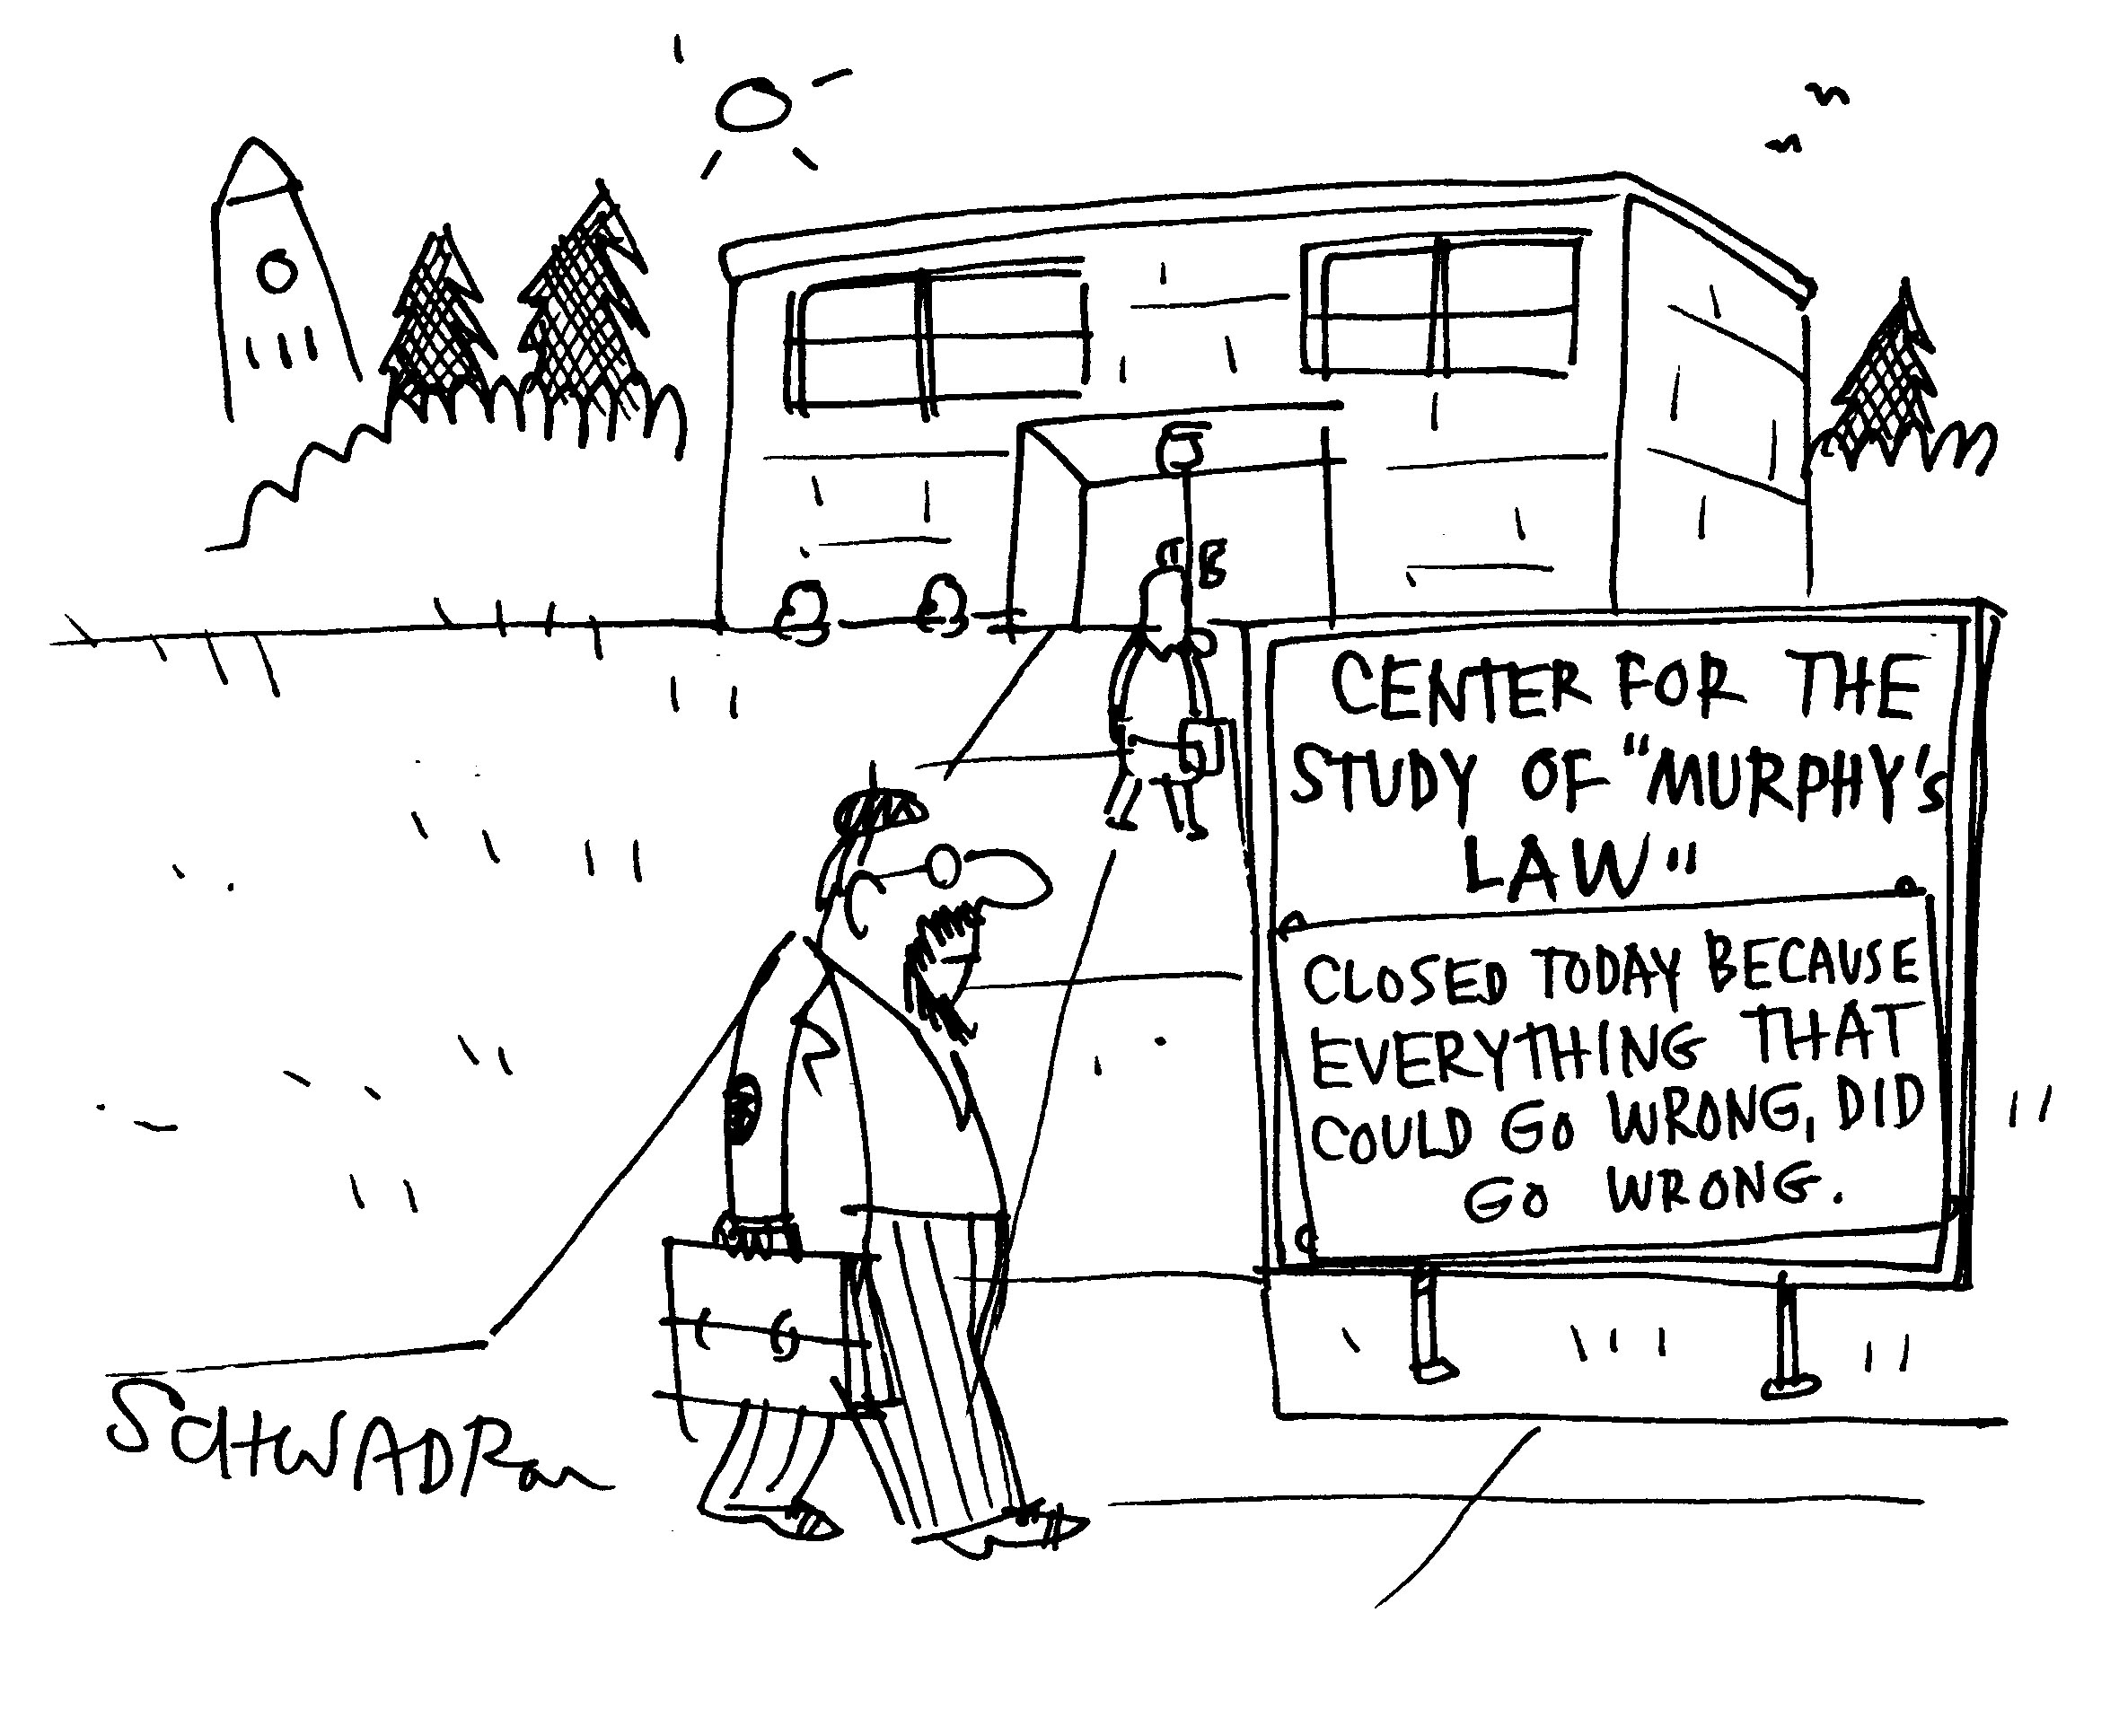
Practical Steps
Create account, check balance, receive Ethers
Send/transfer Ethers
Interaction with a Smart Contract (SC)

Slide 105
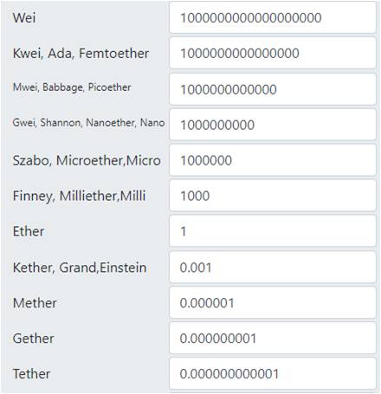
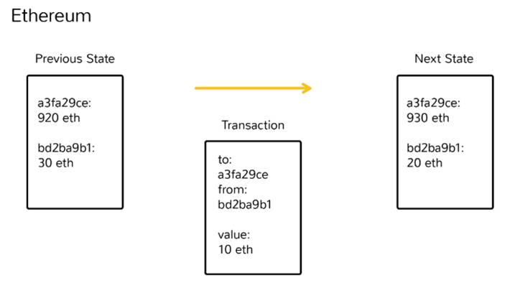
1. First Step
Create an account, check your balance, and receive Ethers
https://www.coindesk.com/information/how-ethereum-works
https://etherconverter.online/

Slide 106
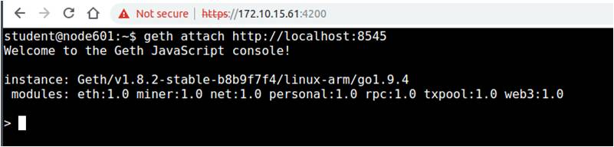
Interacting with the Blockchain (1)
Step 3: Open a new console to your node in a new tab
Type: geth attach http://localhost:8545
Now you can interact with the blockchain node

Slide 107


Interacting with the Blockchain (2)
Create a new account (do not forget your password)
Type: personal.newAccount()
Set the new account as your main geth account
Type: miner.setEtherbase(eth.accounts[0])

Slide 108

Interacting with the Blockchain (3)
Unlock your account to send Ethers
Type: personal.unlockAccount(eth.accounts[0], "password",9999999)
If you want to see your account address
Type: eth.accounts[0]

Slide 109
Check your Balance
Set the new account as your geth main account:
Type:
  eth.getBalance(eth.accounts[0])
    Should return 0
    Value returned in “wei”, which is the smallest unit in Ethereum
If you want to see your balance in Ether:
Type:
  balance = eth.getBalance(eth.accounts[0])
  web3.fromWei(balance, "ether")

Slide 110
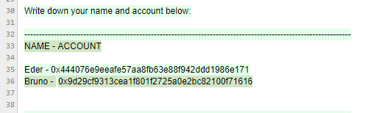
Receive Ethers
Access the CAS Etherpad in your browser
  http://172.10.15.13:9001/p/cas
Inform your account to receive Ethers
Check your balance again

Slide 111
2. Second Step
Transfer Ethers to another account
On geth console type:
  sender = eth.accounts[0]
  receiver = "<account from colleague>"
  valueEth = web3.toWei(0.5, "ether")
  eth.sendTransaction({from: sender , to: receiver, value: valueEth, gas:21000})
Check your balance
Verify the transaction hash in the Blockchain Explorer
You should have less 0.5 ethers in your account

Slide 112
10. Smart Contracts – Practical Part II
Notes:
Cloud computing
- History / Definition / characteristics
- IaaS, PaaS, …
Virtualization
- TBD (GM)
112

Slide 113
Exercise Goals
Register your account in the Smart Contract
Retrieve an account from the Smart Contract
Send funds to the account retrieved

Slide 114
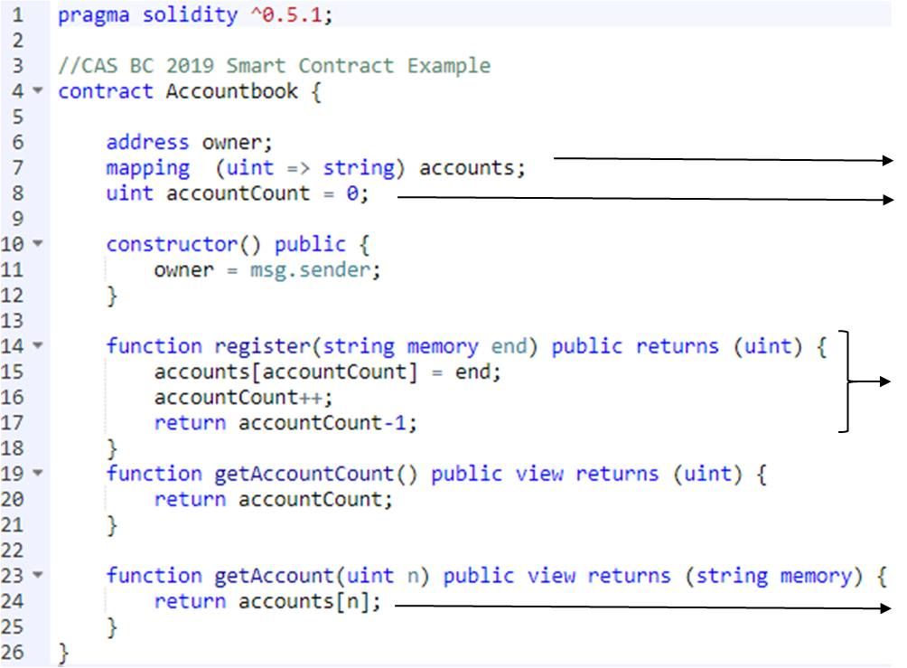
3. Third Step
Interacting with a Smart Contract (SC)
Each account has an unique ID
First ID is 0
New registered account receives an ID
Returns the account associated with the ID

Slide 115
SC Storage
What data does the SC stores?
  List of IDs and Account (Example)
  Number of Accounts: 7
  New Account will have ID 7
ID | Account
0 | 0xC0A565abfa50349c59a4D0647834Bb6763b8fFC9
1 | 0xe3c01b34bBcfeDf5D5Cf090226D50767c8DBC029
2 | 0xd41aA1F353CdcdC3d3bd22D2EcD2e4fF490f2847
3 | 0x5e694ceCb56d4C24a79547468B80c5ffD186B06F
4 | 0xAF418BAe762962dEdb6aC027A0706972260F910d
5 | 0xeB23D0a558482D6D706C51234F4210aef0797F5F
6 | 0xAB38C7C0e9FA8f30bFF71c25781e1207E6BCfb06

Slide 116
3.1 Step: Interact with the SC
Create the functions to interact with the SC
Type: loadScript(' initContract.js ')
Retrieve the number of accounts stored in the SC
Type: example.getAccountCount()
Get the account with ID 0
Type: example.getAccount(0)
Send 0.1 Ethers to the returned account address
Check your balance

Slide 117
3.2 Step: Register your Account
Register your account in the SC
Type: example.register(eth.accounts[0],{from:eth.accounts[0],gas:100000})
Retrieve the number of accounts stored in the SC
Type: example.getAccountCount()
Was there any changes in the number of stored accounts?
Find your account ID and from colleagues ☺
The account to register
Sending from
your account
Gas paid to miners to execute your transaction (tx fee)

Slide 118
11. To Blockchain or not to Blockchain?
Notes:
Cloud computing
- History / Definition / characteristics
- IaaS, PaaS, …
Virtualization
- TBD (GM)
118

Slide 119
Key BC Characteristics
Permissions (write/read)
  Fully: everyone in the world can participate (W/R)
  Partially: selected public can participate (W/R)
Transparency
  Fully: all members access the history of transactions
  Partially: some members access the history of transactions
    Better than a traditional DB
Permanent storage, i.e., immutability
  Transactions cannot be removed
Level of decentralization
  Fully: consensus with elected leader
  Partially: consensus with selected leader(s)
Notes:
There are two distinct views (in practice) on how blockchain permissions can be distributed. The fully public blockchain is found on the most successful applications (cryptocurrencies) meaning that everyone in the world can submit/retrieve transactions. However, it is seen, especially on the 3.0 Era, a different view on which write/read permissions can be “fully” distributed within a selected public.
Still, transparency needs to be maintained to everyone that has access to the blockchain regardless on whether it is “fully” or “partially” permissioned. Similarly, the permanent storage should be respected, meaning that one is not able to change the history of transactions in the blockchain.
Lastly, the level of decentralization should be observed. This is related to “whom” is able to determine which transactions should be accepted or denied in the blockchain whereas in a “partially decentralized” case, it requires a certain level of trust in the entity responsible for collecting and distributing transactions.

Slide 120
BC Advantages and Drawbacks
Selection only!
Characteristics | Advantages | Drawbacks | Remarks
Distributed | No central control, no “master” needed | No central control, no “master” exists | Censorship vs. conflict resolution!
Unknown stakeholders | Everyone can participate | Lacking control of participants’ “writes” | Application-specific needs
Open, transparent | No hiding possible | Stakeholders’ activities publicly viewable | Application-specific needs
Immutable | Once persisted, persisted forever | Wrongly deployed SC(s) not retractable | Realistic for “useful” SCs? GDPR?
Append-only | No deletions | Growing in size | GDPR compliance?
Traceable | Proof of actions | No hiding of actions | Error handling?
Technical aspect | Effective | Efficiency, energy dem. | Sustainability?
Economic aspect | Cryptocurrency (fully elect., decen.) | Impacts on economic stability, currencies, … | Survivability of too ma-ny “tokens” or “coins”?
Legal aspect | Contracts without intermediary | “Unknown” conflict resolution instance(s) | No jurisdictional borders, enforceability?

Slide 121
Choosing a Blockchain
Not a trivial question to answer
  … besides these 2900+ BCs available
Myriad of facets/parameters
  Marketcap
    Value to buy all shares at today’s market value
  Community involvement
    Telegram chats, discussion channels
  Full Node/Miners Geolocation
    Politics, possibility of centralization
  Technical concerns
    Transactions per second, implementation language, design choices
  Security
    Hashing algorithm, possible attack vectors
[1] https://coinmarketcap.com/

Slide 122
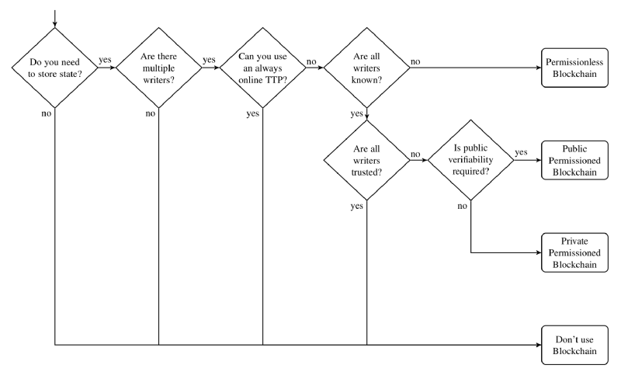
Blockchain Demand “Checker”
K. Wüst, A. Gervais, 2017+2018

Slide 123
12. A Critical Review
Neither Good* nor Bad*, Only “as is”!
* “Good” or “bad” qualifications can be determined from results
of evaluations, which depend heavily on models and assumptions!
Notes:
Cloud computing
- History / Definition / characteristics
- IaaS, PaaS, …
Virtualization
- TBD (GM)
123

Slide 124
What’s the following?
1BvBMSEYstWetqTFn5Au4m4GFg7xJaNVN2

Slide 125
A Bitcoin Address in the Pay-to-PubkeyHash (P2PKH) Format
All electronic,
algorithmic creation!
1BvBMSEYstWetqTFn5Au4m4GFg7xJaNVN2
… being derived from
A = RIPEMED160(SHA256(K)) with
K ≙ public key of a private-public key pair

Slide 126
What’s the following?
18f8ab5e9a5c7e9f3a0c570d56abc37f

Slide 127
The 256 bit private key of your physical asset, the top floor apartment located at
General-Guisan Quai 1, 8002 Zürich!
18f8ab5e9a5c7e9f3a0c570d56abc37f
How can someone guarantee that the public part of this key will be “attached” immutably to your top floor apartment?

Slide 128
Reviewing Bitcoins
Fully decentralized and distributed
  + everyone can participate, no central bank needed
  + everyone interested can access full transaction history
  + almost no change of the history of transactions
  – no control of “everyone”
  – no-one to complain to
  – history of transactions grows forever
Impacts on person’s payments (daily society)
  + person-to-person transactions without any intermediary
  + performance at very low (varying) payment costs
  – user interactions are final
  – no overall maintenance and surveillance

Slide 129
Reviewing “Digital Assets”
Societal impacts
  Tokenization of everything
    Data generated by electronic algorithms (e.g., mining) vs.
    Data “sensed” from the real world (from objects, Internet-of-Things)
  Digitization reached the “value” (besides representations)
    Electronic data maintained immutably (no copy&paste of assets)
    IoT data “hard” to be made valuable
  Consensus mechanisms’ sustainability dimension
    Very strong, thus, highly secure (such as PoW) are energy-demanding
    Less energy-demanding ones (such as PoS) are much less secure
    Byzantine Fault Tolerance ok, centralized with trust assumptions
  Application-specific
    Cryptocurrencies, supply chains, insurances, …
PoW: Proof-of-Work
PoS: Proof-of-Stake

Slide 130
Public Blockchain Challenges!
Selection only!
Solutions seem possible
  How to handle reliably tangible (non-digital) assets in BC?
    A token is represented in bits vs. property/real estate as physical items
  Sustainability: Energy efficiency of consensus mechanisms?
    Energy consumption Bitcoin BC only in 2018 ≈ The Netherland‘s production
  Scalability: BC throughput as a number of transactions per second, volume of data persisted in Mega (?) bytes, costs?
    E.g., BC sizes grow faster than the density of HDDs/SSDs
    BC (always) better than a (distributed) data base? Exorbitant costs?
  Identity management (users, objects) and anonymity
  Standardized APIs for switching BCs for BC-based dApps
    E.g., in contrast, databases from different vendors offer “similar” APIs
  Many economic effects of BC-based cryptocurrencies unknown
    Role of national “e”-currency, interrelationships of about 2100+ cryptocurr.
  Legal/regulative compliance, societal/governmental acceptance

Slide 131
Public Blockchain Risks!
Selection only!
Fundamental concerns
BCs’ “true semantics” depend on the input received!
BCs’ security, privacy, and reliability
    Unknown attack vectors (& 51% attack), Programming errors in SCs
    Alternative consensus mechanisms beyond PoW? Security at stake?
  The breaking of currently used security algorithms
    Long-term storage? Quantum Computing impacts?
  Privacy: persisted data at stake? GDPR?
      The right to forget vs. immutability
      Transparency (public knowledge of BC) vs. privacy (private data)
Networking infrastructure’s reliability (critical infrastructures)
    Lacking Internet connectivity for a “longer” period of time?
Economic/legal risks (cryptocurrency/tokens/coins, BC)
    Fraudulent profitability projections, volatility, dispute resolutions, no central entity or simply a central Customer Relationship Management
GDPR: General Data Protection Regulation

Slide 132
Private Blockchain Risks? Challenges?
Selection only!
Real needs?
  How to handle reliably tangible (non-digital) assets in BC?
    A token is represented in bits vs. property/real estate as physical items
  Sustainability: Energy efficiency of consensus mechanisms!
    Known stakeholders’ tx persisting based on round-robin schemes
  Scalability: BC throughput as a number of transactions per second, volume of data persisted in “any” volume
    E.g., BC sizes grow faster than the density of HDDs/SSDs
    BC (always) better than a (distributed) data base?
  Service offered: trusted third party time stamping service
    Cryptographically sealing electronic data with a tamperproof digital signature and BC timing information (well known from the past)
  BCs’ security, privacy, and reliability
    Depending on known stakeholders’ agreements (like within today’s IT)
    With a very different trust model as compared to public BCs

Slide 133
Broader Challenges? Risks?
Discontinuation of “cash” and replacement with a cryptocurrency – loss of any anonymity?
Cryptocurrencies only – failure of energy supply? Sustainability? Payments made with empty battery?
  On-the-spot payments? Input channels are “delicates”
Decentralization of token handling – full control of the individual? No central “CRM” for sure
  Full decentralization today impossible, thus, “central” players
Reliability of IT systems – here “billions” of handhelds are part of the game? BYOD?
  Different OSes? Different HW? Hundreds of applications? IF?
CRM: Customer Relation Management
BYOD: Bring Your Own Device
IF: Interfaces

Slide 134
Probabilities and Blockchains (1)
Public-private key pairs:
  Two public-private keys may be the same
    Probability of that “astronomically low” (not zero), technically irrelevant
    Primality tests: Sieve of Eratosthenes, probabilistic Miller–Rabin tests
      Composite number at 75% chance of being detected per round
      After 64 rounds of testing, the probability that composite number is undetected is at probability of 2⁻¹²⁸
Mining:
  Probability of winning “block race” proportional to computational power of participants
    Time restriction on block mining; Bitcoin set to the block time: 10 min
    Computational, hashing power increase ⇨ chance of discovering a new block under 10 min increases ⇨ increase target value

Slide 135
Probabilities and Blockchains (2)
  Centralized mining with unfairness and 51% attack
    Incentives to “combine” miner into pools
    Chances to take over a BC from a country with “many” miners
      Mining power of above 51% at one country
Consensus mechanisms (distributed)
  Randomness for multiple parties trying to come to agreement
    Constraints as upper bounds on (a) number of messages sent within a block time (throughput) and (b) time it takes for message to be sent (latency) ⇨ BC (public) make it hard to “consent” an agreement via messages needed ⇨ solved by PoW and messages needed!
    PoS: selection of subcommittee ⇨ unbiasable? Not possible!
Stakeholders (maliciously behaving trusted nodes)
  Probabilities of an “internal” attacker within a given private BC
M. Saad et al.: Exploring the Attack Surface of Blockchain: A Systematic Overview, 2019

Slide 136
Conclusions (1)
1. Blockchains do show a logical evolution of linked lists, however, public BCs “exaggerate” processing demands
  By design: Proof-of-Work (PoW), but this ensures immutability
2. Traceability of objects, especially food, viable via BCs, modulo “trust in sensor” and “coloring” problem, contra-diction of full transparency vs. internal matters remains
  Role of BC vs. DL only arbitrable on a case-by-case analysis
3. Blockchains do not solve the media break, thus, leading to a lack of trust for tangible assets, key: trust in “sensor”
  Major trust model differences for public BC vs. “private” BC/DL

Slide 137
Conclusions (2)
4. The technical future of blockchains is still based on security ingredients of today’s technology, however, long-term security management is key
  “Unknown” impact of quantum computing (certainly on all IT!)
5. Blockchains and Distributed Ledgers have reached society, especially FinTech, but not necessarily daily life
  Visibility of technical basis as hidden from users as for other IT
6. Blockchains show no revolution, but a typical Computer Science (Abstract Data Type) evolution of linked lists
  But “distribution” of consensus does not always make sense
    Any system as of the past has not been replaced fully by a BC

Slide 138
Disclaimer
All material was prepared with utmost care.
Technical details, planned and published use, and real installations may change without notice.
Different versions of software, clients, systems, documents, papers may show very different effects, functionality, or behavior.

Slide 139
Thank you for your attention!

Slide 141
Back-up Slides

