Slide 1


Practical Introduction to Blockchain-based Remote Electronic Voting
IEEE International Conference on Blockchain and Cryptocurrency
Toronto, Canada, Virtual Conference, May 3, 2020
Christian Killer, Bruno Rodrigues, Eder Scheid, Muriel Franco, Burkhard Stiller
Communication Systems Group CSG
Department of Informatics IfI
University of Zürich UZH
[killer,rodrigues,scheid,franco,stiller]@ifi.uzh.ch
Notes:
2-3 Introduction as BS

Slide 2
ToC
Electronic Voting (EV)
  Definitions and Notions with a Global Overview on EV
  History of Switzerland and REV
  Focus on Remote Postal Voting (RPV) in Switzerland
Remote Electronic Voting (REV)
  REV Requirements and Properties
  Building Blocks
    Homomorphic Encryption, ZKP, PBB
BC-based REV
  Provotum Voting Protocol and Evaluation
Summary
11:30
12:30
Break
12:30
13:30
Notes:
Unter BC-based REV einen Punkt danach oder vorher „Practical Exercise“
Playground

Slide 3
Electronic Voting (EV)
  Definitions and Notions with a Global Overview on EV
  History of Switzerland and REV
  Focus on Remote Postal Voting (RPV) in Switzerland
Notes:
3

Slide 4
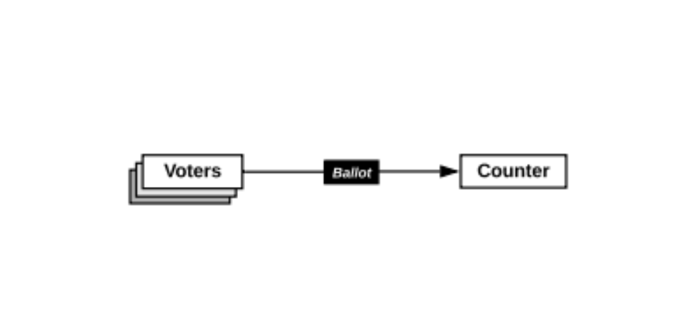
Are elections just counting?
Main difficulties in practice
  No one is trusted
    Anyone is a potential adversary
  The need for evidence
    Any observer should be able to verify the election data
  The secret ballot
    Voters should not be able to prove how they voted to anyone, even if they wish to do so
Notes:
No one is trusted – We need threat models and risk assessments to assess the trust assumptions in each actor
Need for evidence – there‘s a need that any party can verify the data produced, which gives legitimacy to final tally
Secret ballot – Term, minted in the mid 19th century, the origin of Ballot Secrecy

Slide 5
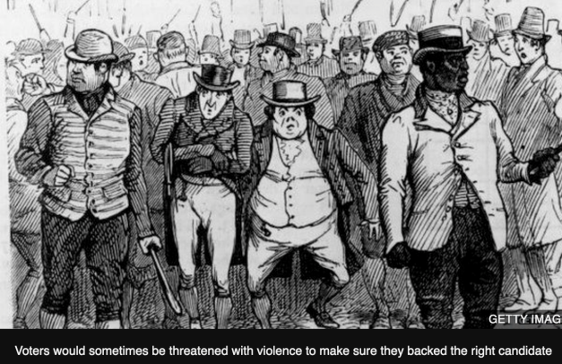
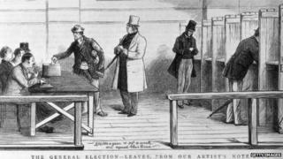
The Secret Ballot
Mid 19th century, the “Australian ballot” was introduced as a means of deterring coercion
Today, society takes for granted this process of voting privately within a public environment, where observers can enforce privacy, but great innovation in its time
In the early 1980s, cryptographers began to propose new election designs with new properties and integrity guarantees
Source: https://www.bbc.com/news/uk-england-leeds-31630588

Slide 6
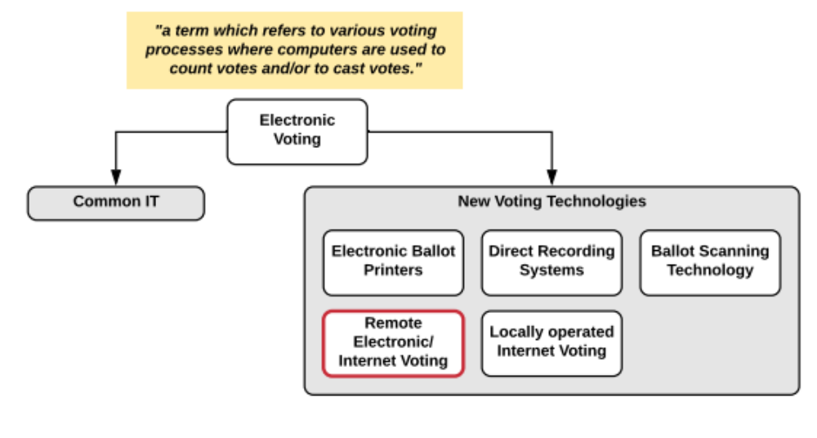
Terminology
Remote Electronic Voting (REV) or Internet Voting
  Vote cast in a remote, uncontrolled environment and not in a voting booth.
Source: https://www.bbc.com/news/uk-england-leeds-31630588
Notes:
Right off the bat, this work focus on REV, however there‘s, globally, different notions of EV

Slide 7
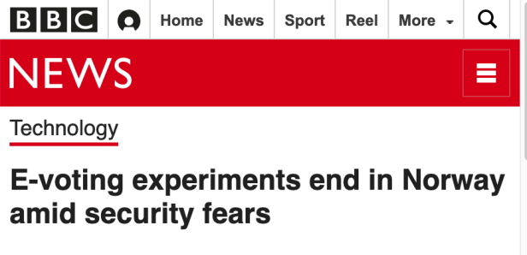
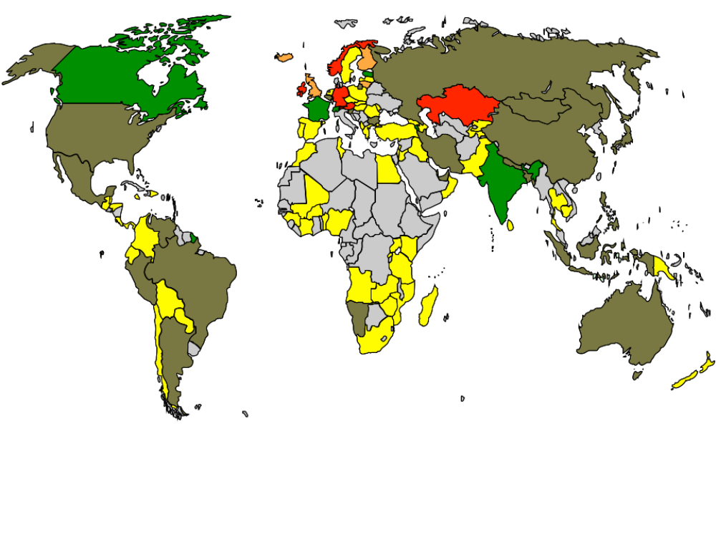
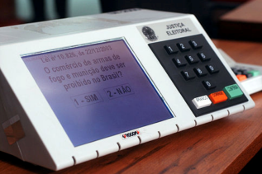
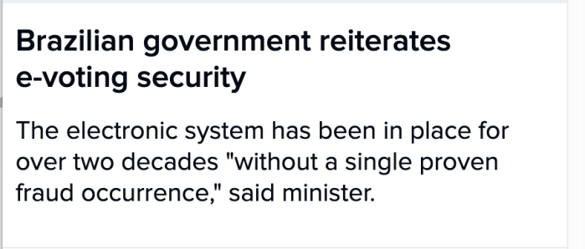
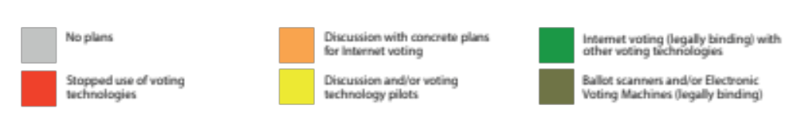
E-Voting World Map
Source: e-voting.cc
Notes:
Heterogeneous Situation as of 2015

Slide 8
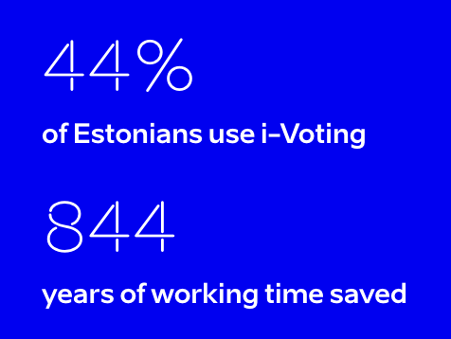
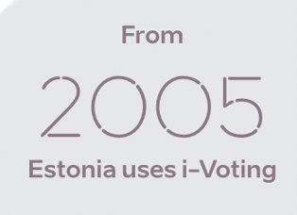
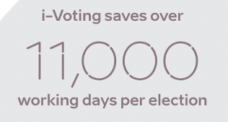
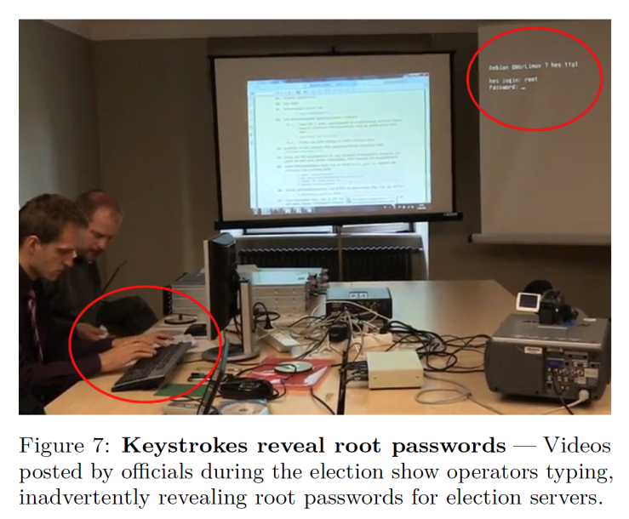
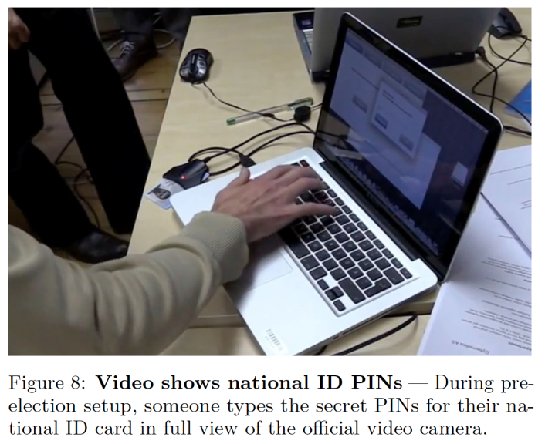
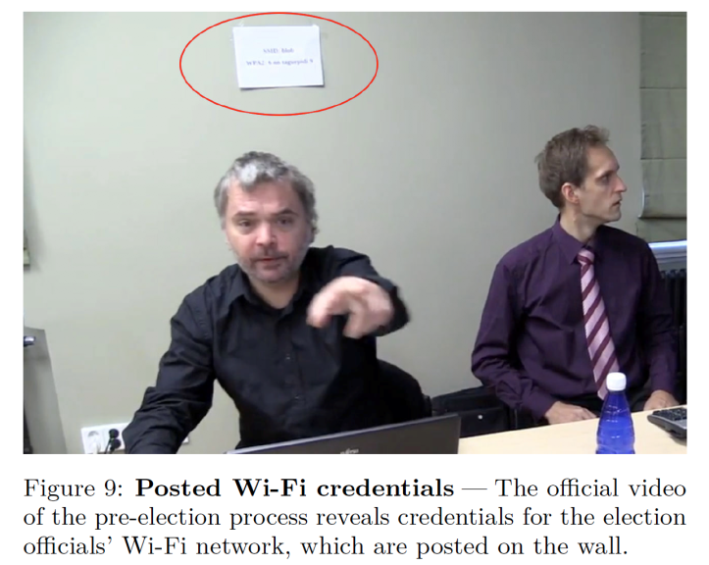
Estonia
Source: Security Analysis of the Estonian Internet Voting System, Drew Springall et al., November 2014
Notes:
Poster Child of REV – Estonia
Official public information – astonishing 44% of electorate
However, 2014 security researchers pointed out significant flaws in basic security procedures

Slide 9
Electronic Voting (EV)
  Definitions and Notions with a Global Overview on EV
  History of Switzerland and REV
  Focus on Remote Postal Voting (RPV) in Switzerland
Notes:
9

Slide 10
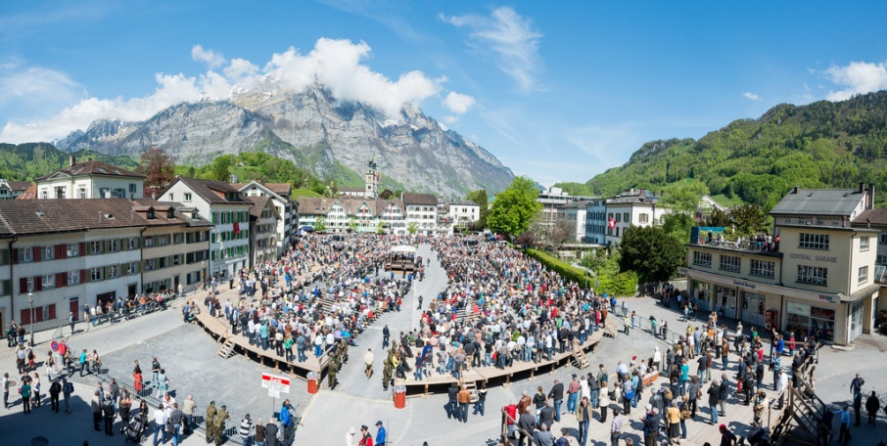
Brief History of Swiss Voting Channels
A tradition of direct democracy (Landsgemeinde)
  Introduction of “Remote Postal Voting” in the 1970’s which was generalized in the 1990’s
  1998: the Federal Council proposes to study Internet Voting (I-Voting) and by the year 2000, official start of the Vote “électronique” project with three pilot cantons (GE, NE, ZH)
Image: Samuel Trümpy Photography, https://www.gl.ch/landsgemeinde.html/216
Source: https://www.bk.admin.ch/bk/en/home/politische-rechte/e-voting/chronik.html
Notes:
From a global, to a more local use-case, which outlines the landscape for the use-case we envision for this tutorial

Slide 11
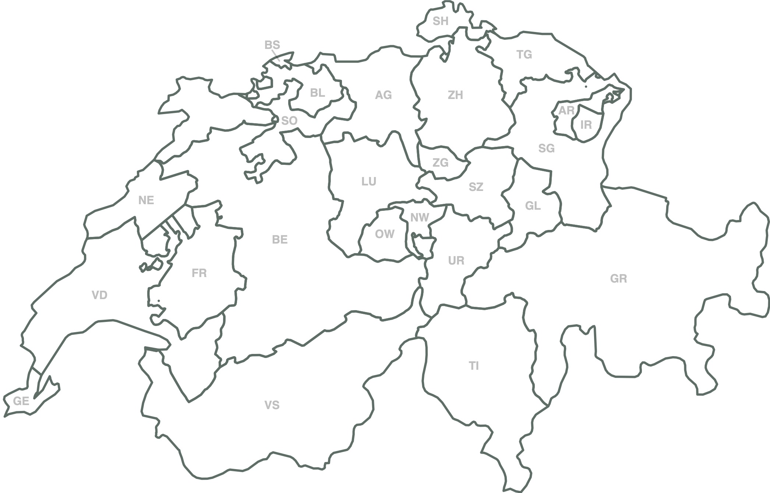
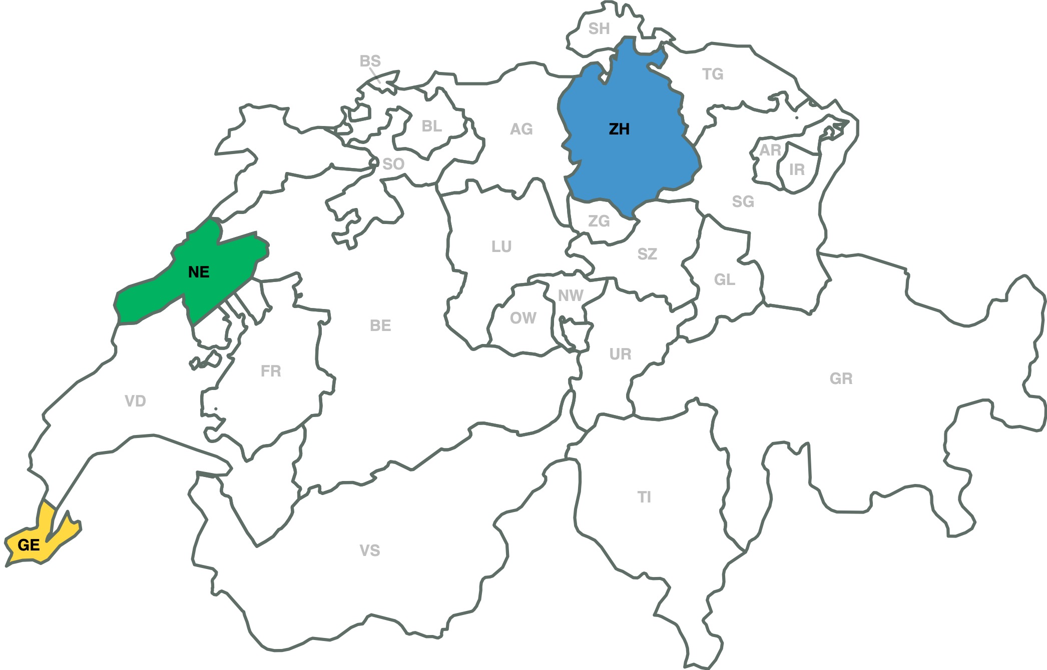
First Trials, Initial Pilot Phase
2004 Zurich System
first trials for federal votes
2005 Neuchâtel System
first trials for federal votes
2004 Geneva System
first trials for federal votes

Slide 12
Extension of Trials
In 2006, the Federal Government opened the door for all cantons to use limited internet voting:
  20% of the cantonal electorate (later extended to 30%);
  10% of the federal electorate
Geneva and Zurich (Vote Consortium) started offering their system to other cantons
  Some drawbacks were also experienced:
    Regulatory issues in Geneva (2005 – 2007)
    Technical issues in Zurich (2011 – now)

Slide 13
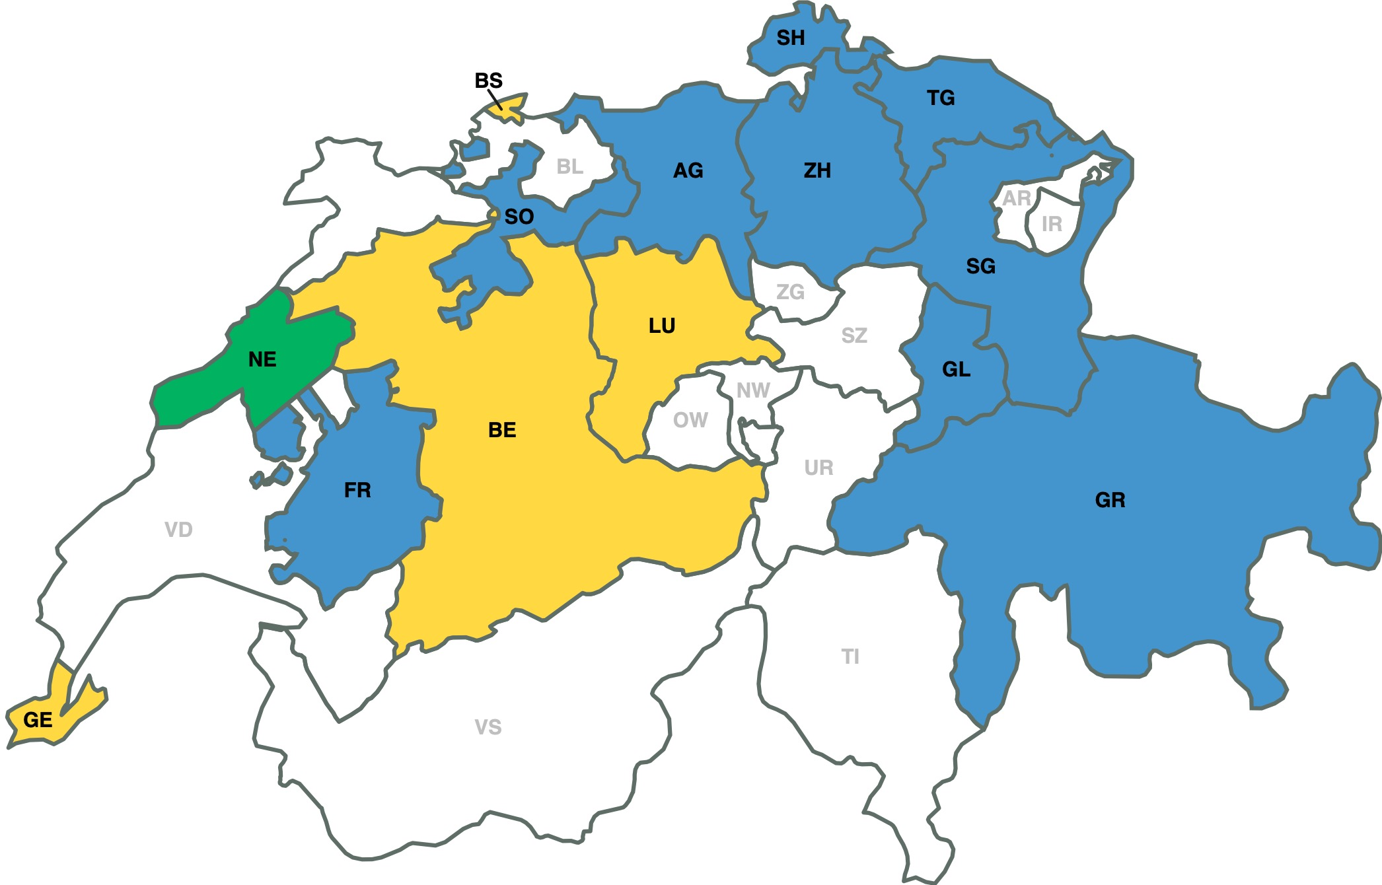
Extension of Swiss-wide Pilots
2009 Foundation Consortium Voté Electronique
2005 Neuchâtel System
first trials for federal votes
2009-2011 Geneva System
Agreements between Geneva and the cantons of Basel-Stadt, Lucerne, and Berne for Swiss living abroad

Slide 14
Situation as of 2011
Geneva System
  Canton owns the SW and operates the system
  Developed by Geneva IT Department
  Voting Protocol by Bern University of Applied Sciences
Zürich / Vote Électronique Consortium System
  Canton owns the SW, external company (Unisys) operates it
  Developed by Unisys
Neuchâtel System
  Canton owns the SW and operates the system
  Developed by Scytl
  Embedded in “Guichet unique“, as one of many offerings

Slide 15
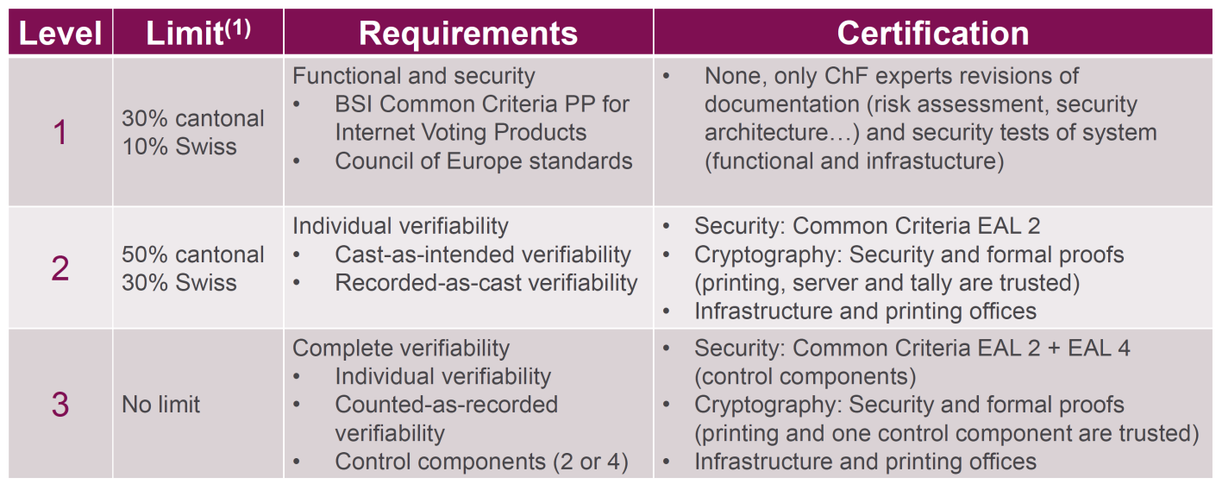
New Swiss Regulations in 2014 (VEleS)
In 2013 new regulations regarding REV in CH
  Federal Chancellery Ordinance on Electronic Voting «161.116 - Verordnung der BK über die elektronische Stimmabgabe vom 13. Dezember 2013 (VEleS)»
Framework for authorization of voting systems with three different levels, linked to the amount of allowed electorate
Source: Defining a national framework for online voting and meeting its requirements: the Swiss experience, Jordi Puiggalí, Adrià Rodríguez Pérez, E-VOTE ID 2018
Notes:
Requirements eingehen

Slide 16
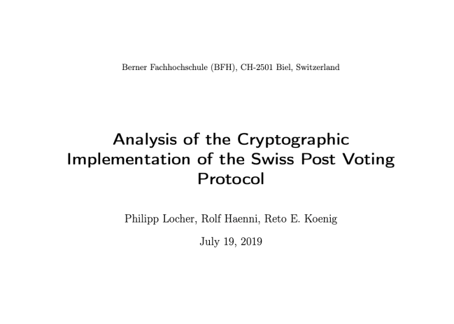
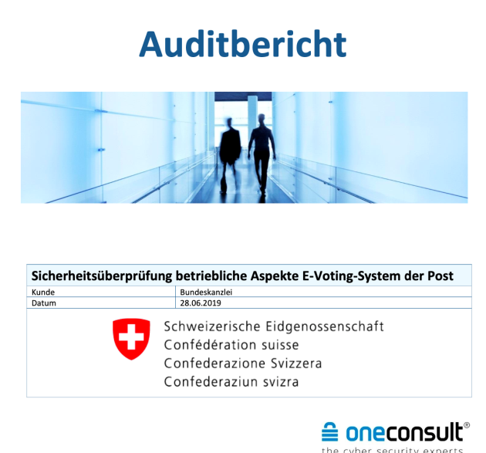
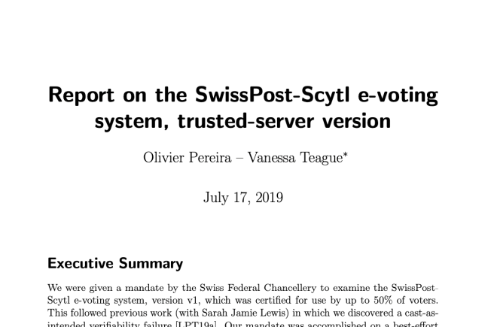
Publication of Source Code in 2019
Publication of the source code in February 2019, researchers have uncovered significant security flaws in the new, fully verifiable, system provided by Swiss Post (sVote, developed by Scytl)
  One of the security issues relates to individual verifiability and thus to the system already used. As a result, the system was not available for the vote on 19 May 2019.

Slide 17
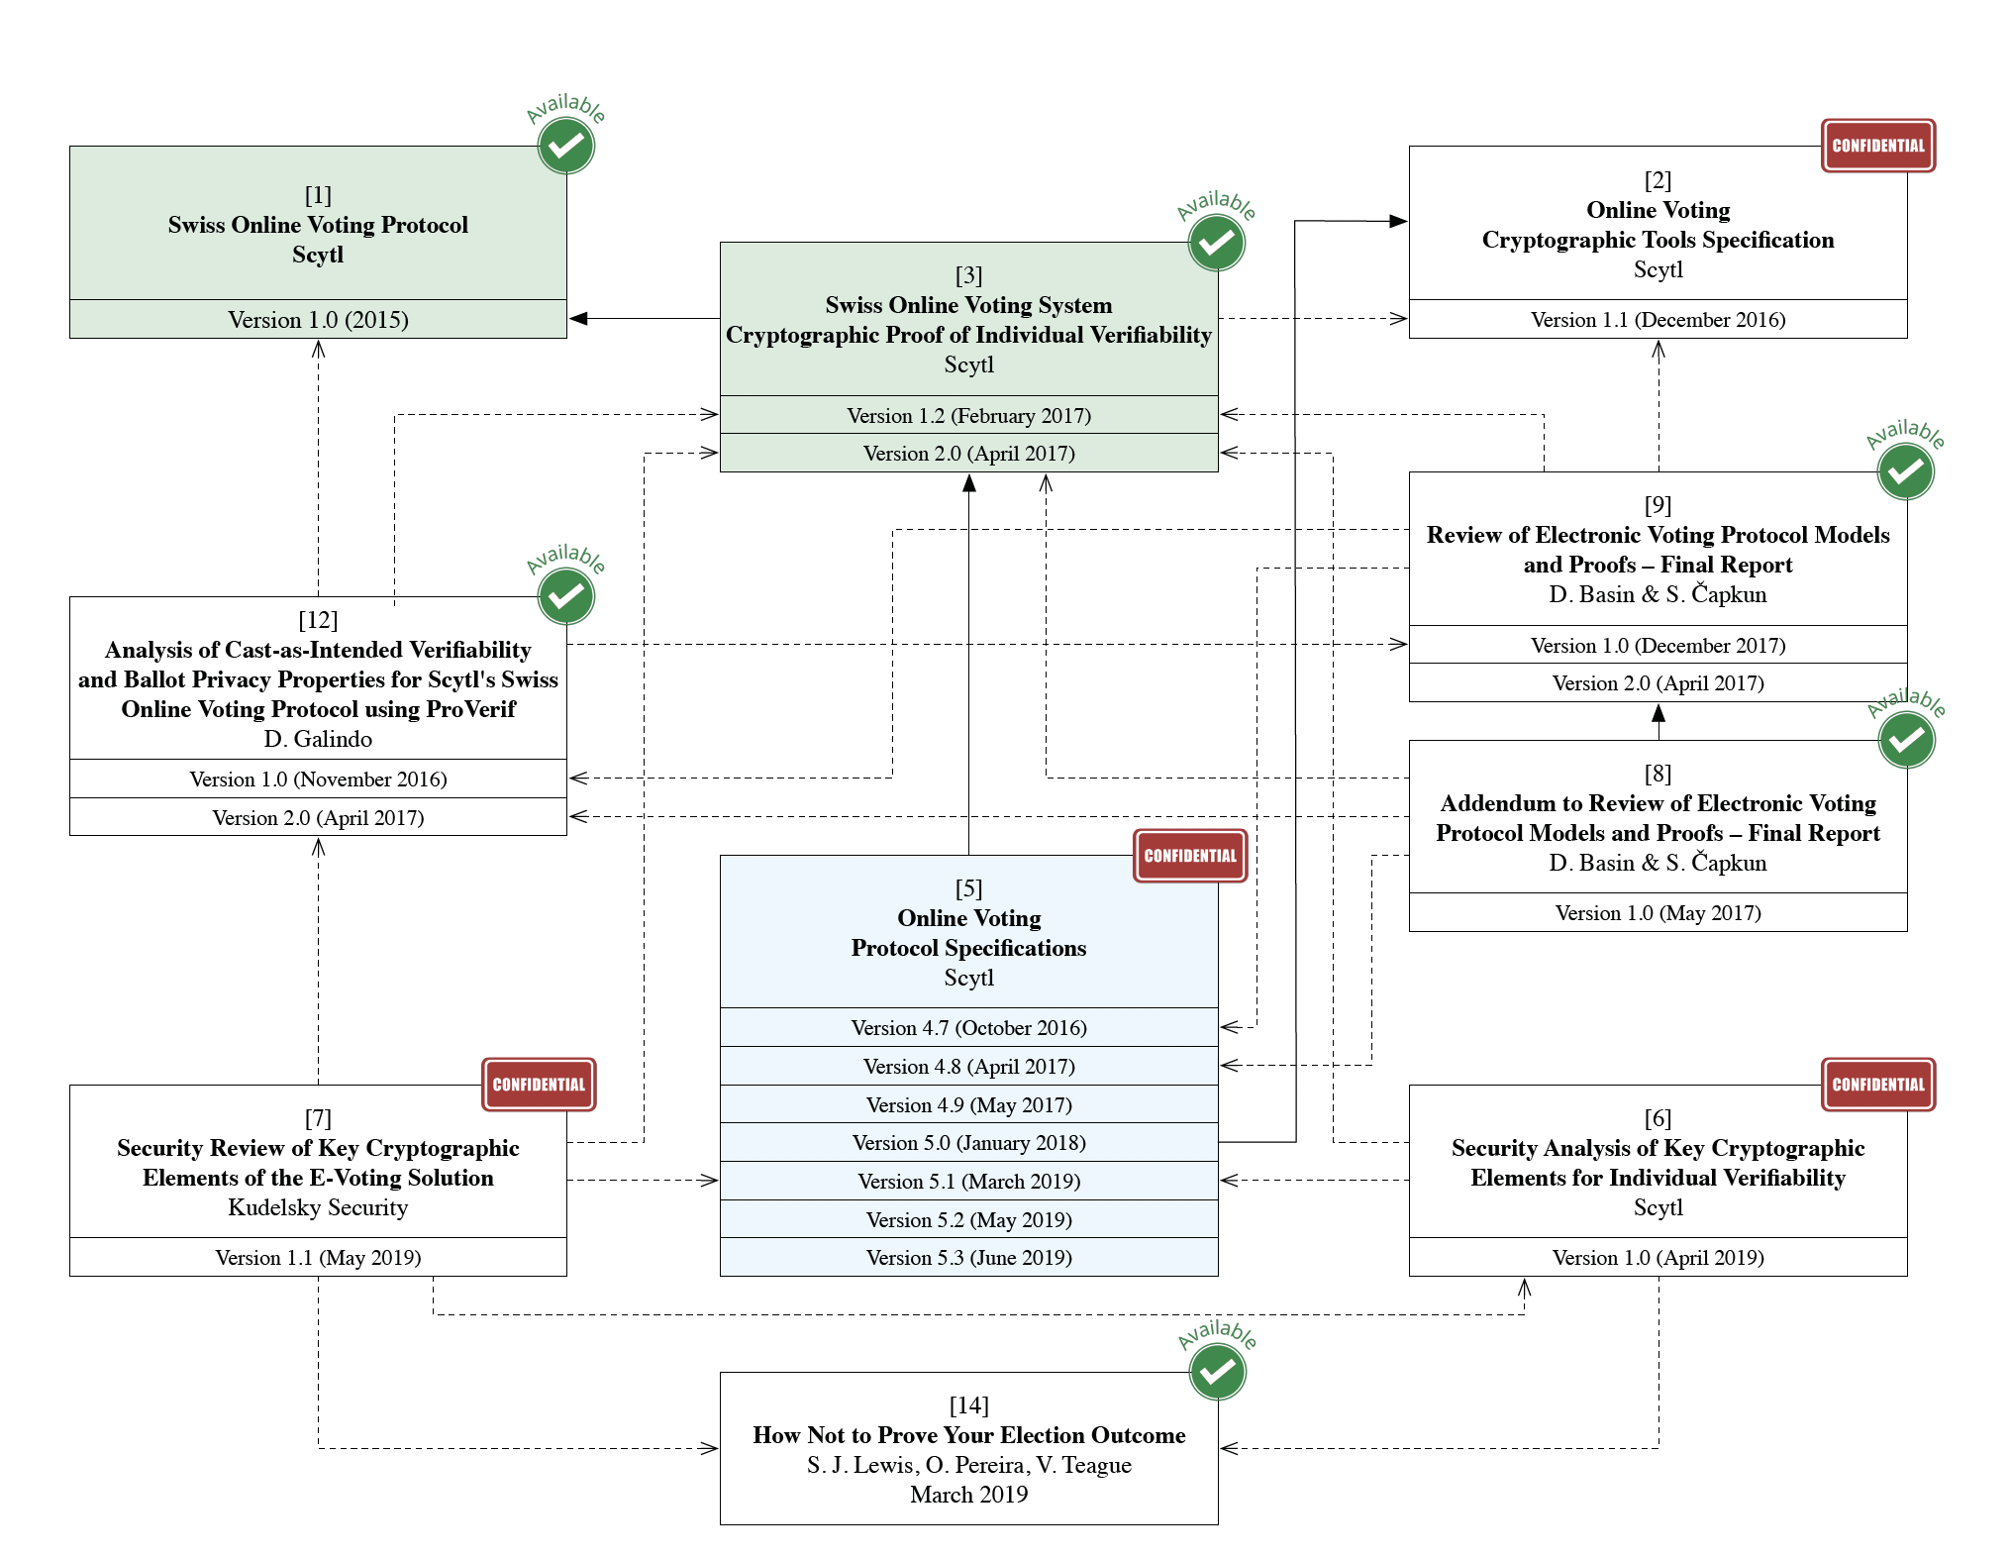
sVote Dependencies
Source: Analysis of the Cryptographic Implementation of the Swiss Post Voting Protocol, Philipp Locher, Rolf Haenni, Reto E. Koenig, https://www.bk.admin.ch/bk/en/home/politische-rechte/e-voting/berichte-und-studien.html
Notes:
Hier schon die Anker werfen in Richtung „Cast as Intened“ auftaucht, Ballot Privacy
Security Review auffassen – die Technischen Funktionen und deren Praktische Bedeutung an zwei solchen Blöcken aufziehst – die öffentliche Diskussion anzufeuern

Slide 18
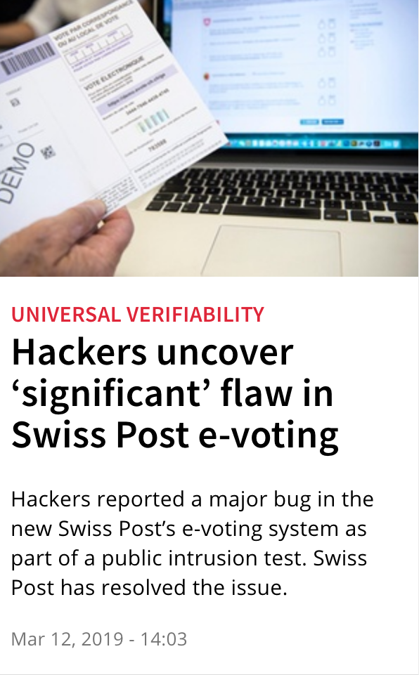
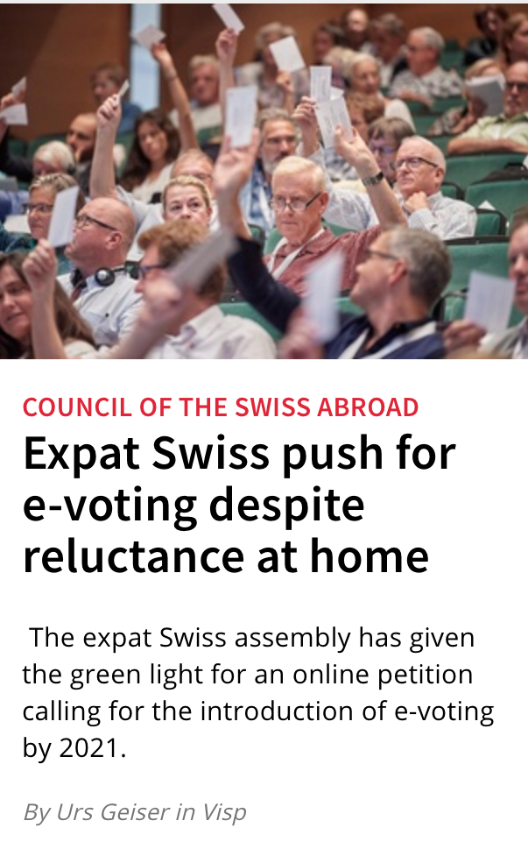
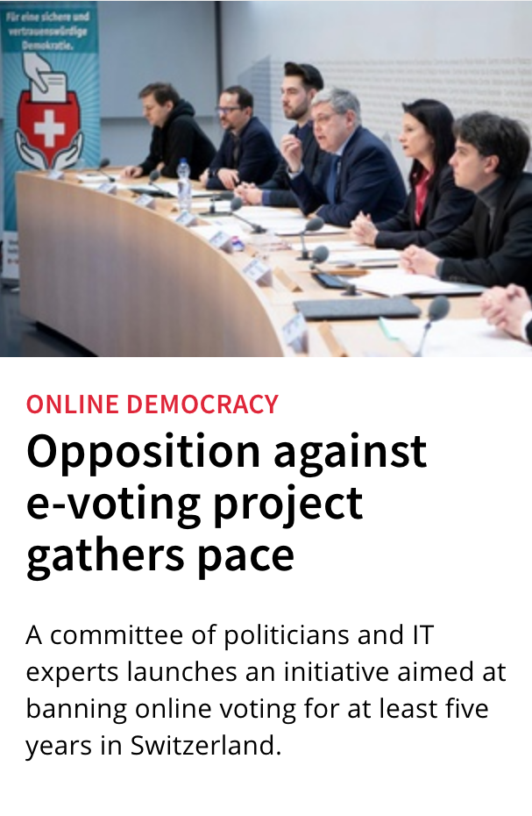
Current Situation in Switzerland
Notes:
So, you might wonder, Why do we care about Remote Electronic Votign in Switzerland?
We already have a Remote Postal Voting System, meaning vote casting is already done in a remote setting, by default.
Also, there’s diverging sentiments towards REV in Switzerland.

Slide 19
Electronic Voting (EV)
  Definitions and Notions with a Global Overview on EV
  History of Switzerland and REV
  Focus on Remote Postal Voting (RPV) in Switzerland
Notes:
Dritter Teil, wir wollen reinschauen wie sicher dass das RPV wirklich ist, um eine Vergleichsbasis haben – hypothetisch formulieren
19

Slide 20


Advertisement on Public Initiative
Swiss public initiative on a “Secure and trusted democracy”
Notes:
20-21 eventuell zu spezifisch
CK: Political Debate that partially initiated this work.
In CH Initiative to "temporarily ban" REV efforts

Slide 21
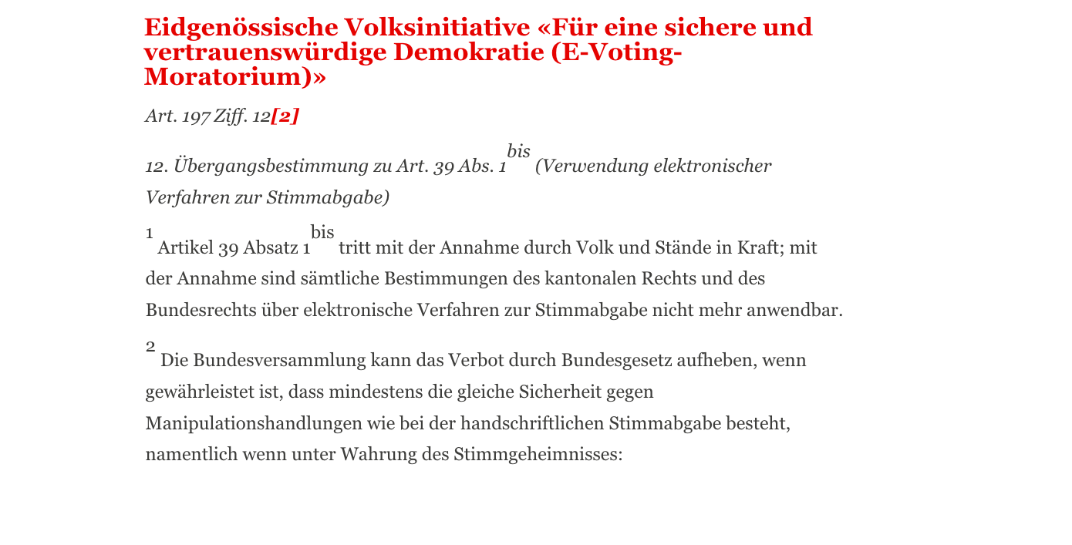
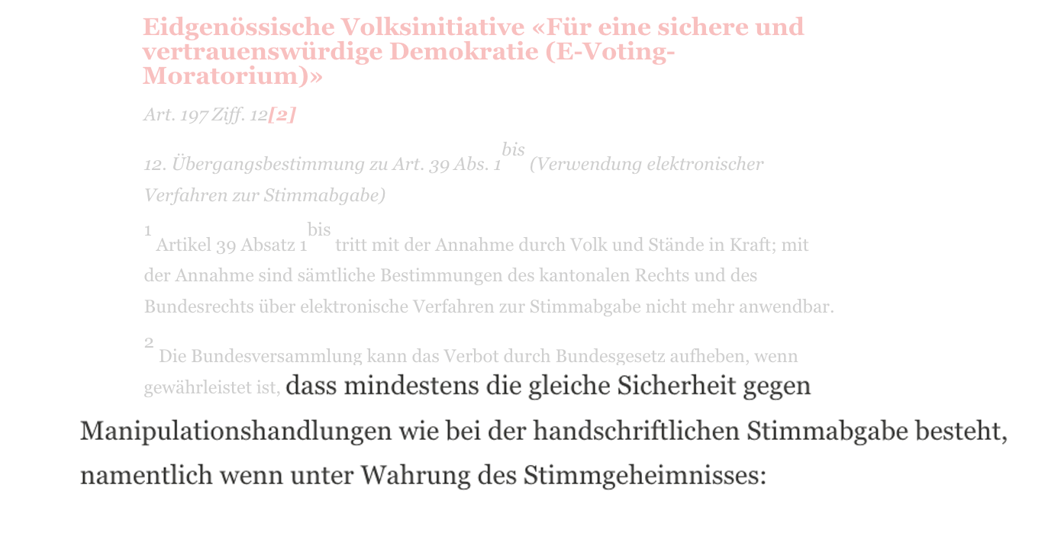
Proposed Law
... if it is guaranteed that at least the same security against manipulation exists as in the case of hand-written voting ...
Notes:
CK: Initiative clearly states: "ban can only be lifted, when traditional voting methods are as secure against tampering as handwritten ballot casting"
Key Question: what exactly does such a minimal level of security involve? Which security metrics and mechanisms are mandatory?

Slide 22

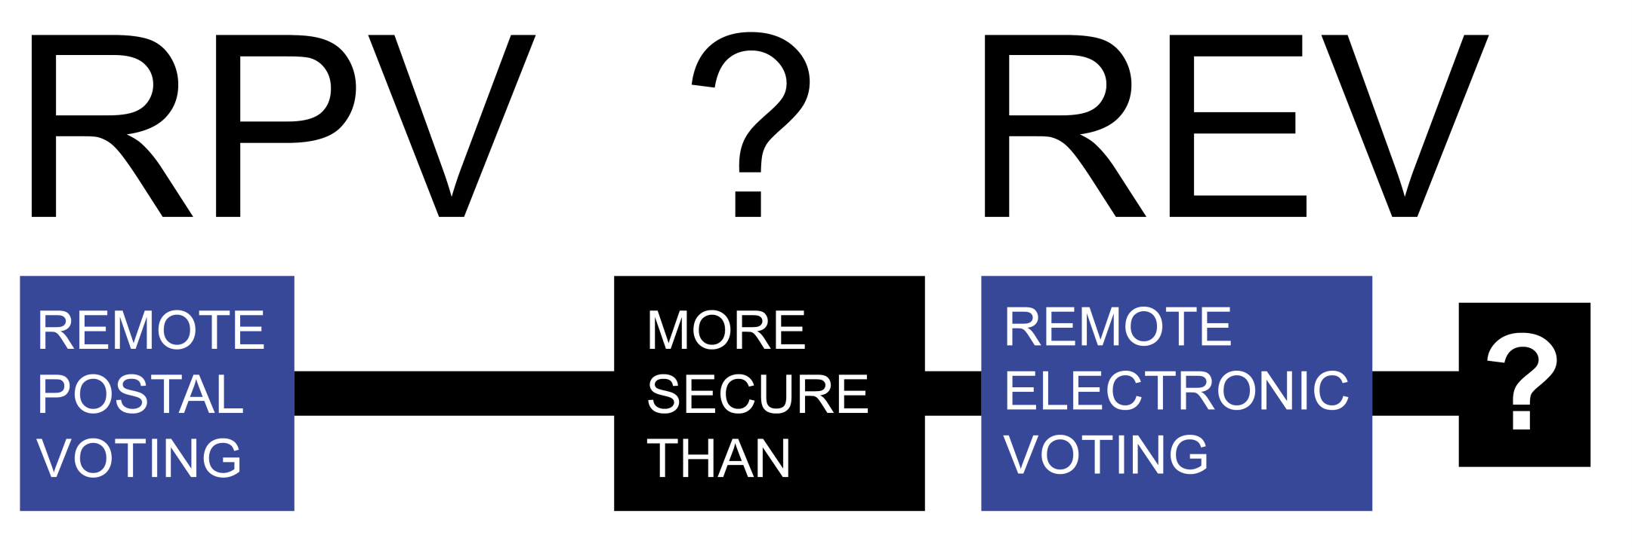
Comparing “Systems“
Notes:
Zeitplanung sehr genau machen wie lange man braucht
CK: Provocative - So it's clear, right: RPV is more secure than REV.
But is it really? What's the full picture?

Slide 23
The Swiss RPV Case
The Swiss RPV is fragmented and difficult to generalize, due to federalism in Switzerland, autonomy, and involvement of many external suppliers
Goal:
To identify weaknesses of RPV to allow for “hardening” of the RPV through security and risk assessment.
  Disclaimer: Focus on generalization, may not cover all cantons and processes exactly, leaves room for exceptions.
  Many exchanges with Swiss authorities and external suppliers
[ KS19] C. Killer, B. Stiller: The Swiss Postal Voting Process and Its System and Security Analysis, E-VOTE-ID 2019
Notes:
CK: So, in a more formalized manner
The Swiss RPV is fragmented, difficult to generalized due to federalism.
Autonomy and Involvmenet of many stakeholders, authorities and external suppliers.
Goal: Penetration Testing approach, Disclaimer again

Slide 24

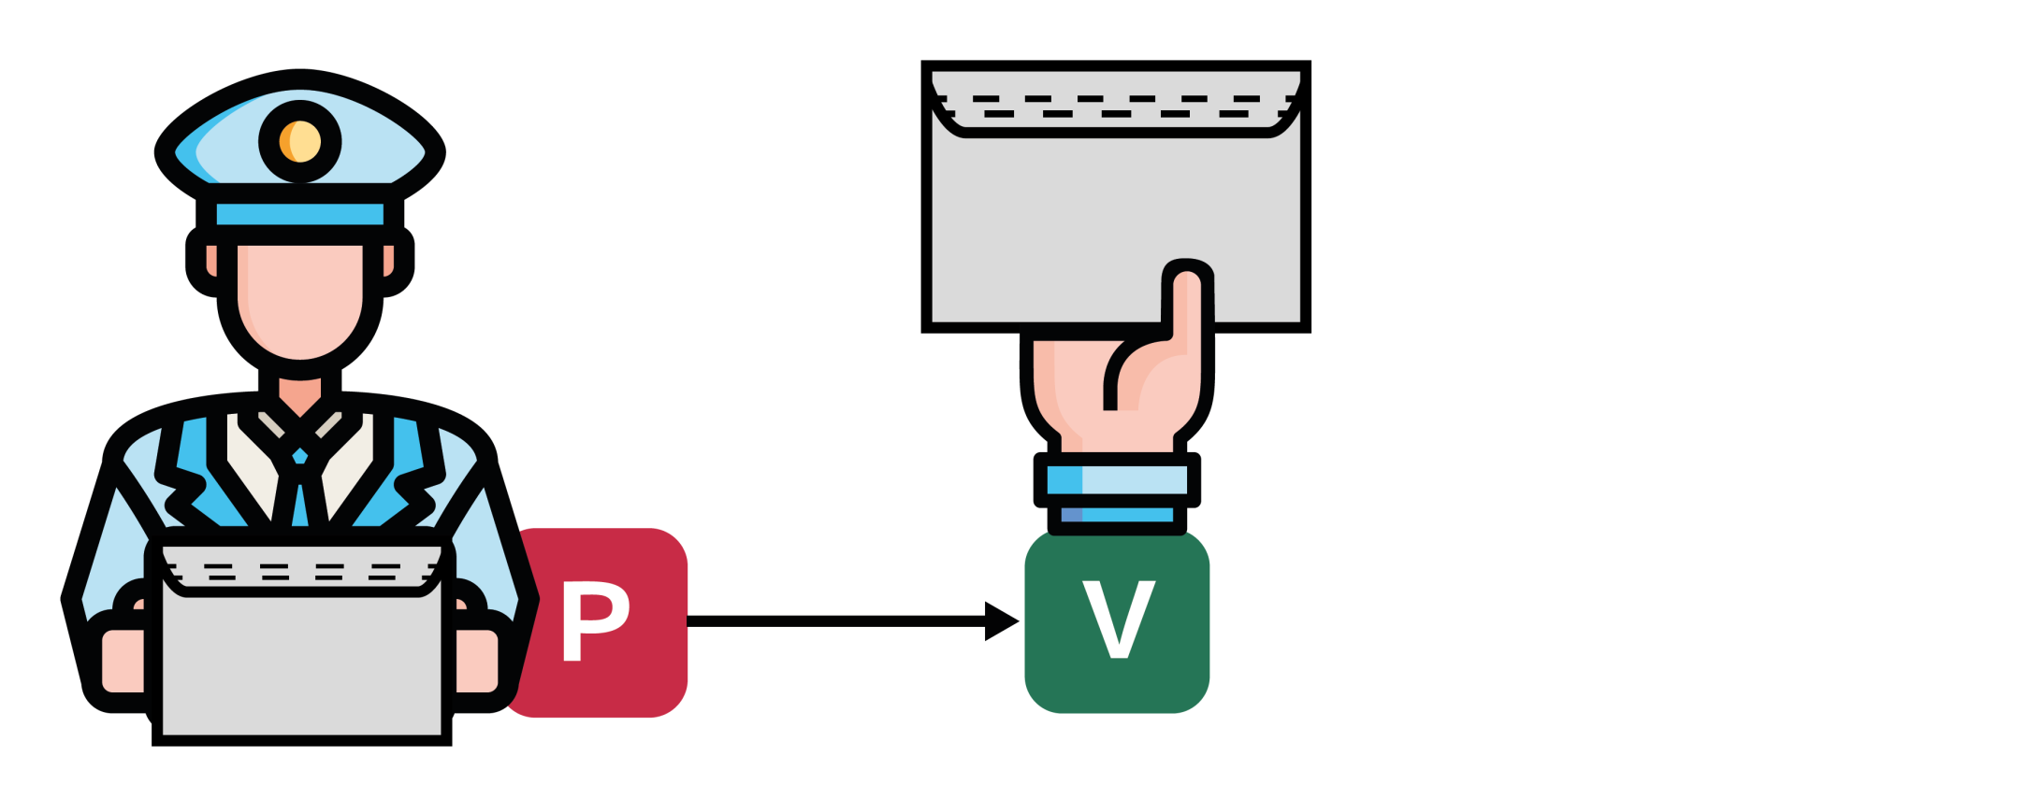
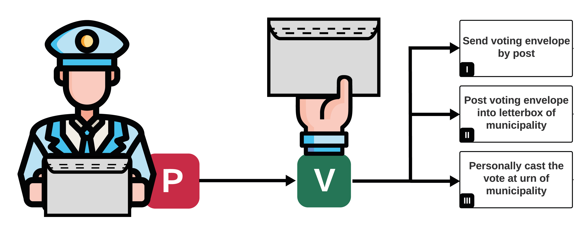
RPV From a Voter’s Perspective
RPV: Remote Postal Voting
Notes:
CK: From a voter's perspective

Slide 25
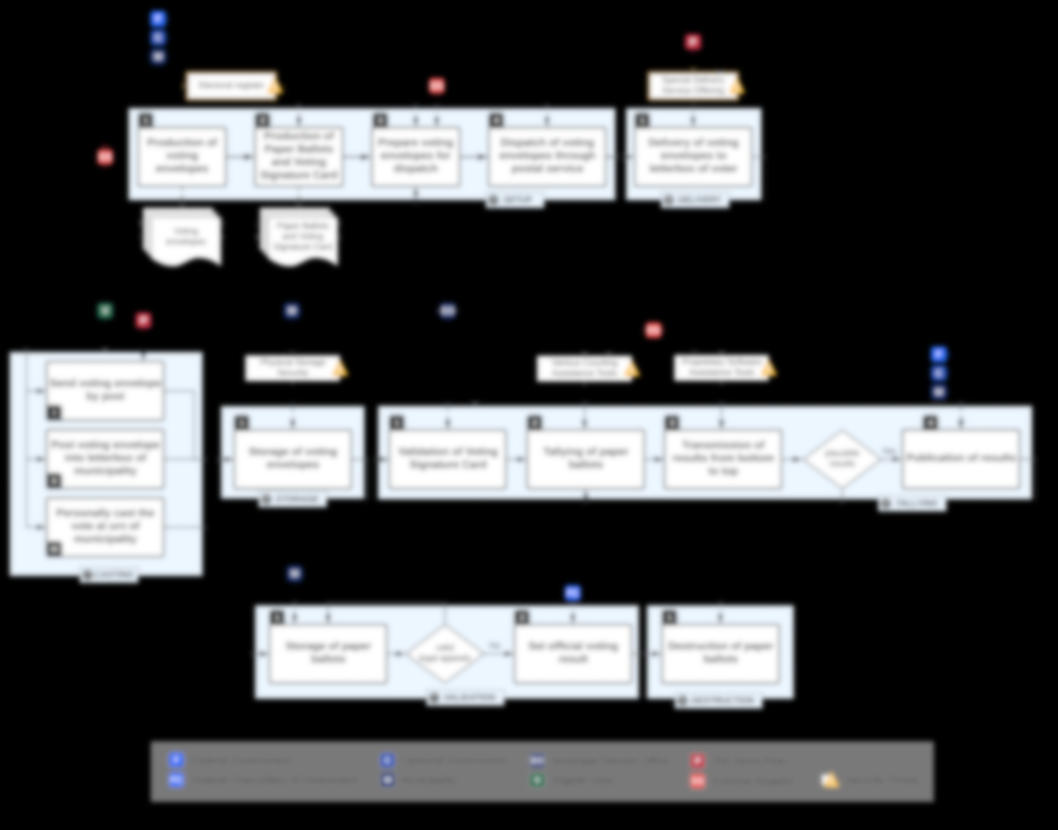
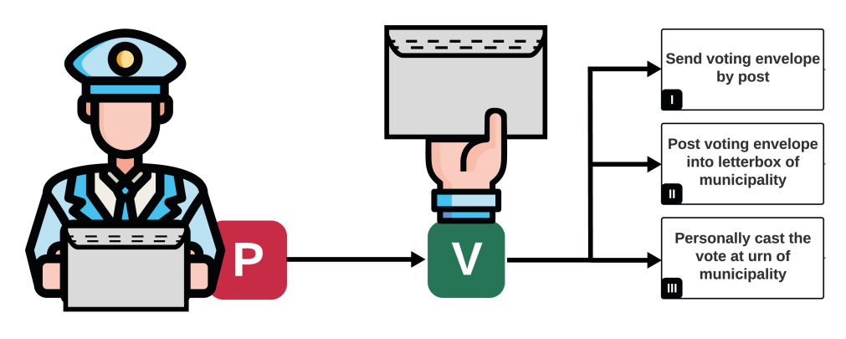
PVPF: Postal Voting Process Flow
Notes:
CK: As seen: this decision is just one part of a huge process flow
This talk will focus on clarifying the image of the process.

Slide 26




















Identification of Stakeholders
Federal Government
?
Federal Chancellery
Cantonal Government
?
Municipality
?
Municipal Election Office
Eligible Voter
?
The Swiss Post
External Supplier
Security Threat
Notes:
CK: So let's identify stakeholders, we only have two by now. But who are the others??

Slide 27
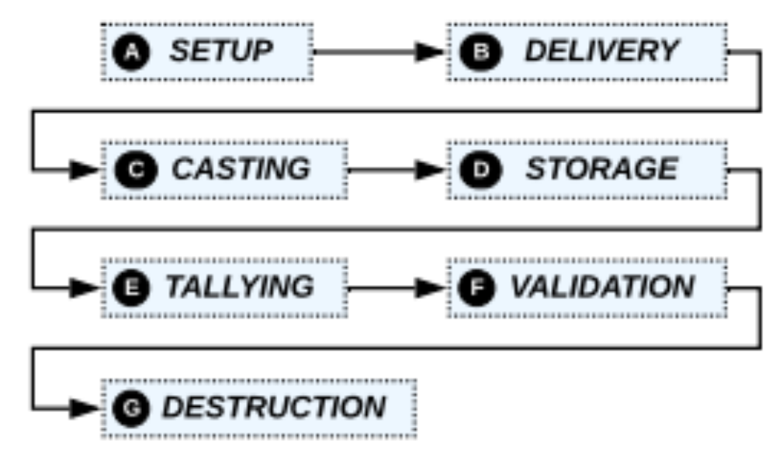
PVPF Phases
Divided into phases A to G with various stakeholders
Federal Government
Federal Chancellery
Cantonal Government
Municipality
Municipal Election Office
Eligible Voter
The Swiss Post
External Supplier
Security Threat
PVPF: Postal Voting Process Flow
Notes:
CK: Now let's map the process out, we have A to G

Slide 28
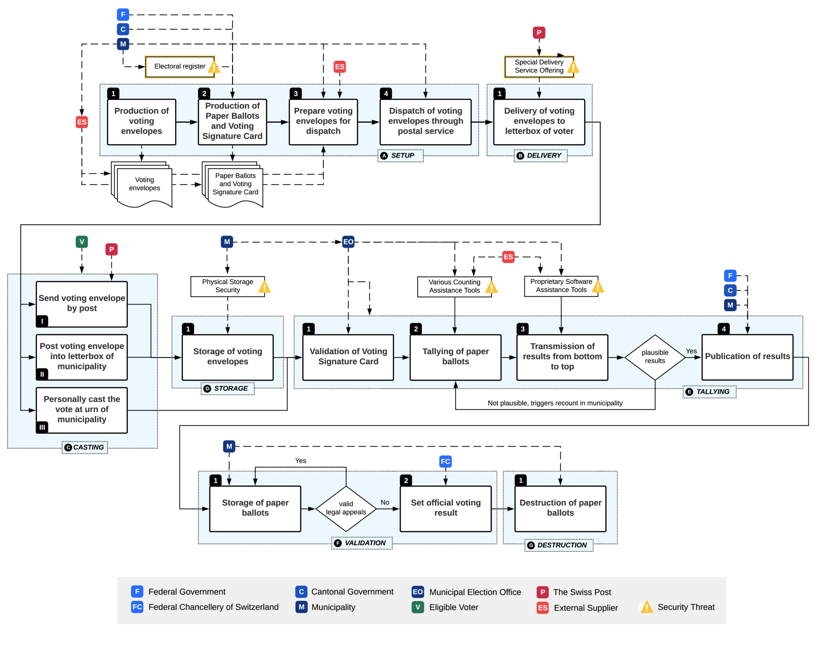
PVPF in Detail (1)
PVPF: Postal Voting Process Flow
[ KS19] .
Notes:
CK: As seen: this decision is just one part of a huge process flow
This talk will focus on clarifying the image of the process.

Slide 29
PVPF in Detail (2)
PVPF: Postal Voting Process Flow
Notes:
CK: Let's widen the scope, we already had the top third. Now we look at the middle lane.

Slide 30
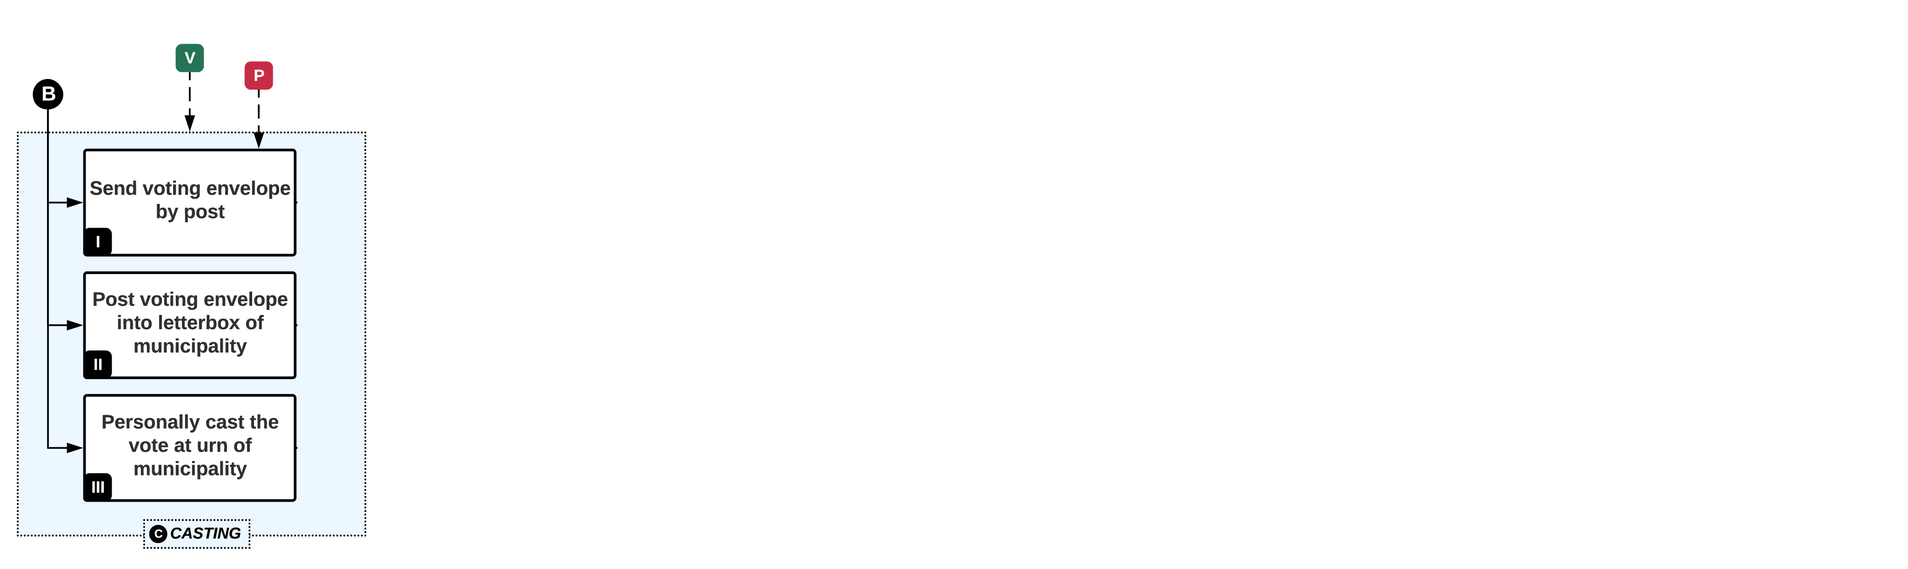
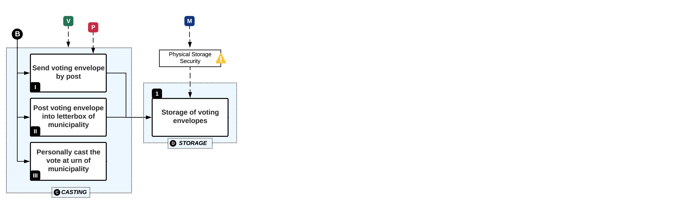
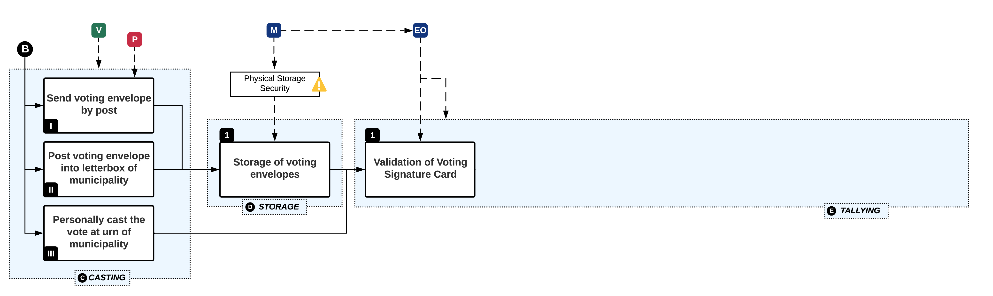
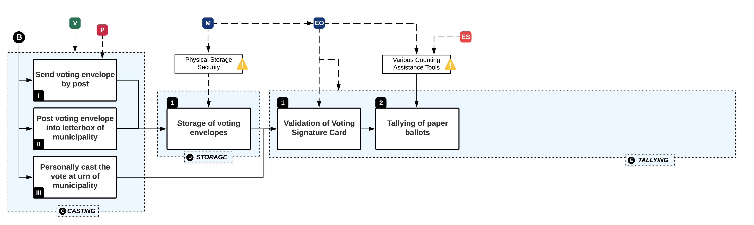
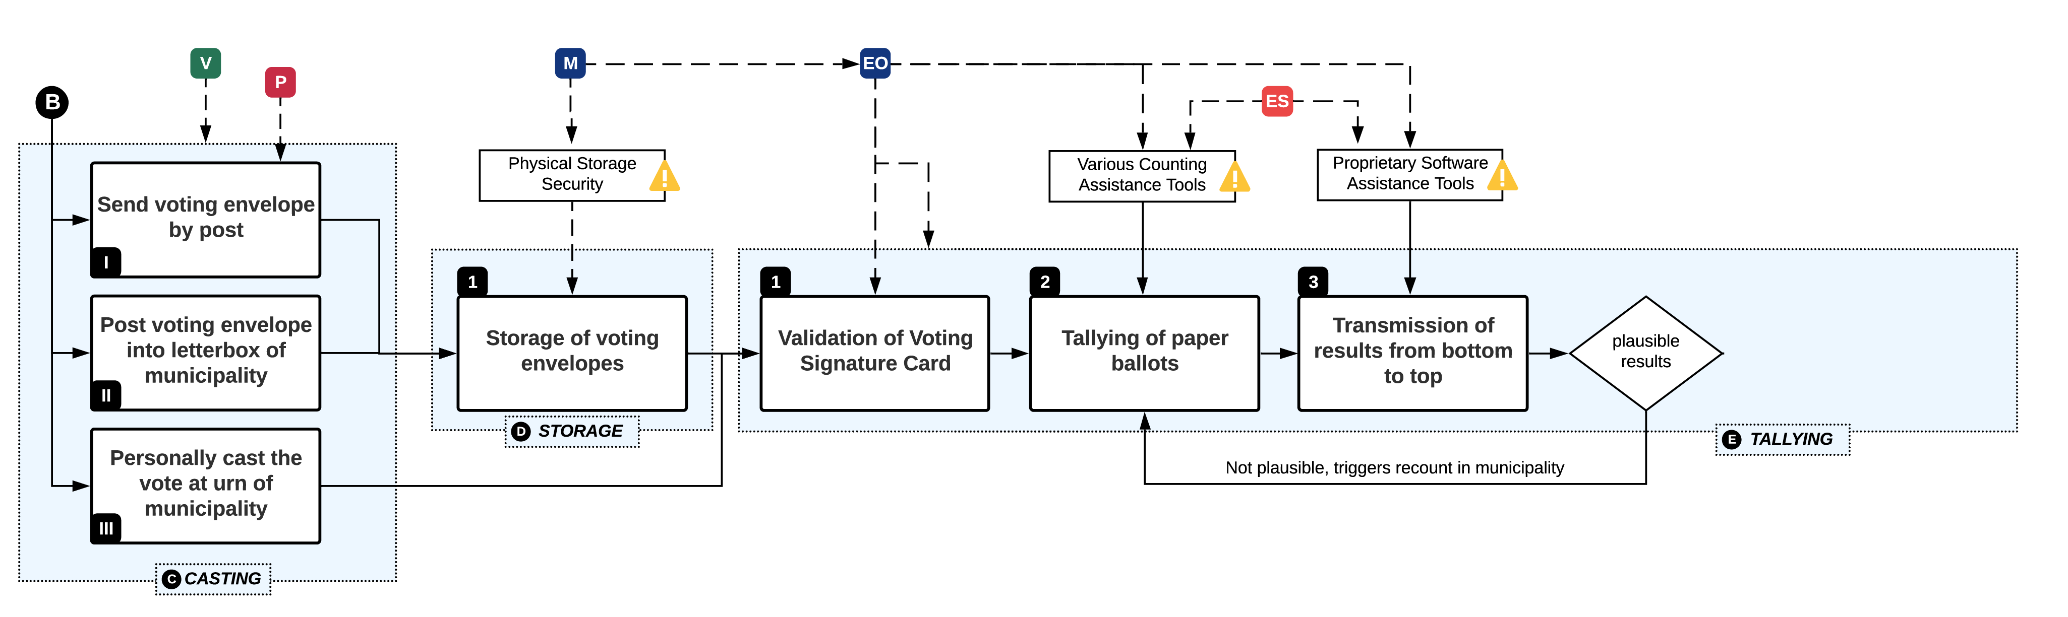
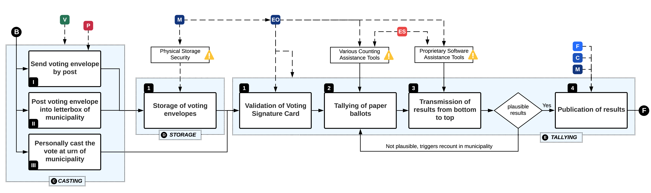
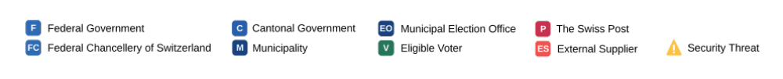
C: Casting, D: Storage, E: Tallying
Notes:
CK: Freestyle

Slide 31




C: Casting, D: Storage, E: Tallying
THREAT EVENTS
TE10: Cast stolen or forged VEs
TE9: Re-route VEs
TE12: Manipulate tallying
TE11: Access stored VEs
TE13: Manipulate final tally
TE8: Steal casted VEs from municipal letterbox
Notes:
Explizit threat events erwähnen – Risk assessments,
Individual threats, individuell markiert
Was zeichnet diesen Threat denn aus, intern, extern
Einfach dem Zuhörer die Chance geben beispielhaft ins Detail gehen
ML: Focus on TE11, 12, 13 – which are split up across the next three slides

Slide 32

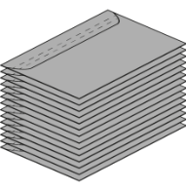
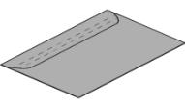
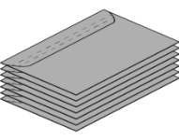
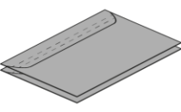
C: Casting, D: Storage, E: Tallying
THREAT EVENTS
TE12: Manipulate tallying
TE11: Access stored VEs
TE13: Manipulate final tally
Notes:
ML

Slide 33


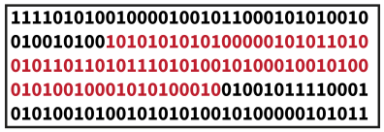



C: Casting, D: Storage, E: Tallying
THREAT EVENTS
TE12: Manipulate tallying
TE13: Manipulate final tally
Notes:
ML

Slide 34
Conclusions on the Swiss RPV
The Swiss RPV system
  Heterogeneous process with cantonal variations 😐
  Substantial trust in third parties ☹
  Distribution of trust and physical decentralization ☺
How can a new design of an electronic voting system distribute trust?

Slide 35
Remote Electronic Voting (REV)
  REV Requirements and Properties
  Security Building Blocks
    Homomorphic Encryption, ZKP, PBB
Notes:
35

Slide 36
REV Requirements
Privacy
  A vote must not identify a voter and any traceability between the voter and its vote must be removed
Verifiability
  A voter should be able to verify if its vote was correctly recorded and accounted for in the final vote tally
Absolute privacy (no information leaks) cannot coexist concurrently with verifiability (sufficient information leaked to verify the result)
  Goal of voting system design is to find a way to enable as much privacy and verifiability simultaneously as possible
Notes:
Theoretisch möglichst breit aufstellen
Beides zusammen geht nicht

Slide 37
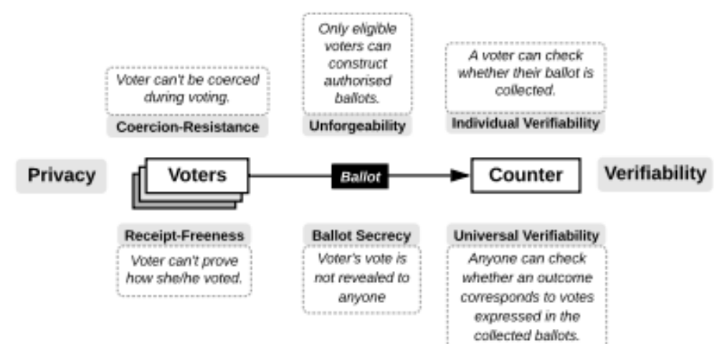
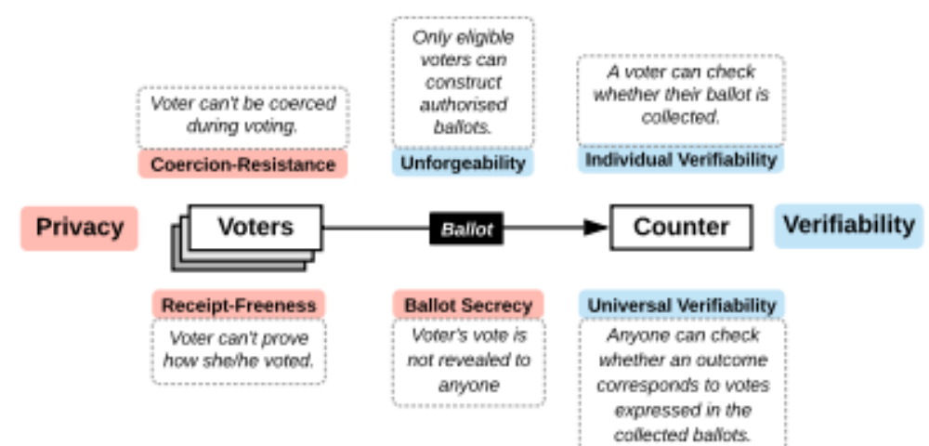

Voting and Electoral Processes
Notes:
Zeit lassen – Zuhörer aber eher keine Ahnung – Zuhörer Zeit lassen
Aber einzeln durchgehen
Explain what is “coercion-resistance”

Slide 38

Privacy and Verifiability Notions
A voter cannot gain information which can be used to prove, to a coercer, how she voted.
A voter cannot collaborate, with a coercer, to gain information which can be used to prove how she voted.
A voter’s vote is not revealed to anyone.
Against:
Forced abstention,
Forced randomised voting
Forced to give up voter credential
A voter can check whether their ballot is collected.
Anyone can check, whether an outcome corresponds to votes expressed in ballots collected.
Notes:
Eine Linie mit und eine ohne Referenzen
Related work

Slide 39

End-to-end Verifiability
End-to-end Verifiability “consist” of:
  Cast-as-Intended
    The voter’s choice was correctly denoted on the ballot by the system
  Recorded-As-Cast
    The voter’s ballot was received the way she cast it
  Count As Recorded
    The Voter’s ballot counts as received

Slide 40
Fairness and Unforgeability
Fairness
  concerns the impossibility to deduct a partial tally, before the end of the vote casting period.
  REV schemes should not allow for intermediate results, which potentially influence voters that have not voted yet.
Eligibility Verifiability
  ﻿anyone can check that each vote in the election outcome was cast by a registered voter and there is at most one vote per voter
Unforgeability
  ﻿Only eligible voters can construct authorized ballots.

Slide 41
Software Independence
Software Independence
  A voting system is software-independent if an undetected change or error in its software cannot cause an undetectable change or error in an election outcome
Addresses the difficulty of verifying
  Complex software in a completely electronic voting systems
Problem: providing assurance that the voting software is in fact correct
  Verify the election results, not the voting system

Slide 42
Refinements of Software Independence
Weak Software Independence
  A voting system that is weakly software-independent conforms to the basic definition of software-independence, that is, there is no recovery mechanism
Strong Software Independence
  A voting system is strongly software-independent if an undetected change or error in its software cannot cause an undetectable change or error in an election outcome, and moreover, a detected change or error in an election outcome (due to change or error in the software) can be corrected without re-running the election
Notes:
Hier einen Übergang machen
Was sind die Building Blocks

Slide 43
REV Building Blocks
Secret-Ballot Voting Schemes, i.e., voting protocols describing the process
Cryptographic Primitives, i.e., procedures used in the protocols to assure privacy and verifiability
Public Bulletin Board (PBB), i.e., ballot box saving all results and logs of the procedures, making the process verifiable

Slide 44

Secret Ballot Voting Schemes
BP: Ballot Privacy
RF: Receipt-
Freeness
CR: Coercion-
Resistance
EBP: Everlasting
Ballot-Privacy
IV: Individual
Verifiability
UV: Universal
Verifiability
BS: Blind Signatures
HE: Homomorphic
Encryption
MC: Multiparty
Computation
MN: Mixnet
CS: Commitment
Scheme
Based on H. Jonker :
“Privacy and Verifiability in Voting Systems” 2013
Notes:
2-3 Systeme erwähnen mit den Unterschiedlichen Ideen und Properties
IV, UV – add to list on right

Slide 45

Encrypt and Sign
What about privacy? Do we decrypt each ballot, verify the signature and just count?

Slide 46

Two Agencies Model
Trusted
E.g., Blind Signatures
Can achieve Ballot Privacy and Universal Verifiability

Slide 47

Homomorphic Tallying
Can achieve Ballot Privacy, Individual and Universal Verifiability
Threshold crypto can be easily applied

Slide 48

Mixnet
Either Re-Encryption or Decryption Mixnet
Can achieve Ballot Privacy, Individual and Universal Verifiability
More flexible than HE, supports write-ins
Notes:
One can see the ballot entering the Mixnet, and you can verify the result by checking the verifiable mixnet ZKPs

Slide 49
Remote Electronic Voting (REV)
  REV Requirements and Properties
  Building Blocks
    Homomorphic Encryption, ZKP, PBB
Notes:
49

Slide 50


Building Blocks for REV Schemes
Non-Interactive Zero-Knowledge Proof of Ciphertext Validity
Additive ElGamal Homomorphic Encryption
Public Permissioned Blockchain
I
II
III

Slide 51

Homomorphic Encryption (1)
I
A public key cryptosystem
$$E=(KeyGen, Encrypt,Decrypt)$$
  Is homomorphic if there are these additional operations:
    An operation $+$ on the message space
    An algorithm $Add$ that takes a public key $pk$ and two ciphertexts $c1,c2$ and outputs another ciphertext $s$
    The correctness condition is that for any message $m1,m2$the following returns $d=m1+m2$:
  $$\left(pk,sk\right)←KeyGen()$$
  $$c_{1}←Encrypt\left(pk,m_{1}\right)$$
  $$c_{2}←Encrypt\left(pk,m_{2}\right) \\ c=Add\left(pk,c_{1},c_{2}\right);$$
  $$d=Decrypt\left(sk,c\right);$$
RED: Secrets, should never be divulged to anyone.
BLUE: public information, are known to everyone
Notes:
Title ändern
HE (1) HE(2) in title
Refactor and use as intro and then 51

Slide 52

Homomorphic Encryption (2)
I
Homomorphic Encryption (HE)
${enc}_{k }\left(m_{1}\right)⨂{ }{enc}_{k }\left(m_{2}\right)=$ ${enc}_{k }\left(m_{1}⨁{ m}_{2}\right)$
      $⨂{ }appropriate operation on ciphertext messages$
      $⨁{appropriate operation on plaintext messages}$
Allows two encrypted messages to be combined meaningfully (by using $⨁$)
The actual operations represented by and $⨁$ depend on the used cryptographic system.
  A variant of ElGamal, called exponential ElGamal, provides additive homomorhic properties.
Notes:
Title ändern
refactor

Slide 53


Homomorphic Encryption (3)
I
In REV, HE used to tally votes
Every eligible voter $V$ can encrypt his or her $vote$ using the election public key $pk$, resulting in the encrypted vote: ${enc}_{pk }$(${vote}_{V}$).
No individual votes need to be decrypted, because the votes can be added together homomorphically.
Thus, the final, encrypted tally is
${enc}_{pk }\left({vote}_{1}\right)⨂{…⨂{ }}{enc}_{pk }\left({vote}_{n}\right)=$ ${enc}_{pk }\left({vote}_{1}⨁…⨁{ vote}_{n}\right)$
Notes:
Title ändern
refactor

Slide 54
Proving Ciphertext Validity
II
But how encryption malleability tackled?
  I.e. What happens if 100 instead of 1 is encrypted?
  In search of a solution to assure the validity of the ciphertext, while assuring Ballot Privacy at the same time
Zero Knowledge Proofs!
  Each voter proves that she cast a valid vote, without revealing her/his vote
  Authorities prove that they know their secret keys (that match the election public keys), without revealing their secret keys
  At the end of the election, authorities prove that they have tallied correctly (decrypted the results correctly), again without revealing their secret keys

Slide 55

Zero Knowledge Proofs
II
Zero Knowledge Proof (ZKP) is a proof of a statement $s$ which reveals nothing about statement $s$, except that it is true
  With the use of a ZKP system, a prover $P$ can convince a verifier $V$ via an interaction that some statement $s$ is true.
Non-interactive ZKP (NIZKP)
  This relies on the prover generating a (to him) unpredictable challenge (which cannot be tweaked) based on his commitment and public knowledge, such as the hash of the commitment.
  In REV: NIZKPs enable a voter to verify that her vote is valid, being able to prove to an outsider what she voted.

Slide 56

Ali Baba‘s Cave (1)
II
The cave has a single entry and is shaped like a ring with two paths
(A and B) and contains a hidden door separating the two paths
Peggy (P – “prover”) knows the password to open the hidden door but does not want to reveal it
To prove to Victor (V – “verifier”) that Peggy knows the password, Peggy enters the cave and chooses a path

Slide 57
Ali Baba‘s Cave (2)
II
Next, Victor enters the cave and demands that Peggy exits the cave using path A or B, chosen at random
  On one hand, since P knows the password, it is trivial for her to pass the test
  On the other hand, would P had not known the password, she would have had a 50% chance only of returning from the path demanded

Slide 58
Ali Baba‘s Cave (3)
II
Victor can challenge Peggy multiple times, thereby, decreasing the probability of Peggy being a fraudulent “prover”
  For each challenge the probability decreases by a factor of two
  Therefore, Victor can repeat this process as many times as deemed necessary, until the desired level of confidence is obtained

Slide 59


Achieving Privacy with HE and ZKPs
II
Ballot Privacy achieved by encrypting with the public election key, and proving validity with NIZKPs
  Thus, no individual ballot needs to be decrypted and authorities keep their secret election keys private, while homomorphically tallying the final result
How can voters verify election data?

Slide 60
Public Bulletin Board (PBB)
III
PBB serving as a
  shared, append-only data structure
  public and searchable by anyone
  consistent view for anyone accessing its information
In practice, a public permissioned Blockchain (BC) fulfills those theoretical requirements
[KRM20].
Notes:
Optisch erkennbar 1,2,3 und das ist das dritte, oder nochmals
The Public Bulletin Board is a central component of any REV system
Serving as a shared, append-only data-structure (immutable)
Therefore, a scientific contribution of this thesis is the actual design and implementation of BCs as PBBs, and the evaluation with which schemes, privacy assumptions that is actually compatible

Slide 61


Public Permissioned Blockchain (BC)
III
Deployment of a Public Permissioned BC
  Read operations: Public
  Write operations: Permissioned
[KRM20].

Slide 62


The Swiss Scenario
The Federalism of Switzerland serves as a suitable framework for a decentralized BC-based REV system
[KRM20].
Notes:
Cantons have authority over the political system
The political system is under the authority of the cantons, i.e., cantonal laws
and ordinances regarding political rights dene elements for these processes.
Various aspects of those elements are relevant for the RPV system in Switzer-
land, and each canton has its own decrees regarding political rights. The federal
structure is mirrored down to the municipal level: each municipality decides
on certain processes, again, aligned to cantonal laws and decrees. For instance,
keeping record of the electoral register is under the authority of municipalities,
leading to di
erent approaches.

Slide 63

Proof-of-Authority (PoA) Consensus
Consensus Algorithm: Clique Proof-of-Authority (PoA)
  EIP 225, used in Rinkeby since 2017
Leader
Co-Leader
Notes:
Epochs – Fixed Time Periods
During an Epoch, a fixed set of nodes is
authorised to sign and broadcast blocks: One leader and a number of co-leaders.
Nodes recognize their role by calculating whether their respective index in the list of authorities is considered a leader or co-leader for the current epoch.
Figure 1 shows an example where the block period is set to two, so in that instance, two co-leaders
are always defined during each epoch. Upon receiving a new transaction, tn, nodes validate parameters
of tn for correctness, while also verifying that tn is not yet persisted in the local storage to avoid processing duplicate transactions. If
the node is leader or co-leader for the current epoch, the node
appends tn to the local storage T, which contains a pool of all
transactions waiting to be summarized to a block. Further, the
received transaction is broadcast to all to propagate the transaction

Slide 64
Blockchain-based REV
  Instructions for local deployment (Practical Part)
  Provotum Stakeholders, Voting Protocol and Evaluations
Notes:
64

Slide 65
Practical Part
To follow along the next steps on your own system, please refer to the guide provided at
  http://bcbev.ch/icbc20
  Project implemented in Typescript and Solidity, organized as Monorepo, dockerized environment
Prebuilt docker application available, by executing ./docker-prebuilt-up.sh
  Works on Windows or Linux, not on macOS (docker network)
  Make sure to set up your github.json with an access token, otherwise you cannot pull from GitHub Packages
Notes:
Wir haben den praktischen Tutorial eingebaut und technisch vorbereitet weil das interaktive keine Zeit hat und argumentation kurz halten, key points – not straightforward to adapt

Slide 66
Blockchain-based REV
  Instructions for local deployment (Practical Part)
  Provotum Stakeholders, Voting Protocol and Evaluations
Notes:
66

Slide 67

BC-based REV System: Provotum
Sealers are operated by cantonal or municipal election offices
The Access Provider funds Ethereum Account by verifying valid token (provided by Identity Provider to the voter)
Proof-of-Authority Consensus provides a Public Permissioned BC
Voting Authority, manages the voting or election (e.g., defines voting question, opens voting)
The Identity Provider authenticates Voters‘ identities according to Electoral Register (list of eligible voters)

Slide 68

Provotum 2.0 Identity Provisioning
performed
Identity Provisioning not part of the official voting steps and
A shuffled list of tokens is provided to the Access Provider
Tokens will be used as a means to assure eligibility
Electoral Register (list of eligible voters) is provided to the Identity Provider, who generates a token for every voter
Disclaimer: Out of scope of the voting protocol, experimental process only to make the system run!

Slide 69

Voting Protocol: Registration (1)
Sealer Sign-Up and Automated PoA Bootstrapping
performed
In this step, each Sealer will register the public wallet address with the Voting Authority

Slide 70

Voting Protocol: Registration (1)

Slide 71

Voting Protocol: Pairing (2)
PoA Bootstrapping, where the appropriate Genesis Block is retrieved from the Voting Authority
The Voting Authority generates an appropriate genesis block and Sealers download it from the Voting Authority
As soon as the BC client was started with the appropriate Genesis Block

Slide 72

Voting Protocol: Pairing (2)
Notes:
Before the voting question can be defined, all Sealers need to download the Blcokchain Configuration, which is the Genesis Block

Slide 73

Voting Protocol: Key Generation (3)
Each sealer generates an ElGamal public/private keypair (sk_{i}, pk_{i}) + a Schnorr Proof (Proof of Knowledge of a discrete logarithm of r)
The Ballot Smart SC generates the Public Election Key which will be used to encrypt individual ballots by voters

Slide 74


Voting Protocol: Key Generation (3)
Each sealer submits his/her public key share
  The Schnorr Proof about the knowledge of the secret key is verified
If the proof is valid and the sealer has not submitted yet, the public key share is stored

Slide 75


Voting Protocol: Key Generation (3)
As soon as all public keys $pki$ had been submitted by the Sealers
The public election key is calculated by forming a product of all public keyshares.

Slide 76

Voting Protocol: Key Generation (3)

Slide 77

Voting Protocol: Voting (4)
(4) The Access Provider verifies the token and funds the public address on the PoA chain
(3) Each Voter submits their token with their public address that will be used for vote submission
(1) Each Voter authenticates with the Identity Provider and (2) receives their individual vote token
(5) Each Voter encrypts their vote, including a NIZKP, proving validity of the ciphertext, and sends it to the Ballot SC

Slide 78

Voting Protocol: Voting (4)

Slide 79

Voting Protocol: Voting (4)
Initial checks if
  Voting is open
  Voter is eligible
  Voter did not vote yet
  Voter sent valid vote
If everything accepted, the vote containing the sender, ciphertext, and proof is pushed to the ballot box

Slide 80

Voting Protocol: Tallying (5)
(3) Once all sealers submitted their decrypted share and proof, the final tally can be decrypted on-chain
(1) Each sealer retrieves the votes and homomorphically tallies the result, (2) decrypting and generating a proof with the respective secret key

Slide 81

Voting Protocol: Tallying (5)

Slide 82


Voting Protocol: Tallying (5)
On each sealer
  Votes are first added
  Then tallied (decrypted), and
  Lastly a proof of correct decryption is generated as well

Slide 83

Voting Protocol: Tallying (5)
Next, proofs of all shares submitted are verified

Slide 84

Voting Protocol: Tallying (5)
All shares decrypted are combined
  Resulting in the final tally

Slide 85
Takeaways Provotum
REV systems require utmost scrutiny to achieve
  Highly demanding properties of
    Privacy, Verifiability, Software Independence, Fairness
    But not limited to
  Open aspects still include
    Usability or legal compliance
Leap from theory to practically deployable REV systems is significant and hard to achieve
  More research is required to evaluate the viability of establishing such a Public Permissioned Blockchain for on-chain distribution of trust across the voting protocol

Slide 86
Evaluations Provotum 2.0
E2E-Verifiability and Ballot Secrecy achieved ✓
Client-Side Cryptography ✓
On-Chain Proof Verification ✓
Distributed Key Generation ✓
Cooperative Decryption ✓
Key-Size (256-bit) not secure✗
Mitigate Identity provisioning scheme threats✗
Receipt-Freeness and Coercion-Resistance ✗
Notes:
Mention definitely red points can be mitigated

Slide 87
Summary
Notes:
Mention Switzerland
Mention Provotum as an instantiation of that why we want to distribute because we have Switzerland
87

Slide 88
Observations
REVs are country-specific
  Mainly due to local legislation
REVs overall system requirements are comparable
  Privacy and verifiability (cannot coexist in full at the same time)
  Fairness, eligibility verifiability, and unforgeability
  Software independence
REVs building blocks: strong security mechanisms
  Secret-Ballot Voting Schemes, i.e., voting protocols
  Cryptographic Primitives, i.e., privacy and verifiability procedures
  Public Bulletin Board (PBB), i.e., ballot box for results/logs
From theory to practical systems – a long way to go!

Slide 89
Considerations
Remote Electronic Voting
  If trust is distributed in REV, then REVs can offer better privacy and verifiability than traditional voting channels, under certain trust and computational hardness assumptions
    As soon as a system is public, future adversaries may be able to decrypt cipher-text
Achieving such trust distribution can be implemented by using a Public Permissioned Blockchain, where authorities collaborate with a Proof-of-Authority (PoA) consensus mechanism
Notes:
x

Slide 90

Thanks for your attention
Questions

Slide 91
Backup Slides

Slide 92

ElGamal Public-Key Cryptosystem
An ElGamal encryption scheme is a triple $(KeyGen, Encrypt,Decrypt)$ of algorithms, which operate on a cyclic group for which the Decisional Diffie Hellman (DDH) problem is believed to be hard.
  Based on the discrete logarithm problem
Public parameters which can be shared by a number of users. Thus, $p,q$ and a generator $g∈G \backslash \{1\}$
    $p$ a “large prime”, by which we mean one with around 2048 bits, such that $p−1$is divisible by another “medium prime” q of around 256 bits.
    $g$an element of $F_{p}^{∗}$ of prime order q, i.e.$g=r^{(p−1)/q} \left(mod p\right)≠1$for some $r∈F$

