Slide 1


Case Report:
Successful Transplantation of Ovarian Tissue
PD Dr. Ruth Stiller
MSc Ana Velasco
Department of Reproductive Endocrinology
University Hospital Zurich

Slide 2
Ovarian Tissue Cryopreservation at the University Hospital Zurich
2001-2021: 105 cryopreservations
  Mean age at the time of cryopreservation: 24.1 years
  Range: 2.4 - 38.5 years
35
30
27
Number of cases
7
Patient age at the time of cryopreservation

Slide 3
Patient Background
28 yrs Pat. with classical Hodgkin Lymphoma,
stage IIB according to Ann Arbor,
NS1 according to Bennett, ED 11/11
    Planned oncological therapy:
    6 cycles BEACOPP esk.
      (Cyclophosphamid, Etoposid, Adriamycin, Procarbacin,
      Vincristin, Bleiomycin, Prednisolon)
  I° Infertility since 2014
Before the start of the chemotherapy laparoscopic ovariectomy left
  (AMH 15 pmol/l before the ovariectomy)

Slide 4
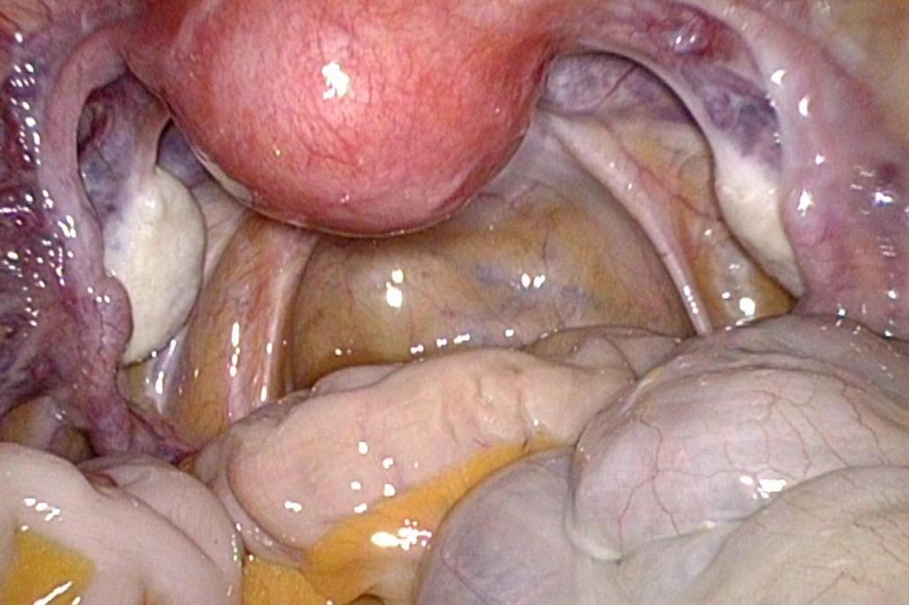
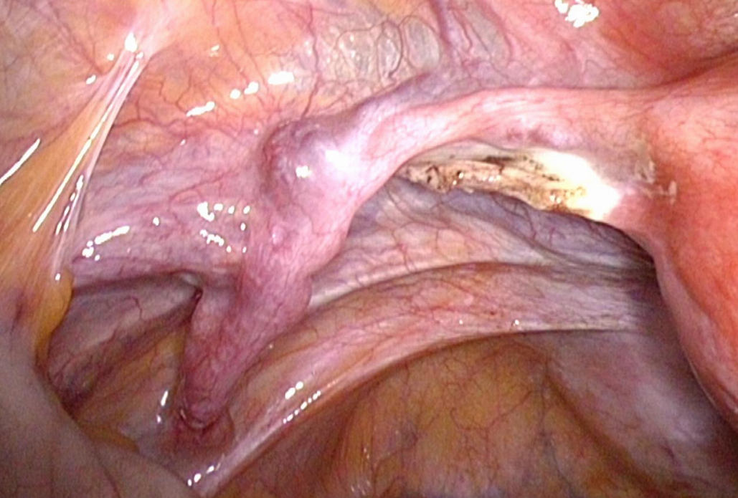
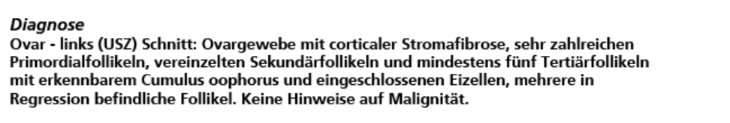

Ovariectomy Left
Pathology
USZ

Slide 5
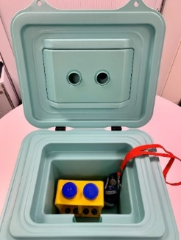
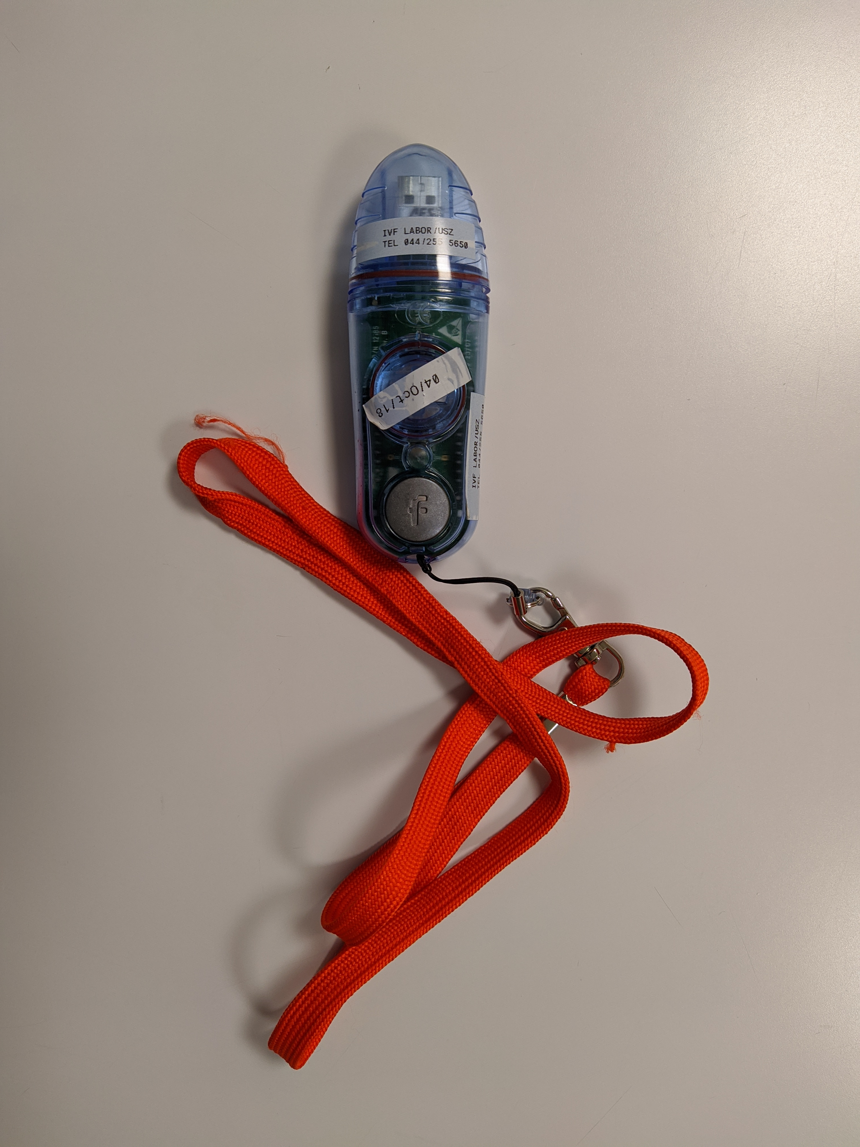
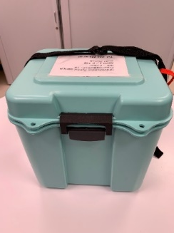
Ovarian Tissue Cryopreservation (1)
Transport
  USZ: room temperature
  From other Center: 4°C with a temperature tracker
Freezing method (Gook et al. 1999)
  Basic Medium: G-MOPS + 10% HSA
  Freezing Medium: 1.5 M PROH + 0.1 M sucrose in Basic Medium
Cleanroom (HEPA filter) concept at USZ. Class 2 laminar flow. Room temperature (RT)
Gook et al (1999): Effect of cooling rate and dehydration regimen on the histological appearance of human ovarian cortex following cryopreservation in 1,2-propanediol. Hum Reprod. 14, 2061-2068

Slide 6
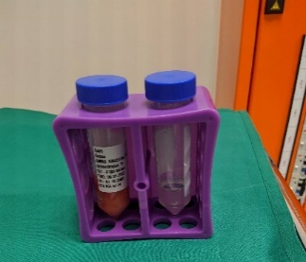
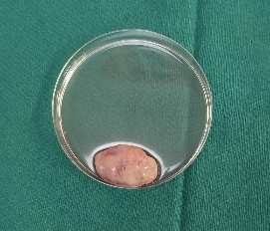
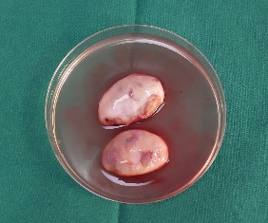
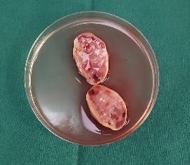
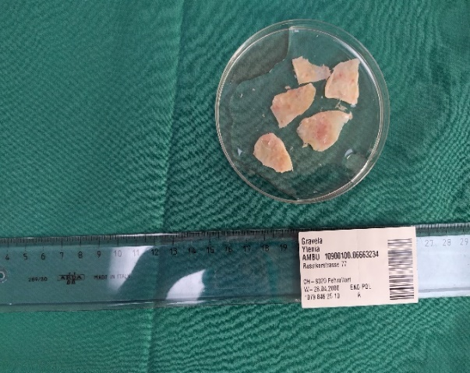
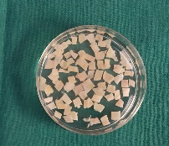
Ovarian Tissue Cryopreservation (2)
Cortex pieces in Freezing Medium for 90 min at RT
4-6 pieces / cryo vial
0.5 x 0.5-0.8 cm

Slide 7
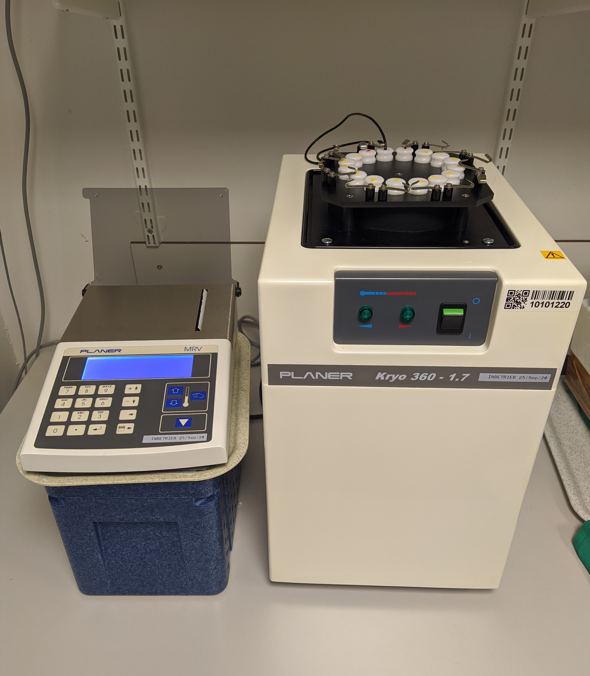
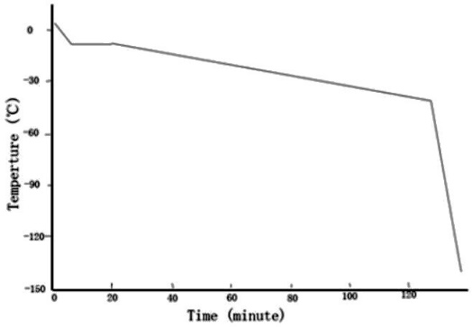
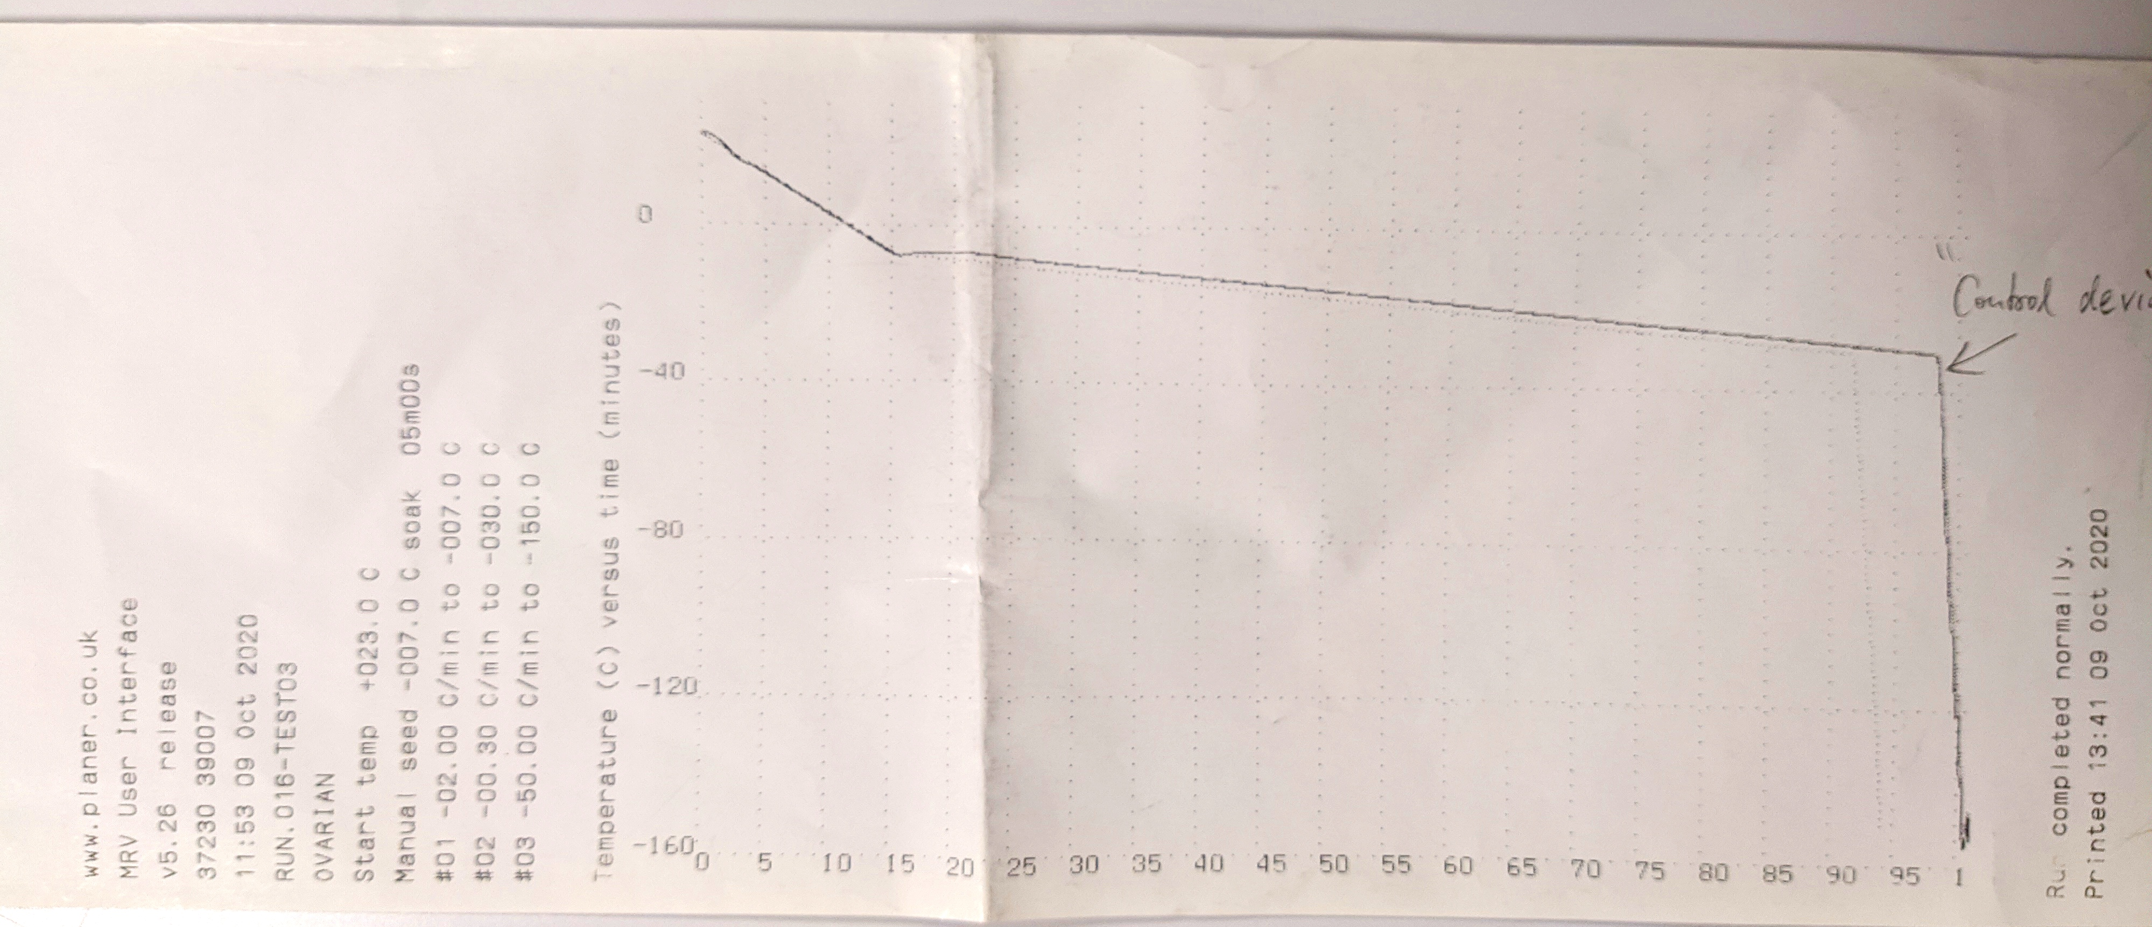
Ovarian Tissue Cryopreservation (3)
Slow freezing program
  23°C to -7°C: -2°C/min
  -7°C for 5 min and seeding
  -7°C to -30°C: -0.3°C/min
  -30°C to -150°C: -50°C/min
  -150°C to liquid nitrogen (-196°C)

Slide 8
Interim Medical History
Chemotherapy
  6 cycles BEACOPP esk. 12/2011-05/2012
  4/2013 premenopausal, regular cycles:
    FSH 21.0 IE/l (not early cyclical Estradiol: 684 pmol/l)
    Progesterone 2.7 nmol/l
11/2015 spontaneous pregnancy and birth
of a healthy son

Slide 9
Medical History - 2018
Referral 7/2018 because of infertility with postmenopausal hormone status and wish of transplantation of the cryopreserved ovarian tissue
  FSH 93.9 U/l
  LH 59.4 U/l
  Estradiol 56 pmol/l
Discussion with oncologists, concerning safety of the transplantation
positive judgement

Slide 10
Ovarian Tissue Thawing
Two vials
RT, 1.5-2 min
37° C, 2 min
RT – Stepwise cryoprotectants removal
  1.0 M PROH + 0.2 M sucrose in Basic Medium, 5 min
  0.5 M PROH + 0.2 M sucrose in Basic Medium, 5 min
  0.2 M sucrose in Basic Medium, 5 min
  Basic Medium, 5 min
37° C until transplantation

Slide 11
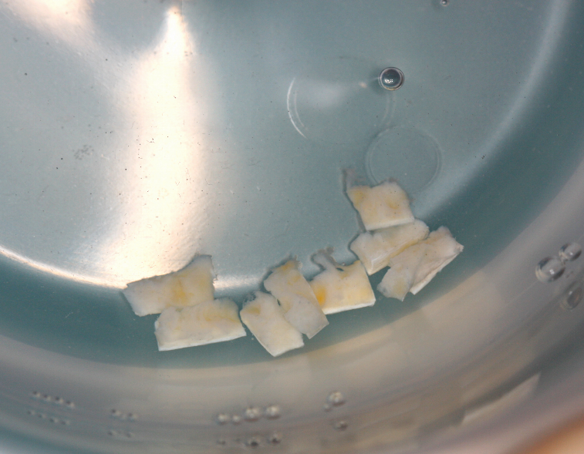
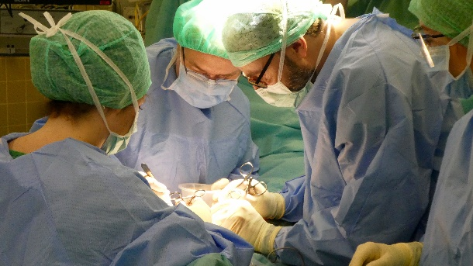
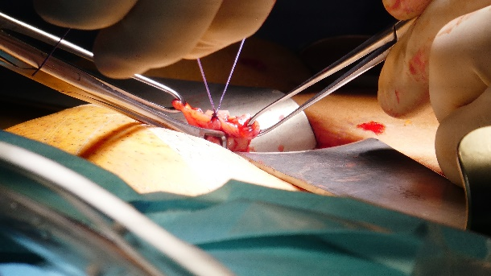
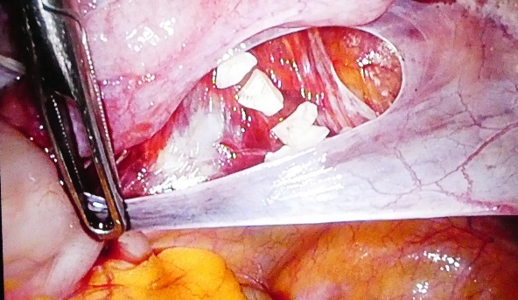
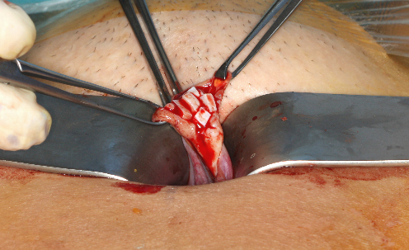
Ovarian Tissue Transplantation:
Surgery
Stiller, USZ

Slide 12
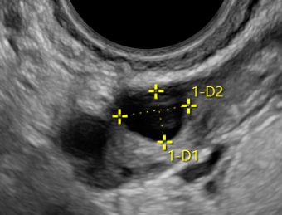
Follow-up after Transplantation
First menstruation after transplantation 20.12.2018
Hormone levels
  1 month after transplantation
    FSH 83.9 IE/l, LH 68.3 IE/l, Estradiol 136 pmol/l,
    AMH < 0,1 pmol/l
  4 months after transplantation
    FSH 11.9 IE/l, LH 6.0 IE/l, Estradiol 67 pmol/l,
    AMH 1.5 pmol/l
  11 months after transplantation
    AMH 2.5 pmol/l
USZ

Slide 13
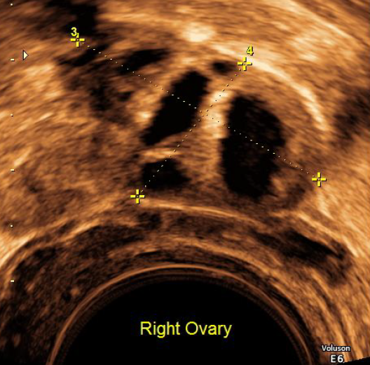
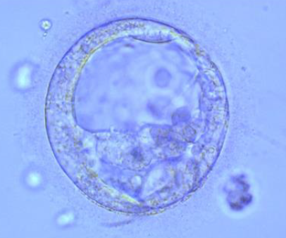
ICSI – Fresh Cycle
5/2019
  Ovarian stimulation,
  antagonist protocol
    7 days stimulation, HMG 2100 IE
  Egg retrieval of 4 oocytes, 2 MII, 2 2PN,
  2 blastocysts (BC): 1 BC cryopreserved,
  1 BC (3BC) transferred
  No pregnancy
Dr. Singer

Slide 14
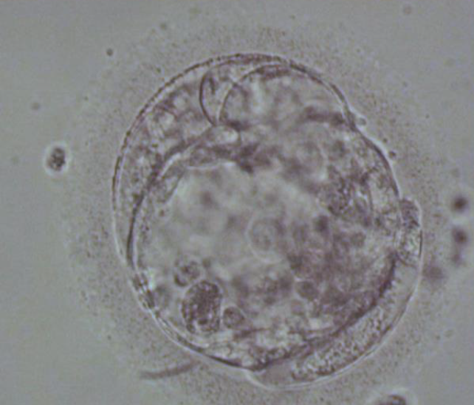

Thawing Cycle
10/2019
  Thawing of the cryopreserved blastocyst,
  and ET of that 3BC blastocyst
Result: pregnancy
Dr. Singer

Slide 15
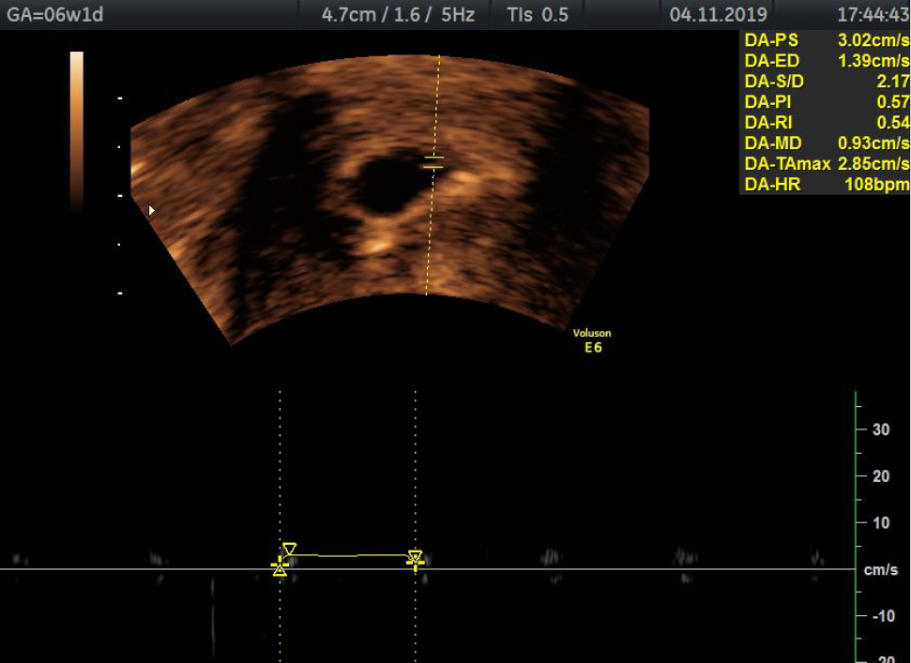
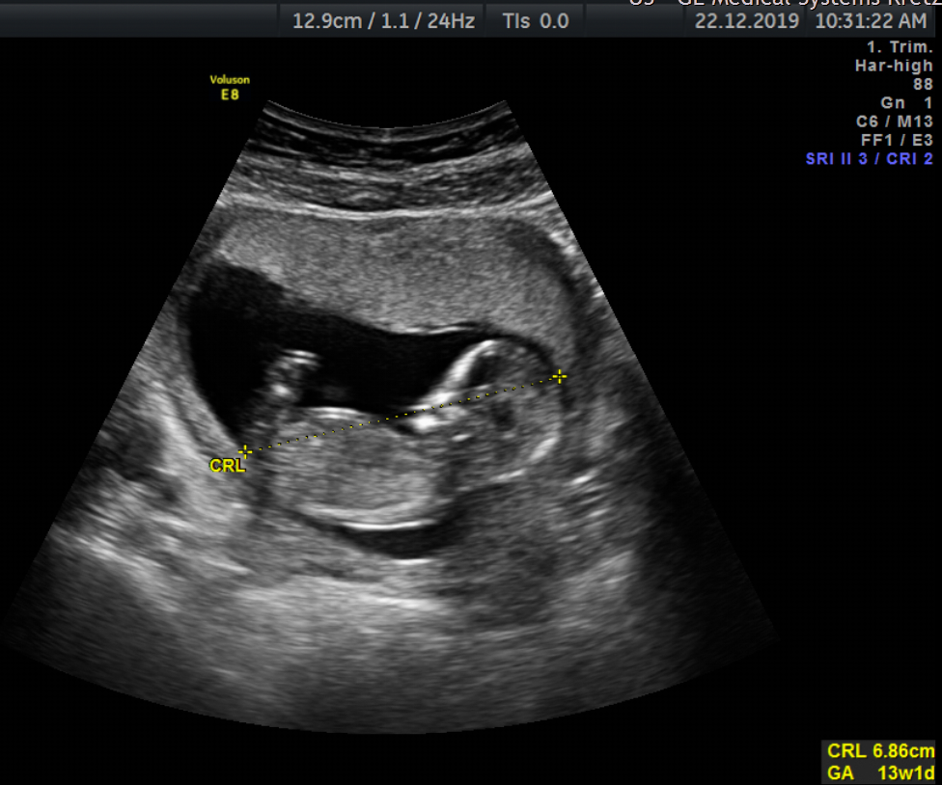
Pregnancy
Follow-up of pregnancy
  Gestational diabetes (ED 27 SSW)
    Fetal macrosomia even with Insulin
  Acute Herpes genitalis 35+5 SSW, PUPPP
  Caesarean section 36+1 SSW of a healthy girl, 2925 g
Dr. Singer; USZ

Slide 16
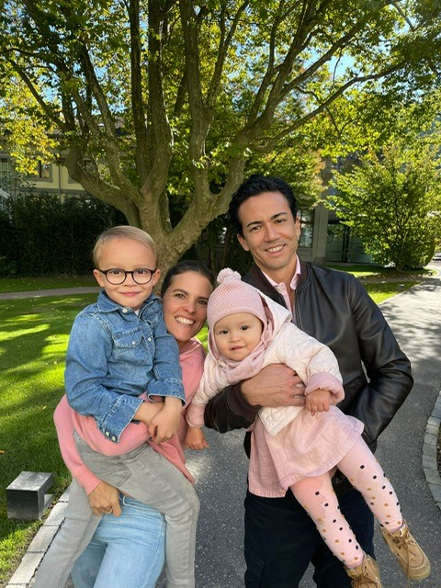
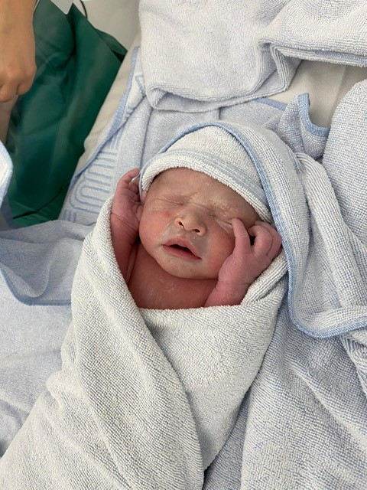
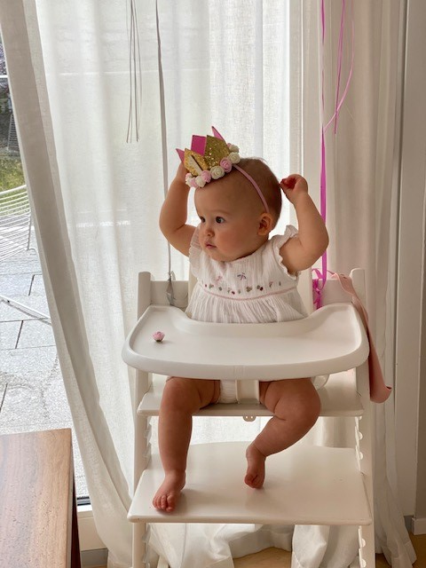
© 2021
© 2021
© 2021
With patient’s permission

